Slide 1
H-1B Ready to Work Jumpstart to Technical Assistance Webinar
Webinar Date: May 5, 2015; 3:00 p.m.
Presented by: Division of Strategic Investments
U.S. Department of Labor
Employment and Training Administration

Slide 2
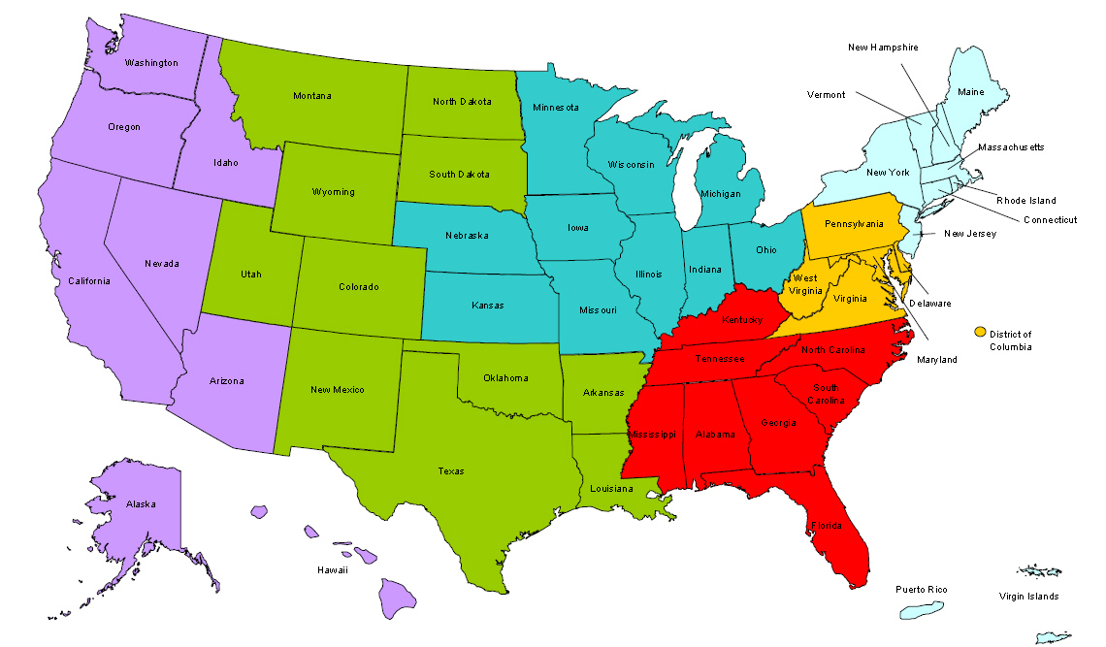
Where are you?
Enter your location in the Chat window – lower left of screen
Notes:
In the Chat Room, please type the name of the your organization, your location, and how many people are attending with you today.

Slide 3
Welcome & Introductions
Moderator:
Megan Baird, RTW Policy Lead, DOL Division of Strategic Investments
Today’s Speakers:
Susan Shorters, President, High Impact Partners
Ayreen Calimquim, Project Lead, RTW TA
Annette Gantt, Technical Assistance Coach, RTW TA
H-1B RTW Technical Assistance Team
High Impact Partners

Slide 4
Polling Questions
Polling Question #1
How many of you are returning H-1B Grantees?!
We have our very first H-1B grant, Ready to Work
Technical Skills Training (TST) Round 1
Technical Skills Training (TST) Round 2
Jobs Accelerator (JA) Round 1
Advanced Manufacturing Jobs Accelerator (JA) Round 2
Make it in America
I don’t know

Slide 5
Polling Questions
Polling Question #2
Let’s get to know who is on the call today. Using the poll, select the role that you play in your H-1B grant program.
For this grant initiative I am the:
Authorized Representative
Program Director/Manager
IT/Data Manager or staff
Training Partner
Employer Partner
None of the above

Slide 6
Ready, Set, Go! Today’s Agenda
Quickstart! Performance Update
Jumpstart! RTW Technical Assistance Plan
Jumpstart! RTW Grant Program Ramp-Up
Heads Up! What’s next in Technical Assistance

Slide 7
Jumpstart! to Performance Reporting
Ready to Work Partnership Grants

Slide 8
A Quick Note RTW Performance Reporting
NOT FOR TODAY’S DISCUSSION
You should have already received the following OMB-approved Reporting Documents:
Performance Reporting Handbook
Data Elements and Edit Checks
H-1B RTW Quarterly Performance Report Form
Ready to Work Community of Practice: Performance Reporting https://etagrantees.workforce3one.org/page/resources/1001512060148229202

Slide 9
RTW Performance Reporting TA
COMING SOON!
RTW Performance Reporting HUB 2.0 Webinar
Live Tutorials: “How-To” Series
Participant Tracking Using RTW Data Elements
Creating Data Files
Uploading Data Files
Resolving Data File Errors in HUB
Small group and One-on-One Coaching
HUB Office Hours for RTW Grantees

Slide 10
Please enter questions in the Chat Room!

Slide 11
Jumpstart! RTW Technical assistance Plan
Ready to Work Partnership Grants

Slide 12
Grant Cycle Phase for Technical Assistance
Grant Cycle Phase 1
Grant Cycle Phase 2
Grant Cycle Phase 3
Start-up and Implementation
Conceptualization
Operational
Participant Outreach and Recruitment
Stability and Sustainability
Strategic Planning with Stakeholders
Partnership Development
Growth/Expansion strategies
Replication of Project
Training Design and Delivery
Job Development and Job Placement Strategies
Organizational Development
PHASE 1: INTENSIVE TA
Program Implementation
Organizational Process and Systems
Identifying and Engaging Partners
PHASE 2: INTENSIVE-TO-MODERATE TA
Program Delivery
Managing Partnerships & Collaborations
Peer-to-Peer Learning Exchanges
PHASE 3: MODERATE-TO-LOW TA
Collect and Promote Best Practices
Strategic Planning and Sustainability Planning
Apply Lessons Learned

Slide 13
RTW TA Overview 2014 - 2018
2015 - 2016
Q1 (Oct 1 - Dec 31)
Performance and Outcomes Accountability
Program Management
Training Design
Q2 (Jan 1 - Mar 31)
Training Design
Career Pathways
Participant Services
Older Workers, Women and Veterans
2017 - 2018
Q1 (Oct 1 - Dec 31)
Performance and Outcomes Accountability
Q2 (Jan 1 - Mar 31)
Employment Placement Services
Q3 (April 1 - June 30)
Employer Partnerships, Sustainability Planning
Participant Services
Q1 (Oct 1 - Dec 31)
Performance and Outcomes Accountability
Program Management
2016 - 2017
2014 - 2015
Q1 (Oct 1 - Dec 31)
Grants Management
Grantee Orientation, Financial Management
Q2 (Jan 1 - Mar 31)
Performance Reporting Rollout
Q4 (July 1 - Sept 30)
Training Design
Certificate and Credential Attainment
Q2 (Jan 1 - Mar 31)
Employment Placement Services
Participant Services
Q3 (April 1 - June 30)
Program Management
Employer Partnerships, Sustainability Planning
Q4 (July 1 - Sept 30)
Training Design
Certificate/Credentialing Outcomes
Q3 (April 1 - June 30)
Program Management
Sustainability Planning
Q4 (July 1 - Sept 30)
Closeout Management
Program Operations
Product Delivery
Q3 (April 1 - June 30)
Program Management and Start-Up Activities
Participant Services
Case Management, Intake Assessment Enrollment
Q4 (July 1 - Sept 30)
Employment Placement Services
Job Clubs, Job Coaching, Rapid Re-employment Strategies

Slide 14
RTW Technical Assistance Plan
Methods for Delivering Technical Assistance
Group Coaching
Topic Specific Webinars
Small Group Learning Events
Peer-to-Peer Mentoring & Learning Exchange

Slide 15
RTW Technical Assistance Plan
Methods for Delivering Technical Assistance
Group Coaching: Strategies to Support Long-term Unemployed Participants
Subject Matter Expert LTU Webinar Series
“Ask the Expert” Grantee Roundtable Discussions

Slide 16
RTW Technical Assistance Plan
Methods for Delivering Technical Assistance
Individualized Coaching: Monthly One-on-One Coaching with a TA Coach
Key Roles
Coaching Approach to TA
Resource
Liaison
Mentor
Trainer
Troubleshooter
Relationship Building
Phase-based/Targeted TA
Direct-Facilitation
Collaborative/Tag-Team
Customized Trainings
Peer-to-Peer TA

Slide 17
RTW Technical Assistance Plan
Other TA Activities and Resources
Peer-to-Peer Sharing Opportunities
LinkedIn
DOL Communities of Practice
Quarterly e-Newsletters
Resource Briefs and Fact Sheets

Slide 18
Please enter questions in the Chat Room!

Slide 19
Jumpstart! RTW Program Ramp-up
Ready to Work Partnership Grants

Slide 20
Ready to Work Partnership Grants
Intensive Participant Services
Case Management Services
Assessment Services
Short-Term Training
Paid Work Experience
Internships
Skills Training Along a Career Pathway
OJT
Apprenticeships
Supportive Services
Specialized Participant Services
Other types of training
Incumbent Worker Upskilling

Slide 21
Program Management:
Grant Ramp-Up
Program Implementation
Leadership & Budget Setup Processes
Partnership Engagement
Read the RTW SGA – it’s your DOL bible!
Understand Your Statement of Work (SOW) and train others on requirements
Monitor timeline to ensure hiring decisions are made in time for program implementation
Set up team meetings, email updates and other regular systems to monitor and report progress
Establish data collection and reporting systems; Collect valid and reliable data
Monitor grant performance and take corrective actions
Secure sub-agreements ASAP with top-down buy-in; monitor activities and progress
Implement employer recruitment strategy; define roles of employers (e.g., OJT, mentoring, mock-interviews, job placement etc.)
Assign a dedicated POC for developing and sustaining employer partners and WIB presence/involvement
Make sure everyone understands the goals and activities of your partners
Ensure leadership buy-in and visible support through regular communication
Connect local budget process to grant award
Establish budget management roles and processes, expenditure procedures, quarterly and fiscal reporting timelines
Communicate progress, challenges and celebrate success! Tell Your Story!

Slide 22
Polling Questions
Polling Question #3
Think about your current practices and assess your capacity in your grant’s Program Management:
1 = We’re just getting started!
2 = We’re in the process of establishing our process and systems.
3 = We’re close to having all talent, processes and systems in place.
4 = We have talent, processes and systems in place

Slide 23
Stakeholder Engagement:
Service & Training Providers
Engagement with service and training providers help to ensure that the long-term unemployed receive the support needed for rapid re-employment
Community Resource Matrix
Identify service providers
Identify training partners
How to Engage Stakeholders
What’s Needed?
What’s it worth?
Formalize partnership
Collaborate
What’s Available?
What can be exchanged?

Slide 24
Stakeholder Engagement: Employers
Early Employer Engagement Helps to Ensure JOBS for your RTW Participants
Approach Employers Early
Job Projections
Industry Growth and Skill Needs
Create a Talent Referral Program
Internships
Paid Work-Experience
Training Curriculum
Accessible, Seamless Training
On-the-Job Training
Clinical Education

Slide 25
Tips for Stakeholder Engagement
LTU Ecosystems – ensure internal stakeholders and POCs responsible for stakeholder engagement understand the needs of local the employment ecosystem
Engage early in the grant – explore areas of collaboration NOW; identify external champions
Focus on developing a true partnership – help stakeholders and employer partners determine their roles and responsibilities
Explore how the RTW grant can support outcomes, such as getting the long-term unemployed jobs, establishing
Leverage your respective core competencies – based on best practice and research, educate employers about benefit and how to hire LTU

Slide 26
Polling Questions
Polling Question #4
Think about your current practices and assess your capacity in Stakeholder and Employer Engagement on a scale of 1-4:
1 = Just getting started
2 = In the process of establishing engagement
3 = Employer and stakeholder engagement in place
4 = Employer and stakeholder goals and commitments in place

Slide 27
Leadership and Decision-Making
Strategic Planning to Support Long-term Unemployed Workers
Are Led by These Teams:
Leadership Team
Management Team
Implementation Team
Strategic Planning
Program Development & Quality
Stakeholder and Partner Engagement
Partner Recruitment & Training
Employer Recruitment Strategy
Partnership Agreements
Fiscal Management & Compliance
Data Analysis Performance Reporting
Talent Development & Management
Valid & Reliable Data Collection & Reporting
Program & Service Delivery

Slide 28
Polling Questions
Polling Question #5
Think about your current practices and assess your capacity in Leadership & Decision-Making Strategy on a scale of 1-6:
1 = Just getting started
2 = In the process of finalizing LTU strategy
3 = LTU strategy is in place
4 = Most LTU internal stakeholders are aware and trained
5 = Most LTU external stakeholders are engaged
6 = A combination of 3, 4 and 5 are in place

Slide 29
Jumping Hoops: Grant Ramp Up Hurdles
Hurdles (Challenges) |  | Hoops (Solutions)
Lack of Leadership Buy-In |  | Inspire Leadership Buy-In
Weak Stakeholder and Partnership Management |  | Monthly or Quarterly Stakeholder Engagement
Slow Start-Up and Blurred Process and Procedures |  | Establish process and procedures
Unreliable Job Placement Opportunities |  | Secure Job Placement using MOUs and OJT Contracts
Loss of Key Staff and Institutional Knowledge |  | Document Institutional Knowledge

Slide 30
Please enter questions in the Chat Room!

Slide 31
Heads Up! What’s next in Technical Assistance
Ready to Work Partnership Grants

Slide 32
RTW Technical Assistance Plan
COMING SOON!
Today’s Webinar Recording, PPT, and Resource Brief Available next Week
Menu of Technical Assistance Activities (Resource Guide)
Monthly TA Coaching Calls Start May 18th
LTU Subject Matter Expert Series Start at the End of June

Slide 33
RTW Technical Assistance Plan
TA Coach: Annette Gantt
Grant Number | Grantee | Region | FPO Name
HG-26656 | Capital Workforce Partners | 1 | Suzanne Pouliot
HG-26657 | City of Providence | 1 | Michael Hotard
HG-26658 | County of Westchester | 1 | Michael Hotard
HG-26668 | New Jersey Council of County Colleges | 1 | Keeva Davis
HG-26671 | RochesterWorks, Inc. | 1 | Keeva Davis
HG-26674 | Workforce Alliance, Inc. | 1 | Suzanne Pouliot

Slide 34
RTW Technical Assistance Plan
TA Coach: Jen Swidler
Grant Number | Grantee | Region | FPO Name
HG-26670 | Puerto Rico Technoeconomic Corridor | 1 | Trevor Capon
HG-26655 | Anne Arundel Workforce Development Corporation | 2 | Christopher Ransome
HG-26660 | District 1199C Training & Upgrading Fund | 2 | Keith Hubert
HG-26654 | Alachua Bradford Re. Workforce Board dba CareerSource NCFL | 3 | Raymond Smith
HG-26661 | Florida State College at Jacksonville | 3 | James May

Slide 35
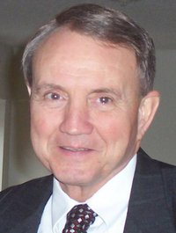
RTW Technical Assistance Plan
TA Coach: Lyle Neumann
Grant Number | Grantee | Region | FPO Name
HG-26665 | Memphis Bioworks Foundation | 3 | Adrian Barrett
HG-26669 | Project QUEST, Inc. | 4 | Terry Moore
HG-26672 | San Jacinto Community College District | 4 | Clyde Lee
HG-26662 | Indianapolis Private Industry Council, Inc. d/b/a EmployIndy | 5 | Carla Wills
HG-26673 | Tecumseh Area Partnership, Inc. d/b/a Region 4 Workforce Boa | 5 | Darren Kroenke
HG-26676 | WSOS Community Action Commission | 5 | Timmy Jordan

Slide 36
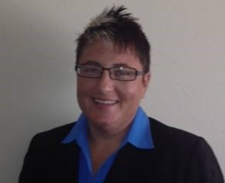
RTW Technical Assistance Plan
TA Coach: Tressa Dorsey
Grant Number | Grantee | Region | FPO Name
HG-26659 | Denver, City and County of | 4 | Amanda Denogean
HG-26663 | It`s My Community Initiative, Inc. | 4 | Amanda Denogean
HG-26667 | Nebraska Department of Labor | 5 | Ray Garcia
HG-26664 | Jewish Vocational Service | 6 | Elina Mnatsakanova
HG-26666 | NOVA Workforce Development City of Sunnyvale | 6 | Denise Dombek
HG-26675 | Worksystems, Inc. | 6 | Marian Esver

Slide 37
Please enter questions in the Chat Room!

Slide 38
Ready to Work Community of Practice
http://etagrantees.workforce3one.org

Slide 39
DOL Contacts
Your Federal Project Officers!
DOL National Office and Technical Assistance Providers
Ready to Work Grantee Mailbox
RTW@dol.gov

