Slide 1
WIOA Quick Start Action Planners:
A New Tool for the Implementation of WIOA

Slide 2
Today’s Presenters
Byron Zuidema
Deputy Assistant Secretary
U.S. Department of Labor, Employment and Training Administration
Gay M. Gilbert
Administrator, Office of Unemployment Insurance
U.S. Department of Labor, Employment and Training Administration
Richard D. Maher
President & CEO
Maher & Maher
Joseph Barela | Moderator
Senior Advisor
U.S. Department of Labor, Employment and Training Administration
Have a question or comment about WIOA? E-mail DOL.WIOA@dol.gov

Slide 3
Presenter
Joseph Barela
Senior Advisor
Employment and Training Administration
U.S. Department of Labor
Have a question or comment about WIOA? E-mail DOL.WIOA@dol.gov
3

Slide 4
Webinar Objectives
Learn what the WIOA Quick Start Action planner is, who should use this tool, and how to get the best results
Get helpful tips for facilitating discussions with your board and partners on moving forward with WIOA implementation
Learn how to create a WIOA Action Plan to address challenge areas

Slide 5
Poll:
Indicate with which of the following you are affiliated (Check as many as apply):
State Workforce Agency or State Workforce Board
Local Workforce Agency or Local Workforce Board
American Job Center
Educational Institution
Business/Economic Development
Other (please enter in the chat)

Slide 6
Presenter
Byron Zuidema
Deputy Assistant Secretary
Employment and Training Administration
U.S. Department of Labor
Have a question or comment about WIOA? E-mail DOL.WIOA@dol.gov
6

Slide 7
Workforce Innovation and Opportunity Act (WIOA)
WIOA is a revitalizing transformation of our public workforce system
Workforce system leaders and partners should be implementing strategies now to realize the full vision of WIOA
Technical assistance and training are needed at all levels of the workforce system to reach this large-scale change

Slide 8
Presenter
Gay Gilbert
Administrator, Office of Unemployment Insurance
Employment and Training Administration
U.S. Department of Labor
Have a question or comment about WIOA? E-mail DOL.WIOA@dol.gov
8

Slide 9
WIOA Quick Start Action Planners (QSAPs)
What are the WIOA QSAPs?
Flexible tools designed to support state and local leadership as they convene their partners to engage in strategic planning to support implementation of WIOA, both now and into the future
QSAPs provide a framework for assessing and prioritizing the areas that require new partnerships, new strategies, and innovation to support the transformational WIOA vision into reality
Tools designed to help state and local boards carry out the new and very complex roles they are required to play under WIOA

Slide 10
WIOA Quick Start Action Planners (QSAPs)
How Can the WIOA QSAPs Help You?
Provides a mechanism to translate strategic planning into strategic action
Identifies areas of strength and specific areas that require new or improved approaches to be successful
Facilitates partner engagement in a neutral way
Connects you to targeted resources in each area of focus that help stimulate strategic thinking and provide models for implementation

Slide 11
WIOA Quick Start Action Planners (QSAPs)
QSAP Topics – Available Now
Partnerships
State Leadership and Governance
QSAP Topics – Coming in April 2015!
One-Stop Center Service Design
Youth Service Strategies
Local Leadership and Governance

Slide 12
How to Use WIOA QSAPs
Each QSAP is separated into topic areas containing indicators directed toward State and Local Leaders, State Leaders Only, or Local Leaders Only. Respond only to the indicators applicable to you.
Example Indicator from Partnership QSAP for State and Local Leaders:
Our public workforce system has a coordinated strategy in place to involve partners and stakeholders in ongoing dialogues regarding transitioning to and implementing WIOA.
Read each statement carefully and mark where you feel your system stands on the following rating scale:
1 = Not at all
2 = Making progress but a long way to go
3 = Have some of this, sometimes
4 = Yes, in place now
5 = Not only in place but we are excelling

Slide 13
Poll:
Rate to what level you agree with the following statement:
Our public workforce system has a coordinated strategy in place to involve partners and stakeholders in ongoing dialogues regarding transitioning to and implementing WIOA.
1 = Not at all
2 = Making progress but a long way to go
3 = Have some of this, sometimes
4 = Yes, in place now
5 = Not only in place but we are excelling

Slide 14
How to Use WIOA QSAPs
Each QSAP takes about 20 minutes to complete.
Ensure you have enough time to complete each one as the data is not saved. If you close the browser, you will lose the information you entered and will have to start over.
Note: QSAP data is NOT saved or sent to ETA. The reports you generate are for your use only.
Once you have reached the end of the QSAP, click “Submit” to calculate your results.

Slide 15
QSAP Results
Once you have responded to every indicator, the tool will produce a final report showing your results on each topic area.
You have the option to save the report to your computer, email to yourself or someone else, or print it.
Links to helpful ETA resources are provided that align with the topic area.
A template of a WIOA Action Plan is available for you to begin focusing on what actions need to happen now

Slide 16
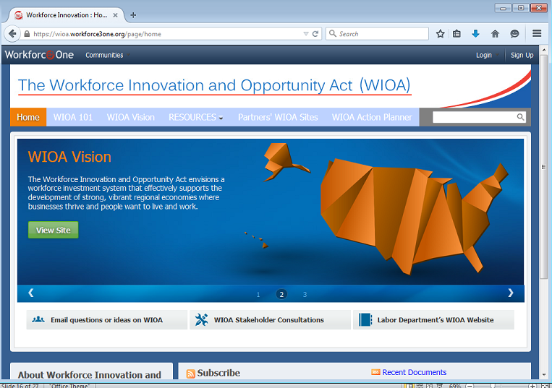
WIOA Quick Start Action Planners (QSAPs)
Explore the
QSAP Tool on
the WIOA
Collections Page

Slide 17
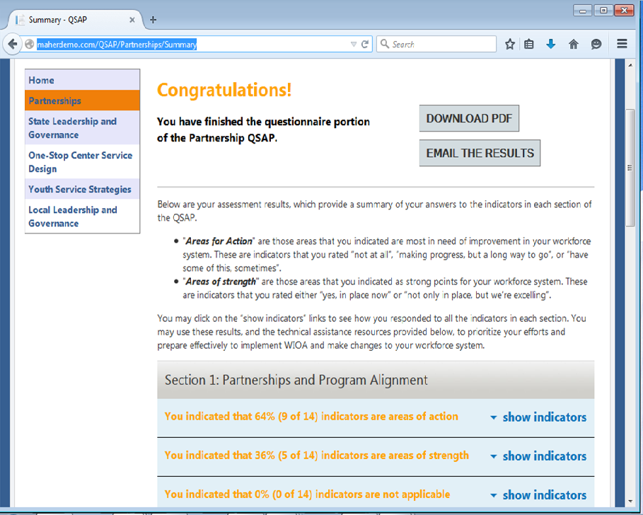
WIOA Quick Start Action Planners (QSAPs)
Results Page

Slide 18
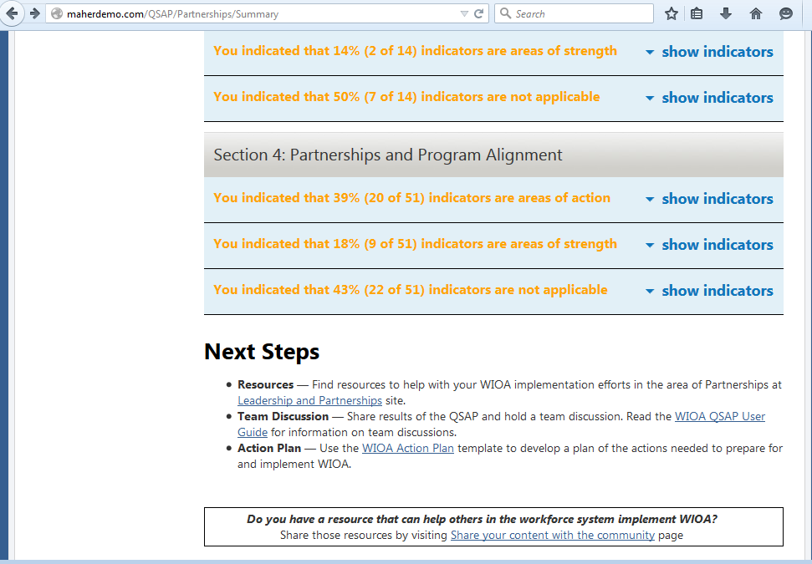
WIOA Quick Start Action Planners (QSAPs)
Results Page

Slide 19
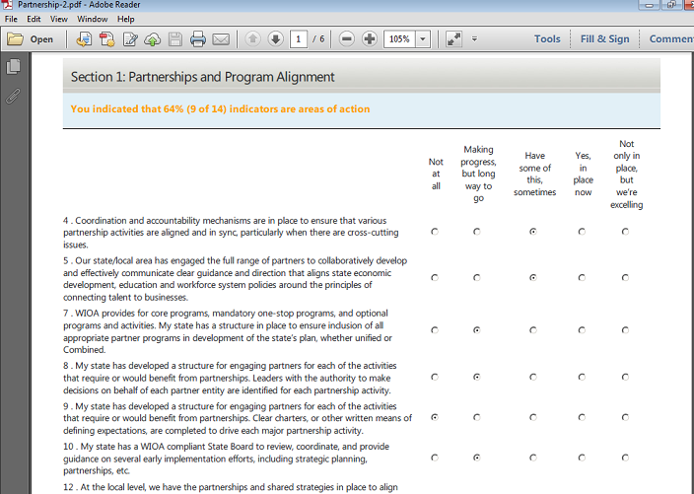
WIOA Quick Start Action Planners (QSAPs)
Final Report

Slide 20
WIOA Quick Start Action Planners (QSAPs)
You Have Your Results - Now What?
Use the QSAP to Initiate Action Among Leaders and Partners
Schedule a meeting with board members, leaders, partners, and local elected officials
Compare results and discuss where differences lie
Address common challenge areas
Develop an Action Plan

Slide 21
WIOA Quick Start Action Planners (QSAPs)
Tips for having a team discussion
Consider the following:
What areas represent our strengths?
What areas represent opportunities for improvement?
Do we have internal disagreements about our self-assessment scoring? What can we learn from the different perspectives?
What are the priorities for change for our workforce system?

Slide 22
WIOA Quick Start Action Planners (QSAPs)
Other Ways to Use QSAPs
Convene a Facilitated Discussion
Complete QSAPs collectively with your team or board, using the PDF versions of the QSAP (provided on the landing page of the tool)
Benchmarking Tool
Complete QSAPs again in 3, 6, or 12 months to see what changes have happened, and what still needs to be done

Slide 23
WIOA Action Plan
Once you have met with your team and discussed QSAP results, it’s time to complete a WIOA Action Plan

Slide 24
WIOA Action Plan
Identify areas of opportunity for improvement and corresponding goals
Think of the necessary STRATEGY to reach make this change happen
What are the steps?
Who is involved?
What resources are needed?
What is timeframe?
Most Importantly- Start Now!

Slide 25
WIOA Quick Start Action Planners (QSAPs)
Thank you for participating in today’s webinar!
The QSAP tool can be found here:
https://wioa.workforce3one.org/page/planner
As well as:
QSAP User Guide
PDF Versions of QSAPs
WIOA Action Plan Template

Slide 26
Poll Questions
Do you plan on holding a partner/stakeholder meeting to complete the QSAPs?
Yes
Possibly
No
Do you think the QSAP will be a helpful tool in your leadership development as you implement WIOA? Please explain.

Slide 27
Please enter your questions in the Chat Room!

Slide 28
Thank You!
Find resources for workforce system success at:
www.workforce3one.org

