Slide 1
YouthBuild Webinar Series Transformation for Court-Involved Youth
March 3, 2015
Presented by:
Division of Youth Services – YouthBuild
U.S. Department of Labor
Employment and Training Administration

Slide 2
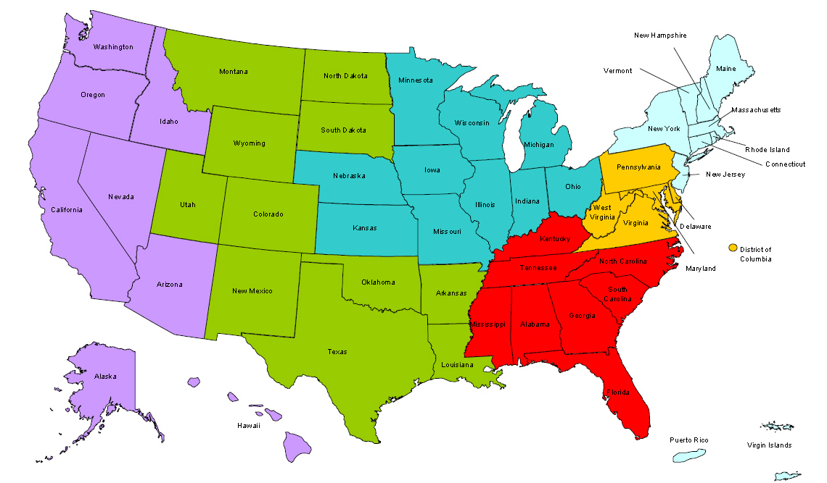
Where are you?
Enter your location in the Chat window – lower left of screen

Slide 3
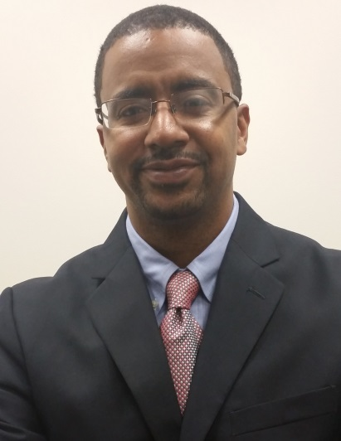
Moderator
Mark W. Smith
Workforce Analyst
United States Department of Labor

Slide 4
Here’s what you can expect in this webinar
Participants will receive recommendations on supporting court-involved youth in attaining post-program success
Participants will be given considerations to support the implementation of student-focused leadership development initiatives
Participants will be able to network and peer share promising strategies.

Slide 5
Webinar Format
Overview of the content
Discussion in breakout rooms
Report back from breakout rooms
Webinar feedback

Slide 6
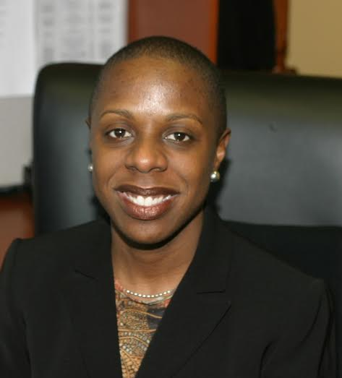
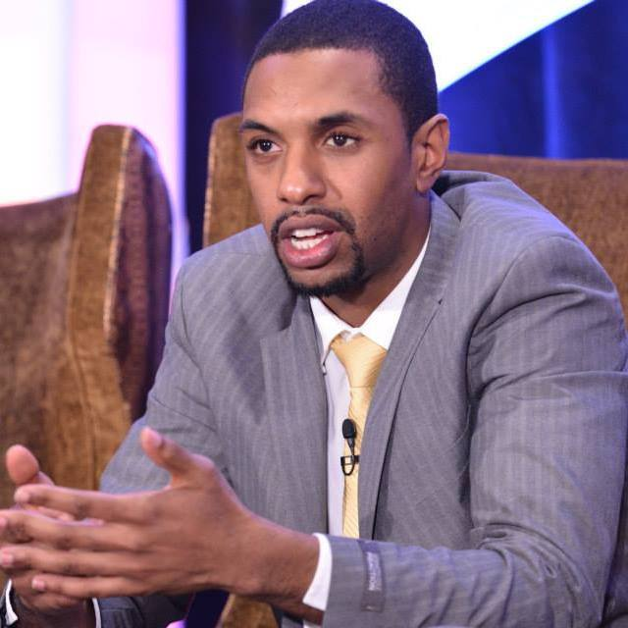
Presenters
Monica Zeno-Martin
Senior Vice President for Program Impact
YouthBuild USA
Lashon Amado
Program Associate, Education and Youth Leadership
YouthBuild USA

Slide 7
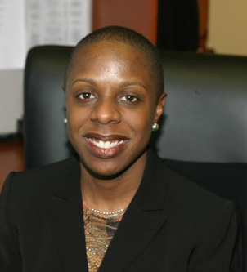
Presenter

Slide 8
Presentation Overview
Grant background
Overview of student-led leadership development initiative
Q & A via chat

Slide 9
US DOL Court-Involved Youth Initiative
High Poverty/High Crime grant
US DOL Reintegration of Ex-Offenders Program

Slide 10
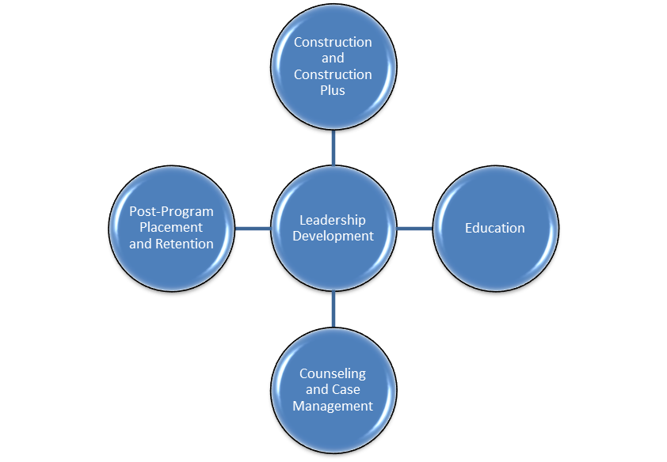
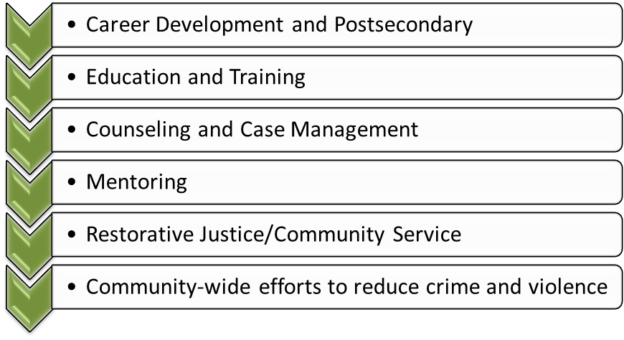
DOL Grant Project Components
+

Slide 11
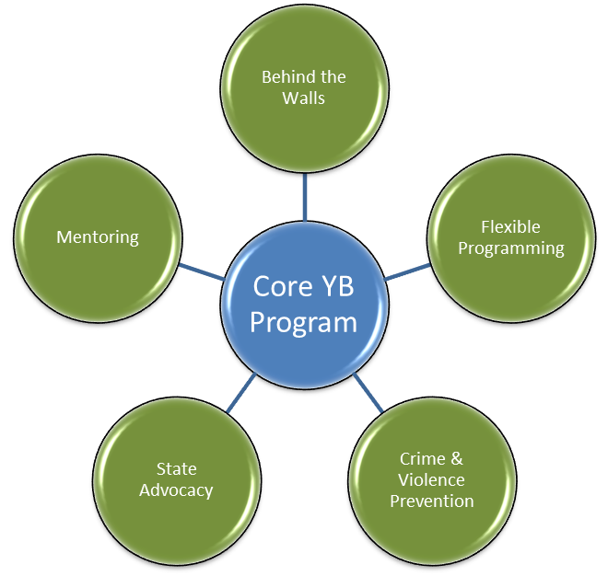
SMART Program Model
=

Slide 12
Grant Performance Measures
Enrollment
In-school retention for youth 17 and under
HSE or HSD achievement for youth 17 and under
HSE or HSD for youth 18 and over
Placement rate for youth 18 and over
Recidivism

Slide 13
SMART Program Model

Slide 14
Question 1
Has your program ever had a targeted focus on working with court-involved youth?
Yes
No

Slide 15
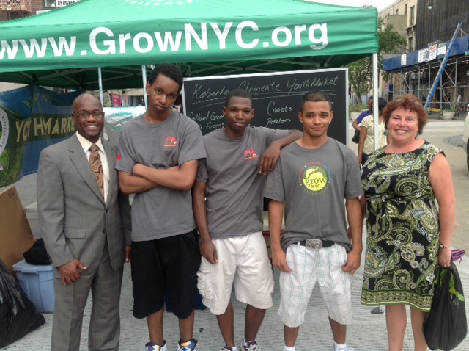
SMART START Advisory Council

Slide 16
Presenter
Lashon Amado
Program Associate, Education and Youth Leadership
YouthBuild USA

Slide 17
SMART START Advisory Council Goals
Policy input to YouthBuild USA on program standards, design, and development to strengthen programs
Emphasis on leadership and professional development
Empower youth to be proactive in their communities and program
Increase awareness of juvenile justice and criminal justice issues on local and national levels

Slide 18
Question 2
Do you have a policy council in place at your program?
Yes
No

Slide 19
SMART START Advisory Council Operations
Bi-weekly/monthly conference calls
Personal challenges (geared towards leadership development)
Check-ins (via phone or email)
Develop recommendations on issues on the community and program design
Attend national conferences and events

Slide 20
SMART START Advisory Council Benefits
Leadership and professional development
Connection to the broader YouthBuild movement including graduate leadership
Increased knowledge of ex-offender rights to necessary support services
Increased awareness of CJ and JJ issues across the nation

Slide 21
SMART START Advisory Council Data
89% completed SMART, received an award/certification, served in leadership roles
84% were placed in postsecondary education or employment
68% were under justice system supervision

Slide 22
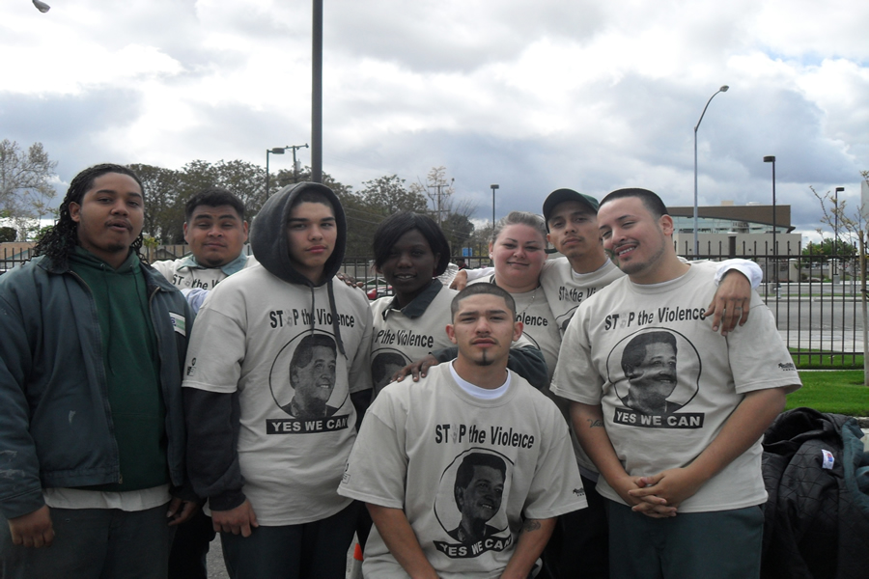
SMART START Advisory Council Success
Letter to President Obama in support of My Brother’s Keeper Initiative

Slide 23
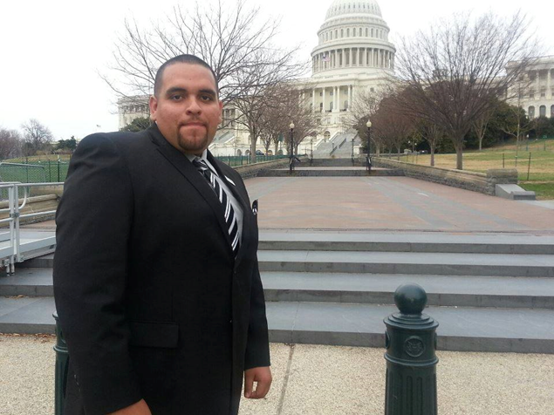
SMART START Advisory Council Success
Council member named 2014 Corps Member of the Year

Slide 24
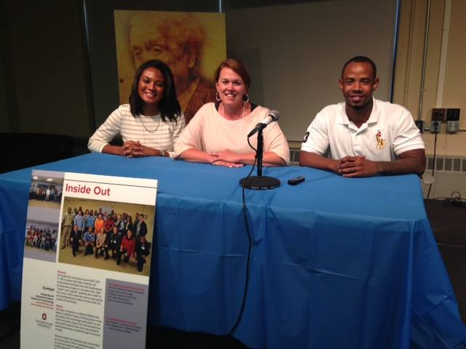
SMART START Advisory Council Success
Council member presented at Ohio State University on the effectiveness of re-entry programs

Slide 25
SMART START Advisory Council

Slide 26
Discussion
Participate in open discussion with facilitators and peers. Phones will be un-muted.
Be courteous. Reduce extraneous noise for the best audio quality by muting your phone, if you are not speaking.
Choose the breakout room based on the number shown on your screen.
It may take a few minutes for the room number to appear on your screen.

Slide 27
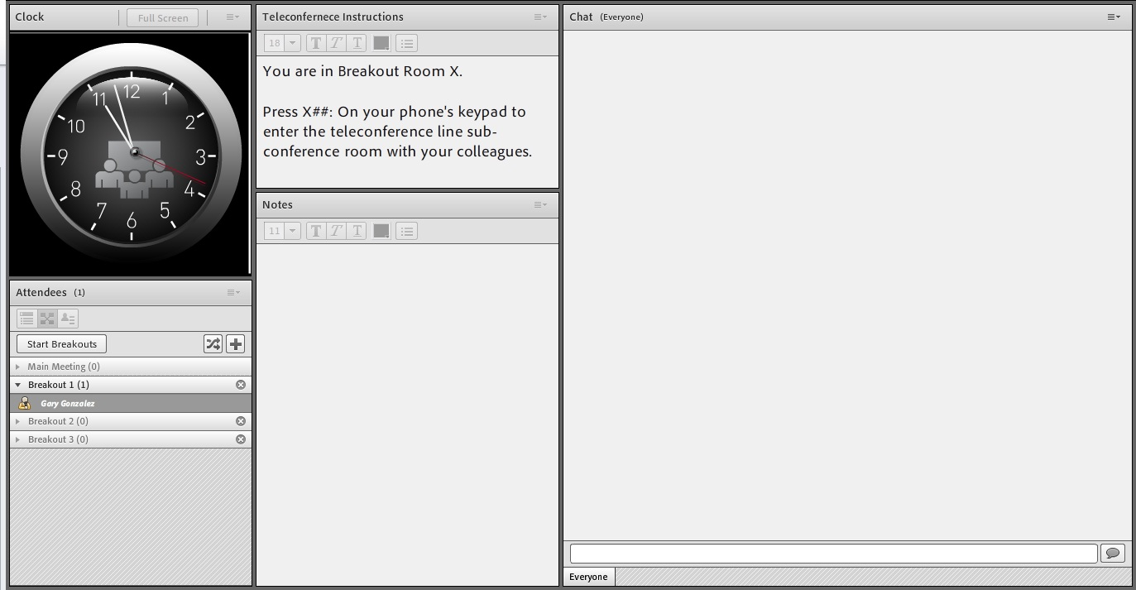

Slide 28
Report Back
What was discussed during the session?
What questions consistently surfaced?

Slide 29
Resources
Division of Youth Services http://www.doleta.gov/youth_services/
This division is primarily responsible for coordinating all youth-related workforce activities, providing leadership, policy direction, program administration, technical assistance and guidance, and support activities for youth programs as authorized
Reintegration of Ex-Offenders Program http://www.doleta.gov/RExO/eta_default.cfm
The Division of Youth Services also houses the Reintegration of Ex-Offenders (RExO) Program. This program consists of a portfolio of grant projects providing pre- and post-release services to both eligible youth and adult offender populations. RExO is home to a number of TA resources designed to strengthen communities through the application of proven mentoring, job training, education, legal aid, and other comprehensive technical assistance resources and services.

Slide 30
Resources
The Office of Juvenile Justice and Delinquency Prevention http://www.ojjdp.gov/
The Office of Juvenile Justice and Delinquency Prevention (OJJDP) is a Department of Justice Program, which provides support to local and state governments in an effort to improve the juvenile justice system. The OJJDP Model Programs Guide is an excellent resource for anyone working in the juvenile justice system.
Leadership Development at a YouthBuild Program http://www.ybhandbooks.org/files/tools/LeadershipDev.pdf
Leadership Development at a YouthBuild Program program manual offers advice on how to plan, organize, and implement the leadership development component of a YouthBuild program.
Pathways to Long-Term Success for YouthBuild Students http://www.ybhandbooks.org/files/tools/Pathways-To-Long-Term-Success-1211_0.pdf
Pathways to Long-Term Success for YouthBuild Students program manual will help your program develop a comprehensive plan for the post-program success of your students.

Slide 31
Contact Information
Monica Zeno-Martin
Senior Vice President for Program Impact
YouthBuild USA
mzenomartin@youthbuild.org
Lashon Amado
Program Associate, Education and Youth Leadership
YouthBuild USA
lamado@youthbuild.org

Slide 32
Save the Date!
“Protecting our Communities through Environmental Service”
April 7, 2015 at 2:00 PM (ET)

Slide 33
Thank You!
Find resources for workforce system success at:
www.workforce3one.org

