Slide 1
September 29, 2015
TAACCCT Industry Webinar Series:
Information Technology

Slide 2
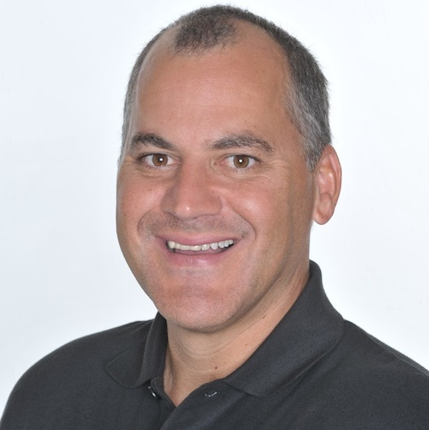
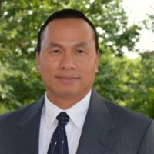
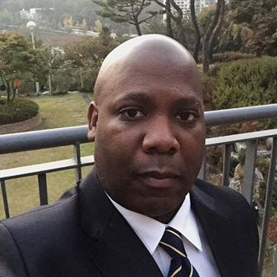
Presenters
Rick Lumadue
Program Manager, Grantee Relations
SkillsCommons.org
John Nguyen
Project Manager, NISGTC Program
Collin County Community College
Edward Sargent
Project Director, PACE-IT
Edmonds Community College

Slide 3

Participant Poll
Which TAACCCT round do you represent?
Round 1
Round 2
Round 3
Round 4

Slide 4
TAACCCT LEARNING NETWORK
AT A GLANCE
U.S. Department of Labor, Employment & Training Administration
(National)
Jobs for the Future
CalState/Merlot
Maher & Maher
American Association of Community Colleges
U.S. National Science Foundation
ATE Centers
Other Non-Federal Providers of TA and Resources for TAACCCT Grantees:
Creative Commons
CAST
The Transformative Change Initiative

Slide 5
Agenda Items
Welcome & Introductions
Highlights from Grantees
Brief Q&A
Review of Curriculum/Materials on SkillsCommons
Discussion

Slide 6
Participant Poll
What is the focus of your grant in the IT industry?
Cyber Security
Programming
Networking
Health
Industrial
Other
What job level are you training for?
Entry level
Middle Skills
Advanced level

Slide 7

PACE-IT at Edmonds Community College
Edward Sargent
Project Director, PACE-IT

Slide 8

What is PACE-IT?
Five competency-based, self-paced, fully online, stackable, IT certificates.
  Web Developer
  Technology and Integration Support
  Intro to Network Security
  Data Management
  Ethical Hacker

Slide 9

What Makes our Program Special?
Self-paced and Online
Continuous support
Industry standards
Our learning resources
Collaboration

Slide 10
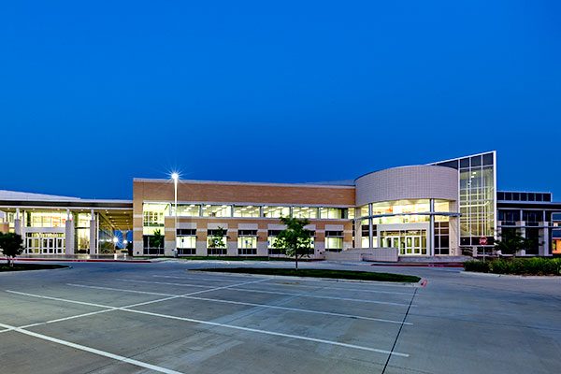

NISGTC Program at Collin College
John Nguyen
Project Manager, NISGTC Program

Slide 11

Collin College’s NISGTC Program: Key Grant Goals
Outreach, recruitment, and support for TAA and other workers
  Career Coaches
  Workshops
Created and engaged four Business & Industry Leadership Teams to co-lead grant.
Implement hands-on & technology-enabled training delivery mechanisms to improve learning
  Virtual Labs
  Online Courses

Slide 12
Noteworthy Curriculum Products
105 Courses created and placed on NTER
  27 Programming
  18 Cybersecurity
  15 Networking
  25 Geospatial
  20 Cross-Specialty
Virtual Lab
  250 new virtual labs aligned with NISGTC courses
  275 Colleges & Universities utilizes VLab
  45,970 DOL grant students accessing VLab

Slide 13

Q&A

Slide 14
Participant Poll
Have you uploaded any products into SkillsCommons yet?
Yes
No

Slide 15
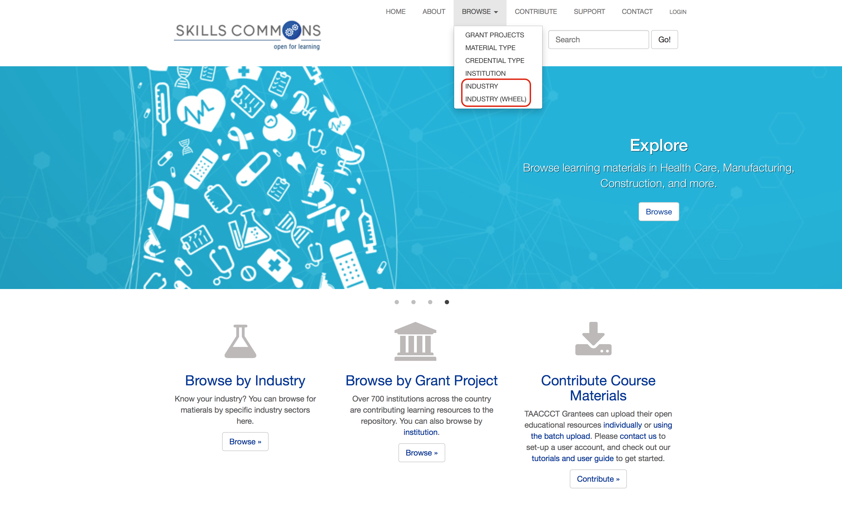
Browse the SkillsCommons Repository by Industry:
An Overview
Rick Lumadue, Program Manager of SkillsCommons.org; support@skillscommons.org

Slide 16
Business & Industry Leadership Teams (BILTs)
Comprised of 175 plus national companies in four information technology (IT) specialty areas
  Programming, Networking, Cybersecurity, Geospatial Technologies
BILTs meet quarterly
  Three Virtual
    Discuss trends and review of grant activities
  One face-to-face
    BILT ranked and prioritized Knowledge, Skills, and Abilities (KSA)
    Faculty cross-referenced existing curricula to KSA
    BILT reviewed / approved certificate and degree programs
    College/state final approval
Other Benefits
  Co-led curriculum development
  Co-led in campus career workshops
  Hired program completers

Slide 17
Q&A

Slide 18
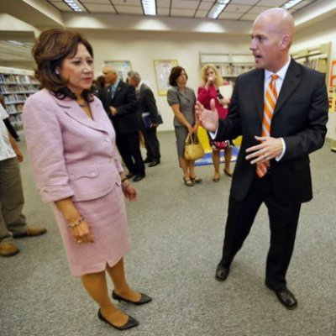
Christian lagarde
clagarde@aacc.nche.edu
TEL 617.728.4446 FAX 617.728.4857 info@jff.org
88 Broad Street, 8th Floor, Boston, MA 02110
122 C Street, NW, Suite 650, Washington, DC 20001
WWW.JFF.ORG

