Slide 1
Finishing Your TAACCCT Grant Successfully Understanding Grant Closeout TAACCCT Round 2
November 5, 2015

Slide 2
Agenda
As we celebrate/wrap up TAACCCT Round 2….
What is our legacy?
Showcasing your innovation!
What do the numbers say?
Upcoming data validity task
Survey – Urban Institute
Final Progress Reports
What do I have to show for it?
Submitting Grant Products and Deliverables
Who gets all my stuff?!?!
Grant Closeout Process

Slide 3
What is Our Legacy?
Cheryl Martin
Division of Strategic Investments
ETA Office of Workforce Investments

Slide 4
SHOWCASE YOUR INNOVATION: Share your story!
We encourage you to send a brief write-up to the TAACCCT mailbox (TAACCCT@dol.gov) responding to the following questions:
In what TAACCCT strategy area(s) have you experienced the greatest success?
Please describe the new policies, practices or programs that have had the greatest impact on student credential and job attainment.
Of your successful programs, strategies, policies, practices and partnerships, what will be sustained and/or institutionalized and scaled to reach more students?
Are there other impacts you’d like to share? Any “ripple effects”/surprising outcomes as a result of your work?
Your impact and legacy to TAACCCT is important and we encourage you to also email TAACCCT@dol.gov with prepared documents, videos or other materials that illustrate your TAACCCT story!

Slide 5
Final Performance and Progress Reports (and other numbers)
Cheryl Martin
Division of Strategic Investments
ETA Office of Workforce Investments

Slide 6
Heads Up
We will be sending some Round 2 Grantees a data validity task after 2015 (Year 3) APRs are closed out.
Urban Institute will be sending out a grantee survey.
PLEASE NOTE: This information supersedes that provided in the closeout Webinar from June 24, 2015.

Slide 7
Final Progress Reports
The last Quarterly Progress and Annual Performance Reports will serve as the grant’s Final Performance and Outcomes Report.
The final QNPR will provide both quarterly and cumulative information on grant activity
The final APR will provide annual information on grant activity from October 1, 2015 to September 30, 2016 (the fourth year only)
The system will automatically aggregate all four years in the “thermometer” reports to provide cumulative data

Slide 8
When to Report
Reporting Requirement:
Not later than 45 days after the end of the reporting period.
For grants ending September 30, 2016:
Final QNPR is due not later than November 14, 2016
Final APR is due not later than November 14, 2016
Avoid reporting system lockout
Corrections, as necessary

Slide 9
What to Report
Quarterly Narrative Progress Report
Information on grant activities during the last quarter and cumulative information on grant activities during the entire period of performance
For example: Section C: Status Update on Employer Involvement
This quarter: One new employer interested in continuing to hire graduates
Cumulative: Seven employers total hired graduates throughout the grant period

Slide 10
What to Report
Annual Performance Report
The final APR will reflect the activities since the third year APR, that is, your fourth year activities in addition to any activities that occur during the closeout period
Grantees may use the fourth year as a follow-up year, or use the first six months to continue grant-funded program activities and the final six months for follow-up
Either way, you will submit only one time, and this final APR should be submitted by November 14, 2016

Slide 11
What to Report
Annual Performance Report: The first six months
Grantees may use the first six months of the final year to continue grant-funded program activities.
If a grantee chooses this option, they may continue to report on all outcomes (B.1 –B.10) for this first six months of this final year
During the final six months of the grant period, only follow-up outcomes (B.7-B.10) should be reported
If grantees do not choose this option, they should be reporting only follow-up outcomes (B.7-B.10)

Slide 12
Supporting Documentation for Final Report
Program Activities Reported for the First Six Months
You must have participant and financial records to support the aggregate data submitted
For example, that individual students were tracked and reported as participants in outcome B.1 prior to the end of the 42nd month.
PLEASE NOTE: No grant funds can be spent on programmatic activities in the final six months of the grant, and only outcomes paid for with grant funds may be reported in your APR.

Slide 13
FAQ
Question: What if we achieved additional outcomes during the closeout period (the 90 days after the grant period)? If a student who completed during the grant period finds employment, can I still get credit for this?
Final Outcomes
Contact your FPO to request that your final APR be unlocked so that you can amend your reports with any additional follow-up outcomes during closeout.

Slide 14
What to Report
Final Outcomes
Outcomes achieved during closeout period, after grant period ends, should be reported in items B.7 – B.10 (follow-up outcome measures)

Slide 15
FAQ
Question: How did we do? Or, what do the numbers tell you about how we did?
Standardized Outcomes
Use the Thermometer Report
https://etagrantees.workforce3one.org/view/2001413239329657021/info

Slide 16
Product Submission Process
Cheryl Martin
Division of Strategic Investments
ETA Office of Workforce Investments

Slide 17
Grant Products and Deliverables
Creative Commons Attribution License
Grantees will license to the public all work created with the support of the grant under a Creative Commons Attribution 3.0 (CC BY) license;
Grantee will release all new source code developed or created with grant funds under an open license acceptable to either the Free Software Foundation and/or the Open Source Initiative; and
Work that must be licensed under the CC BY includes both new content created with the grant funds and modifications made to pre-existing, grantee-owned content using grant funds.

Slide 18
Grant Products and Deliverables
Third Party Review of Deliverables
Grantees will be required to identify third-party subject matter experts to conduct reviews of the deliverables produced through the grant.
Grantees must provide the Department with the results of the review and the qualifications of the reviewer(s) at the time the deliverables are provided to the Department.

Slide 19
Grant Products and Deliverables
TAACCCT Repository of OER
California State University – MERLOT (Multimedia Education Resources for Learning and Online Technology
http://www.skillscommons.org
BEGIN UPLOADING PRODUCTS
AS SOON AS POSSIBLE!

Slide 20
FAQ
Question: Can I use Creative Commons 4.0 Attribution License?
Answer: Yes
Question: Do I have to use Creative Commons 4.0 Attribution License?
Answer: No

Slide 21
FAQ
Please Clarify the Types of Items that are Considered Grant Deliverables
According to the SGA, the Department considers curricula, course materials, teacher guides, and other products developed with grant funds to be considered grant deliverables. These items were identified in each grantee’s statement of work as deliverables and to be submitted to the Department according to the workplan or prior to the end of the period of performance.

Slide 22
FAQ
How Should We Submit the Subject Matter Expert Review of Deliverables?
According to the SGA in Section III.G.5, grantees are required to submit the deliverables for independent review by subject matter experts. These reviews, along with the credential of reviewers and any related materials should be submitted to http://SkillsCommons.org.

Slide 23
FAQ
Are Outreach Materials and other Program Support Materials Considered Grant Deliverables?
Although program management and implementation tools, outreach materials, and other program support materials are tangible items that could be considered “works” produced through your grant project, these items are not necessarily considered deliverables unless explicitly described as such in a grantee’s SOW. Grantees should use their discretion in consultation with their FPO about which of these to submit to the Department.
See also the Closeout FAQ.

Slide 24
FAQ
Question: Are activities and costs related to reviewing and posting deliverables allowable during the final year (or six months)?
Costs related to reviewing (including third-party review), finalizing, and posting grant deliverables (i.e. curriculum, course materials, etc.) to Skillscommons.org are not considered program development or delivery, and accordingly, grantees may continue to incur costs for these activities throughout the entire grant period.

Slide 25
Grant Closeout Process
Kevin Brumback & Avery Malone
Division of Policy Review and Resolution
ETA Office of Grants Management

Slide 26
What is Grant Closeout?
The completion of the grant life cycle
The official end of the government’s relationship with the grantee
29 CFR Part 95, Subpart D – After-the-Award Requirements
Part 95.70- .73
29 CFR Part 97, Subpart D – After-the-Grant Requirements
Part 97.50 – .52
Why do we close a grant in the first place?

Slide 27
Who We Are
Division of Policy, Review and Resolution (Stephen Daniels)
Grant Officer/Team Leader and 7 Resolution Specialists
Closeout approximately 700 – 1,000 grants a year
330 in June alone

Slide 28
Closeout Timeline
We track anticipated workload one year out
60 days prior to POP end date – Closeout office verifies POP end date with program office and grant officer for upcoming grants set to close
15 days prior to POP end date – Closeout specialist sends out initial closeout notification letter to grantee

Slide 29
Closeout Timeline (cont.)
Within 45 days after POP end date – Grantee must submit final 9130 for last quarter. Checks Line 6 as “Final.”
Approx. 70-75 days after POP end date – Specialist sends follow up reminder to grantee to submit all documents.
90 days after POP end date – Grantee must submit all remaining closeout documentation.
29 CFR 95.71(a) and 29 CFR 97.50(b)

Slide 30
Closeout Timeline (cont.)
Documents to be submitted:
9130 Final Quarter and Closeout 9130
Grantee’s Release
Government Property Inventory Certification
Inventory List
Grantee’s Detail Statement of Costs
NICRA & breakdown
Grantee’s Assignment of Refunds, Rebates and Credits
Grantee’s Close-out Tax Certification

Slide 31
Closeout Timeline (cont.)
91+ days after POP end – Compliance and reconciliation
All grants should be closed within 1 year of expiration (DLMS-2 Chapter 800)
Under new UG, awards must be closed within one year of receipt and acceptance of all required final reports

Slide 32
Closeout Deadlines – Rd. 2 Grantees
September 30, 2016 – Grant expires, closeout begins.
November 15, 2016 – Final quarterly 9130 due.
December 30, 2016 – Closeout 9130 and remaining closeout documents due. Last day to draw down funds without permission from closeout unit.

Slide 33
Notification Letter

Slide 34
End User Manual

Slide 35
Submission Confirmation Letter

Slide 36
Preliminary Settlement Letter

Slide 37
Elements of the Grant Closeout Package
For Non Governments

Slide 38
Final Quarterly 9130

Slide 39
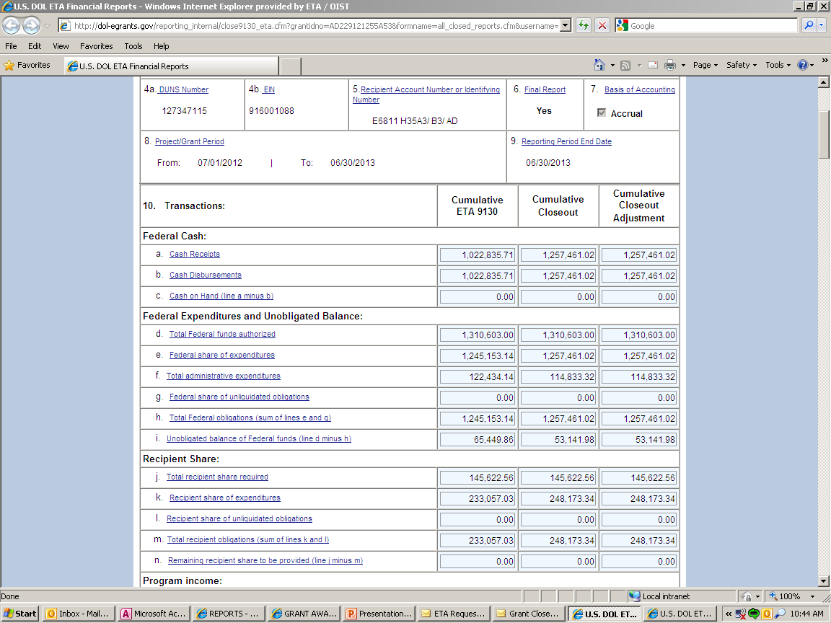
Closeout Financial Report (Closeout 9130)

Slide 40
Final Quarterly 9130/Closeout 9130

Slide 41
Liquidation of Obligation
In closeout, grantee may only liquidate obligations incurred during POP – not incur new obligations
Grantee may not direct charge staff time to work on closeout of grant after POP end date

Slide 42
Compliance
Drawdowns & Administrative Costs
There is a 10% limitation on administrative costs. 10% of grant award amount.

Slide 43
Compliance – Budget and Costs

Slide 44
Budget Realignments in Closeout
Grantee provides written justification to FPO
FPO determines if appropriate
FPO sends justification to closeout specialist and documented in file

Slide 45
Compliance – Indirect Costs

Slide 46
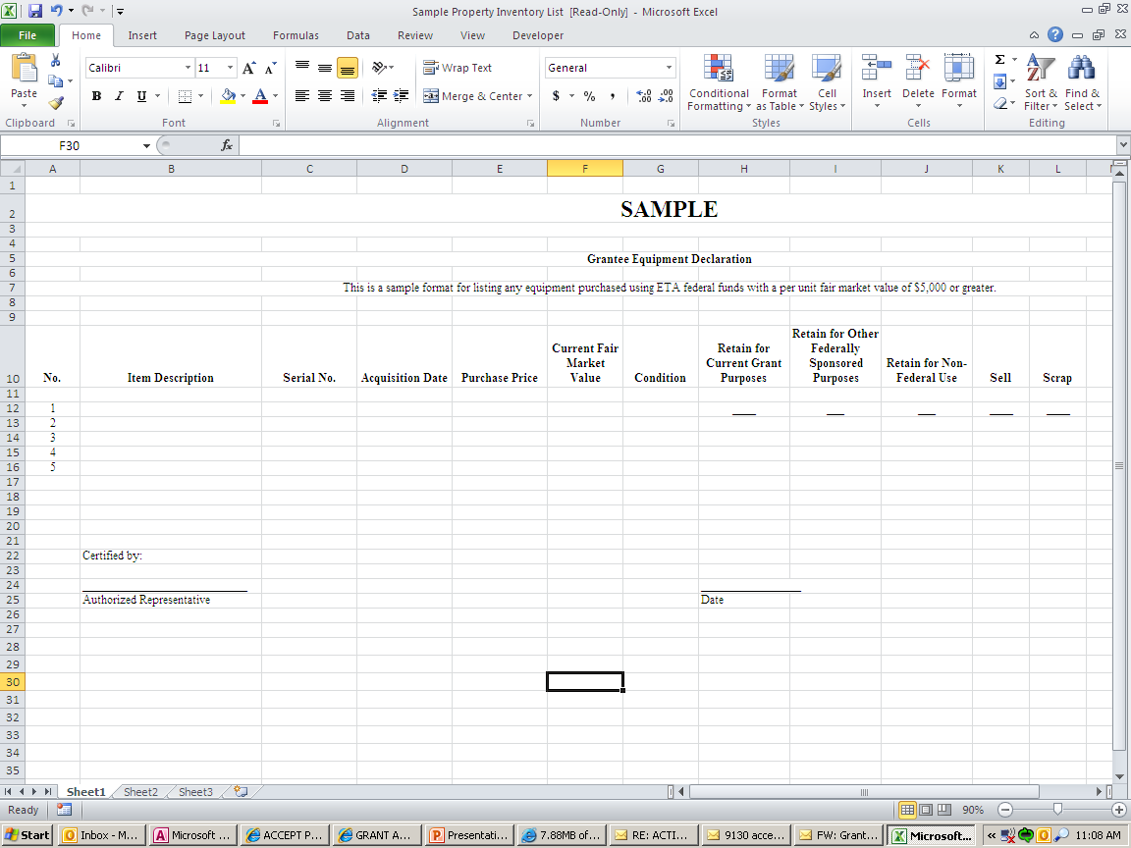
Property Certification Form

Slide 47
Common Misunderstandings
Expenditure amount higher than drawdown amount.
They need to match.
Completing the equipment form correctly.
Misunderstand all required forms and documents to be submitted.

Slide 48
Common issues Which Delay Closeout
Non-responsive grantees
Refunds
Equipment disposition
9130 issues
Administrative cost issues
Indirect cost issues
Question and disallowed costs/ID’s and FD’s
Budget realignments

Slide 49
Refunds
29 CFR 97.50(d), 97.51(b)
29 CFR 95.71(d), 95.72(a)
Grant closeout does not affect recipients obligation to return funds due to DOL as a result of refund.
Prompt refund of any balances of unobligated funds.
Refunds may require revising final expenditure report.
Refunds can be electronically through PMS or via check.

Slide 50
Frequently Asked Questions
Does marking “Yes” on Box 6 on the ETA 9130 trigger the closeout process?
Grant ends September 30, when does the grantee need to submit the final 9130 and the Closeout 9130?
November 15, 2016/December 30, 2016
When is the last time I can draw down funds?
December 30, 2016
Can stand-in costs be used to pay disallowed costs?

Slide 52
Thank You!
Please refer to the grantee closeout FAQ included in the handouts with this webinar. It will also be posted on the TAACCCT site below shortly,
under Grants Management/Round 2 Closeout.
Find resources for TAACCCT success at:
https://etagrantees.workforce3one.org
Subscribe to TLN resources, ask questions or connect with peers at TAACCCT@dol.gov

