Slide 1
H-1B Ready to Work
Introduction to H-1B Quarterly Performance Reporting and the HUB Reporting System
Webinar Date: February 5, 2015; 3:00 p.m.
Presented by: Division of Strategic Investments
U.S. Department of Labor
Employment and Training Administration

Slide 2
Polling questions for webinar lobby
Polling Question #1
How many of you are returning H-1B Grantees?!
  We have our very first H-1B grant, Ready to Work
  Technical Skills Training (TST) Round 1
  Technical Skills Training (TST) Round 2
  Jobs Accelerator (JA) Round 1
  Advanced Manufacturing Jobs Accelerator (JA) Round 2
  Make it in America
  I don’t know

Slide 3
Polling questions for webinar lobby
Polling Question #2
Let’s get to know who is on the call today. Using the poll, select the role that you play in your H-1B grant program.
For this grant initiative I am the:
  Authorized Representative
  Program Director/Manager
  IT/Data Manager or staff
  Training Partner
  Employer Partner
  None of the above

Slide 4
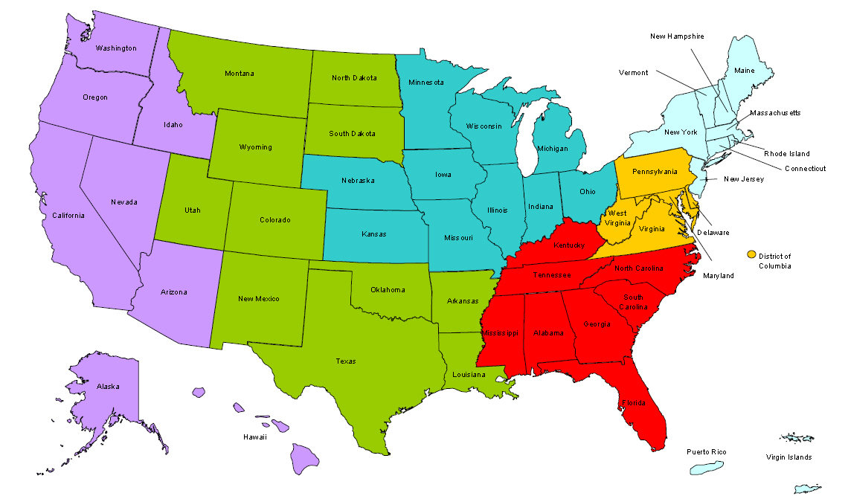
Where are you?
Enter your location in the Chat window – lower left of screen

Slide 5


Welcome & Introductions
H-1B Performance Reporting
Today’s Speakers and Key Contacts!
H-1B Policy Lead
Megan Baird
Performance Reporting TA
Ayreen Calimquim

Slide 6

Agenda
Definition Deep-dive: Long-term Unemployed; other unemployed; and, Incumbent Workers
Quarterly Progress Reporting Orientation
Interim Reporting Guidance
HUB Reporting System Phase 1

Slide 7
Participants Eligible to Receive Training and services
RTW Definition Deep Dive
H-1B Ready To Work SGA

Slide 8
RTW Definition Deep Dive
Unemployed
Unemployed
(Less that 27 Weeks)
Incumbent
Incumbent
Long-Term Unemployed
Underemployed
LTU (Unemployed 27 Weeks or More)

Slide 9
RTW Definition:
Long-term Unemployed Workers
Ready to Work Definition of Long-Term Unemployed
For the purposes of this SGA, Long-term unemployed individual is defined as
“an individual who has been unemployed for 27 consecutive weeks or more”
Included in this definition are:
individuals who have lost their job during or after the recent recession (commencing from December 1, 2007 forward) and have exhausted or nearly exhausted unemployment benefits (if they were eligible to receive such benefits);
underemployed individuals who lost their job during or after the recent recession and have obtained only episodic, short-term, or part-time employment but have not yet reconnected with a full-time job commensurate with the individual’s level of education, skills, and previous wage or salary earned prior to the individual’s loss of permanent employment.
Within these categories, grantees may serve a wide range of individuals, such as, individuals with disabilities, veterans, minorities, Indian and Native Americans, and other individuals.

Slide 10
RTW Definition:
Long-term Unemployed Workers (cont.)
Ready to Work Definition of Long-Term Unemployed: “Underemployed”
Underemployed individuals are individuals who :
  lost their job during or after the recent recession and have obtained only episodic, short-term, or part-time employment but have not yet reconnected with a full-time job commensurate with the individual’s level of education, skills, and previous wage or salary earned prior to the individual’s loss of permanent employment.
*underemployed individuals fall within the definition of long-term unemployed and are therefore considered long-term unemployed

Slide 11
RTW Definition:
Other Unemployed Workers
Ready to Work Definition: Other Unemployed Worker
For the purposes of this SGA, other unemployed individual is defined as:
“as an individual who is without a job for fewer than 27
consecutive weeks (i.e. not long-term unemployed), is not
underemployed, and who wants and is available to work”

Slide 12
RTW Definition:
Incumbent Workers
Ready to Work Definition: Incumbent Worker
For the purposes of this SGA, an Incumbent Worker is defined as:
“as an employed worker in need of skills upgrade to obtain a new job or retain a current job that is requiring new or different skills in an H-1B industry/occupation, and where training is developed with an employer or employer association to upgrade skills training.”
Included in this definition are:
Newly hired workers, and
Workers whose hours have been reduced and/or earnings have declined.
*An employed worker whose employer does not have a training
agreement with the grantee (where training is developed with an employer or employer association to upgrade skills training) is not eligible to be served under this SGA.

Slide 13

Please enter questions in the Chat Room!

Slide 14
Quarterly Progress Reports Overview
Quarterly Progress Reporting Orientation
H-1B Ready To Work Grantees

Slide 15
The Value of Performance Reporting
Performance data is used to
Illustrate Success
Ensure Sustainability and Evaluate Effectiveness
Continuous improvement
Identify Areas for Opportunity
Identify Areas for Technical Assistance
Great Programs + Great Data + Great Outcomes =
Greater Success for American Workers!

Slide 16
H-1B Grants Reporting Deadlines
Quarter Start Date | Quarter End Date | Report Due Date
January 1 | March 31 | May 15
April 1 | June 30 | August 14
July 1 | September 30 | November 14
October 1 | December 31 | February 13th

Slide 17

H-1B Reporting Requirements
Two reports due each quarter
  Financial
  Progress Reports
    Quarterly Performance Report
    Quarterly Narrative Report
Final Report due at the end of the grant

Slide 18
Reporting Components in the HUB System
QNR
Submit & Certify!
QPR*
*Please note: For this reporting quarter (12.31.14), Grantees will not submit a QPR reflecting participant data.
HOT RESOURCE!
http://prezi.com/mg1ajudw7jap/?utm_campaign=share&utm_medium=copy&rc=ex0share

Slide 19
H-1B Performance Reporting Overview
Quarterly Performance Report (QPR)*
  Participant level data including aggregated counts on services provided using grant funds.
  A Standardized Quarterly Performance Report template will be provided
Quarterly Narrative Report (QNR)
  Summary of activities provided using grant funds that usually aren’t captured in the performance report
  A Narrative Report template will be provided
*Please note: For this reporting quarter (12.31.14), Grantees will not submit a QPR reflecting participant data.

Slide 20
Components of the QPR*: Participant Data Collection
Personally Identifiable Information (Including SSN and Date of Birth)
Participant Demographic Information
Training Activities and Service Start and End Dates
For further guidance on handling the protection of Personally Identifiable Information (PII) please refer to:
Training and Employment Guidance Letter (TEGL) NO. 39-11 – Guidance on the Handling and Protection of Personally Identifiable Information
*Please note: For this reporting quarter (12.31.14), Grantees will not submit a QPR reflecting participant data.

Slide 21
Components of the QNR
Sections | Description
Section A | Summary of Grant Activities
Section B | Status Update on Leveraged Resources
Section C | Status Update on Strategic Partnership Activities
Section D | Timeline for Grant Activities and Deliverables
Section E | Status of Deliverables
Section F | Key Issues and Technical Assistance Needs
Section G | Best Practices and Success Stories
Section H | Additional Information (optional)

Slide 22
Poll: Who has already begun serving participants?
  Yes! We started serving participants in this reporting quarter.
  Not yet! But we plan to start serving participants next quarter.
  Not yet! We are still gearing up and plan to start serving participants this summer.

Slide 23
Interim Quarterly Progress Reporting Guidance
Interim Reporting Guidance
Effective for the quarter ending December 31, 2014

Slide 24
H-1B Performance Reporting Interim Reporting Guidance
  While ETA seeks OMB approval for standardized data elements and forms, Ready To Work grantees will be required to follow an interim reporting process.
  This interim reporting guidance is applicable for the reporting period October 1, 2014 – December 31, 2014, with a due date of February 13, 2015.

Slide 25
H-1B Performance Reporting Interim Reporting Guidance (cont.)
  For the reporting quarter December 31, 2014
  Grantees will not be uploading participant data to generate a QPR at this time.
  Grantees will only submit a quarterly narrative report in HUB as part of the interim reporting process.
    Grantees that have served participants should report this in their QNR section H “Additional Information.”

Slide 26
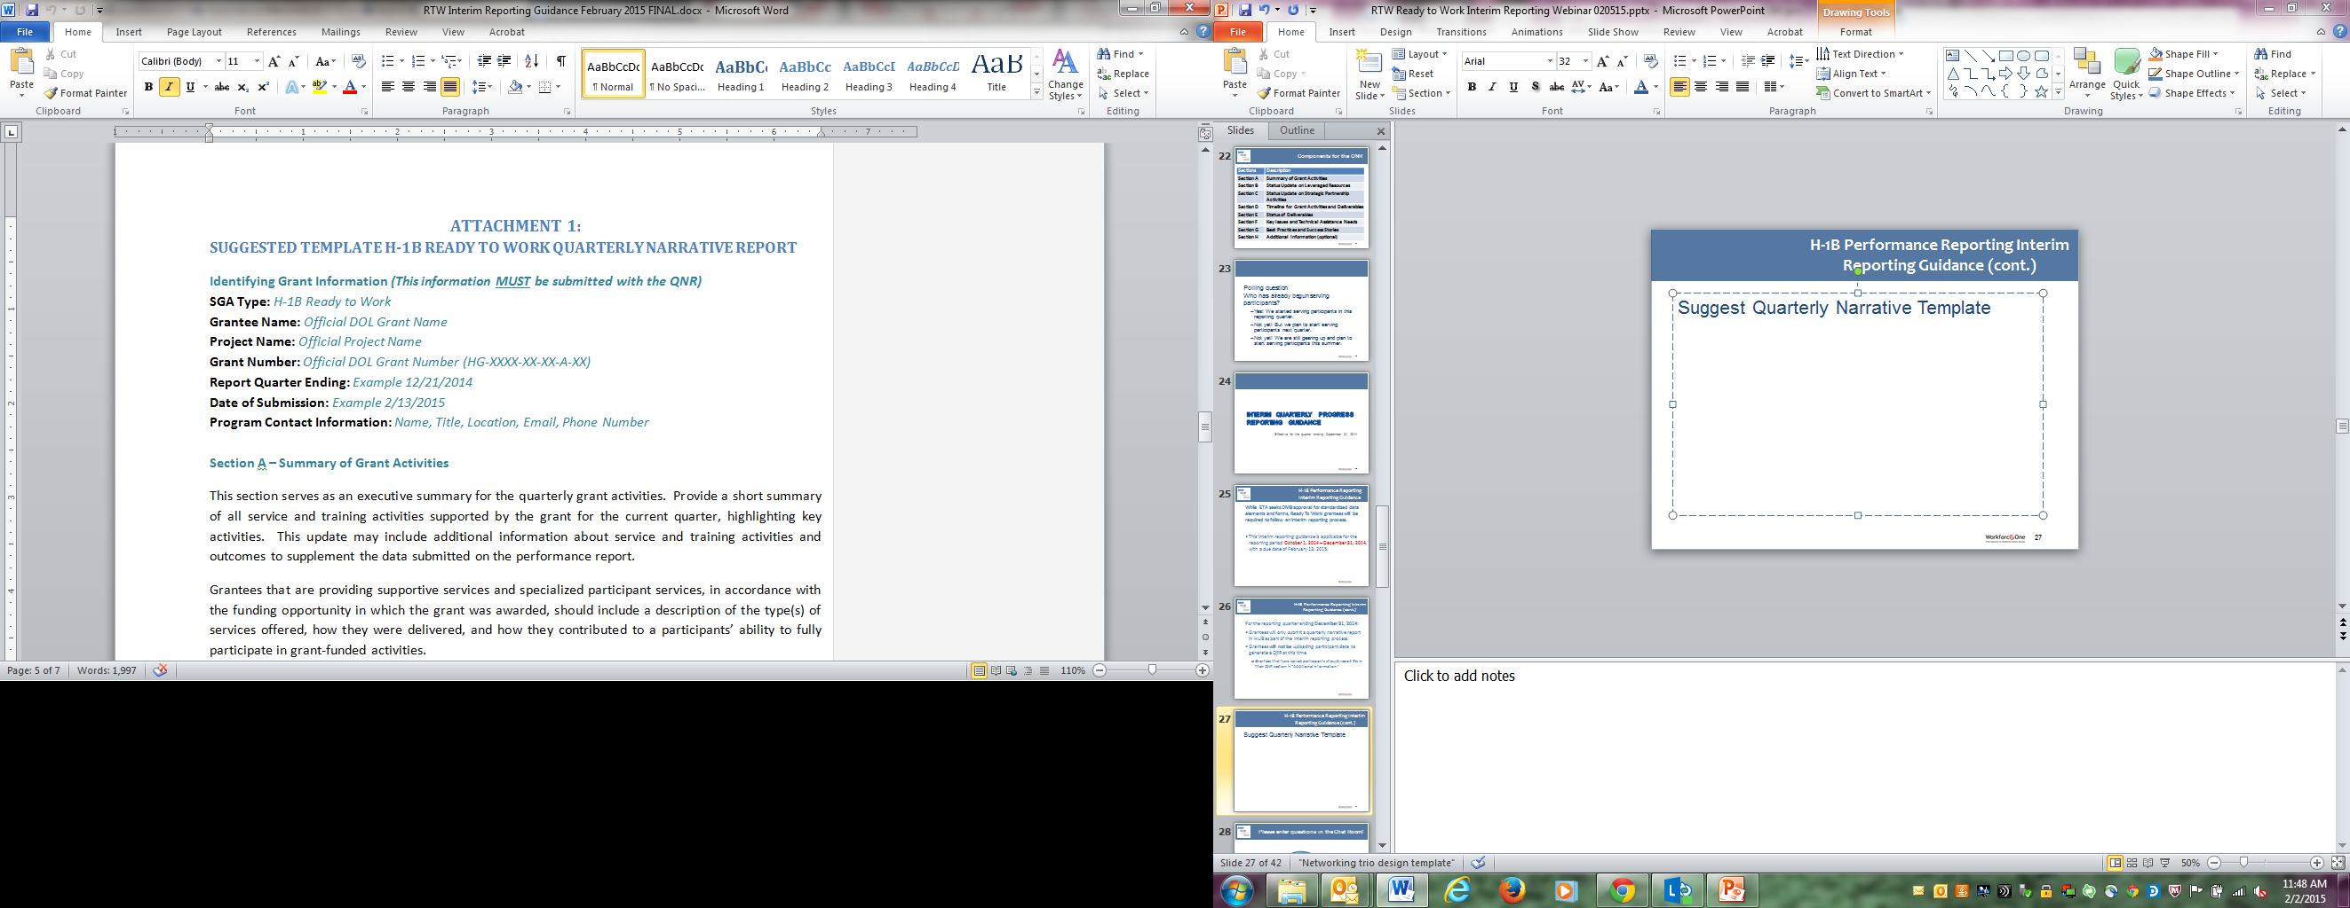
H-1B Performance Reporting Interim Reporting Guidance (cont.)
Suggested Quarterly Narrative Template

Slide 27
Please enter questions in the Chat Room!

Slide 28
HUB Reporting System Overview
HUB Reporting System Phase 1
HUB Overview and Submitting Your 12/31/2014
Quarterly Progress Report

Slide 29
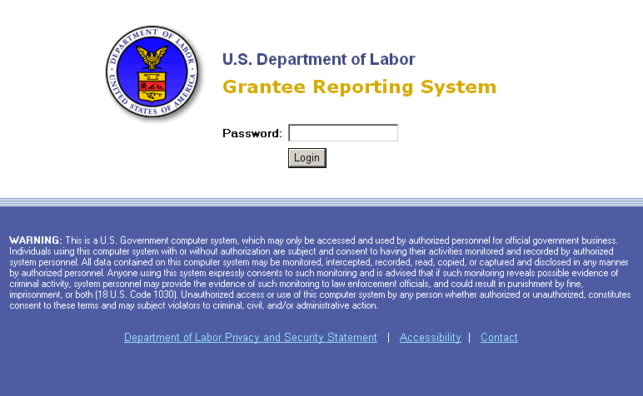
Resource Link to HUB http://www.reports.doleta.gov/

Slide 30
HUB Performance Reporting System
Accessing HUB
HUB url: http://www.reports.doleta.gov/
Pin and Password
Pin and Password will be issued to the grant Authorized Representative
Coordinate with your Authorized Representative to obtain your password to access HUB
Check the spam or junk folders for email

Slide 31
HUB Performance Reporting System
Accessing HUB Phase 1
Q: Where is my HUB PIN and Password?!
A: Grantees will receive access to HUB no later than February 9, 2015, via email from helpdesk.ot@dol.gov.
PLEASE NOTE: This HUB PIN and Password is issued for Phase 1 of the HUB System launch. Grantees will receive a new PIN and Password when Phase 2 of the HUB System is available in March.

Slide 32
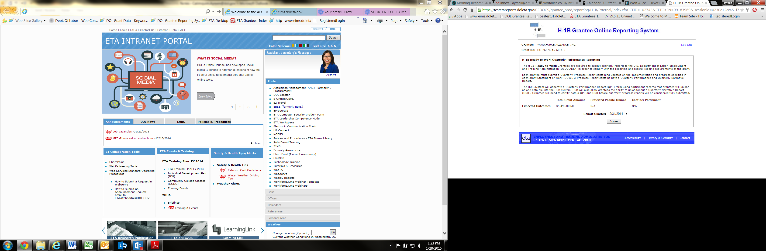
TIP: Ensure you select the correct reporting quarter.

Slide 33
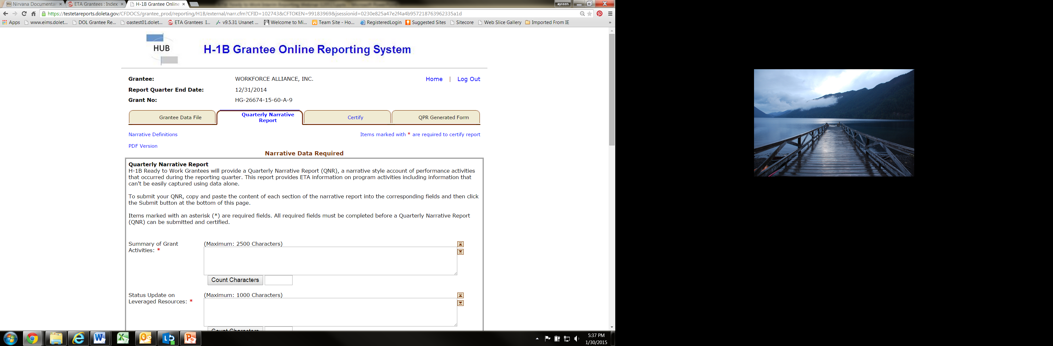

Slide 34
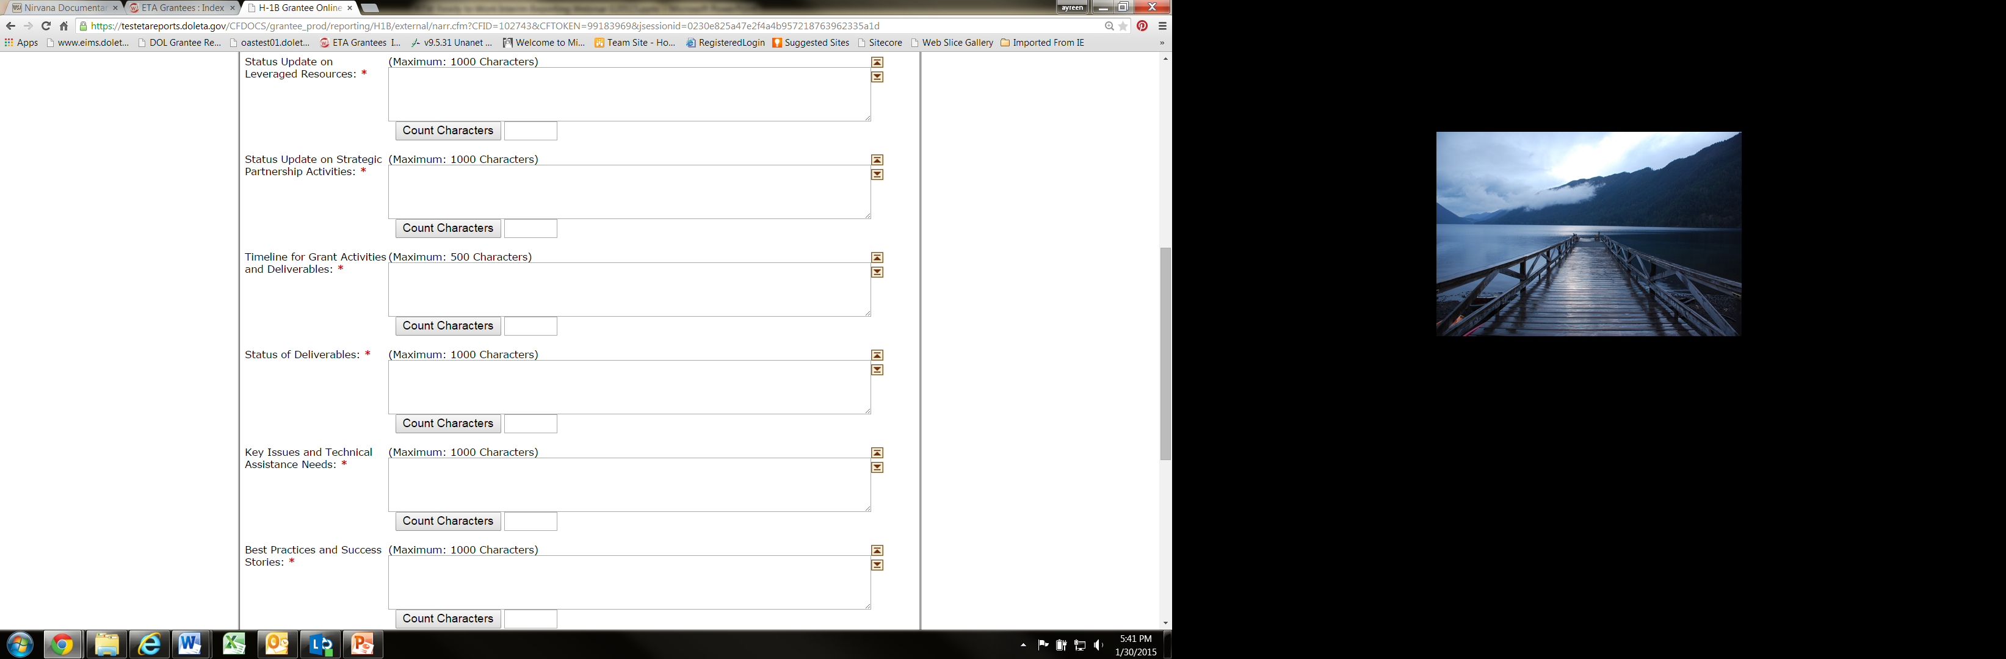

Slide 35
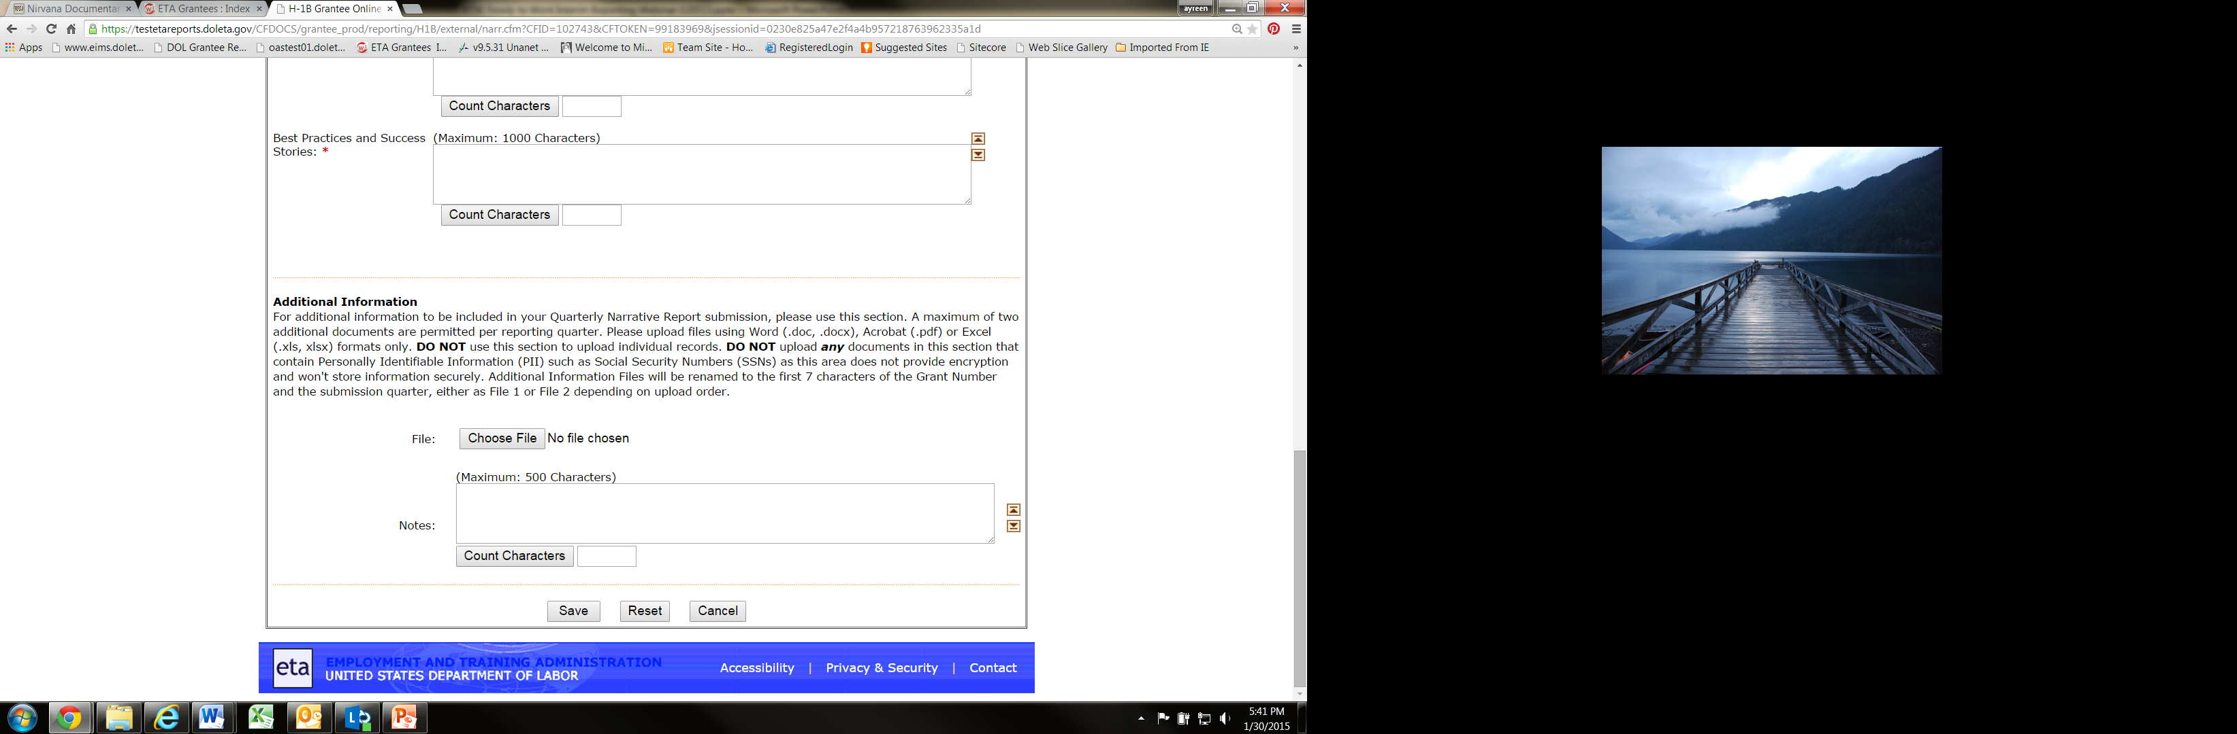

Slide 36


Slide 37
Please enter questions in the Chat Room!

Slide 38

Ready to Work
Community of Practice
http://etagrantees.workforce3one.org

Slide 39

DOL Contacts
Your Federal Project Officers!
Ready to Work Grantee Mailbox
RTW@dol.gov
ETA Help Desk
(for HUB System Technical Questions)
EBSS.Help@dol.gov

Slide 40
Look for upcoming Webinars in this series!
SAVE
DATE
the
H-1B Ready to Work Performance Reporting Webinar
COMING IN APRIL 2015!
HUB System Part II: Data Elements and Edit Checks, Uploading a Data Files and Generating a Quarterly Performance Report (QPR) form, Aggregation Rules

Slide 41


