Slide 1
April 20, 2015
Orientation to Creative Commons CC BY and Skills Commons: A Road Map for Meeting TAACCCT SGA Requirements

Slide 2
TAACCCT LEARNING NETWORK
AT A GLANCE
U.S. Department of Labor, Employment & Training Administration
(National)
Jobs for the Future
CalState/Merlot
Maher & Maher
American Association of Community Colleges
U.S. National Science Foundation
ATE Centers
Other Non-Federal Providers of TA and Resources for TAACCCT Grantees:
Creative Commons
CAST
The Transformative Change Initiative

Slide 3
TAACCCT LEARNING NETWORK EXPLAINED
How to find us:
  Find TLN resources on ETA Grantees (click on TAACCCT in right column)
  Contact DOL and JFF: TAACCCT@dol.gov
  Contact CalState/Merlot: support@skillscommons.org
  Note: Evaluation support is provided separately through DOL’s Chief Evaluation Office, supported by Urban Institute and Abt Associates. Contact them at TAACCCTeval@urban.org.

Slide 4
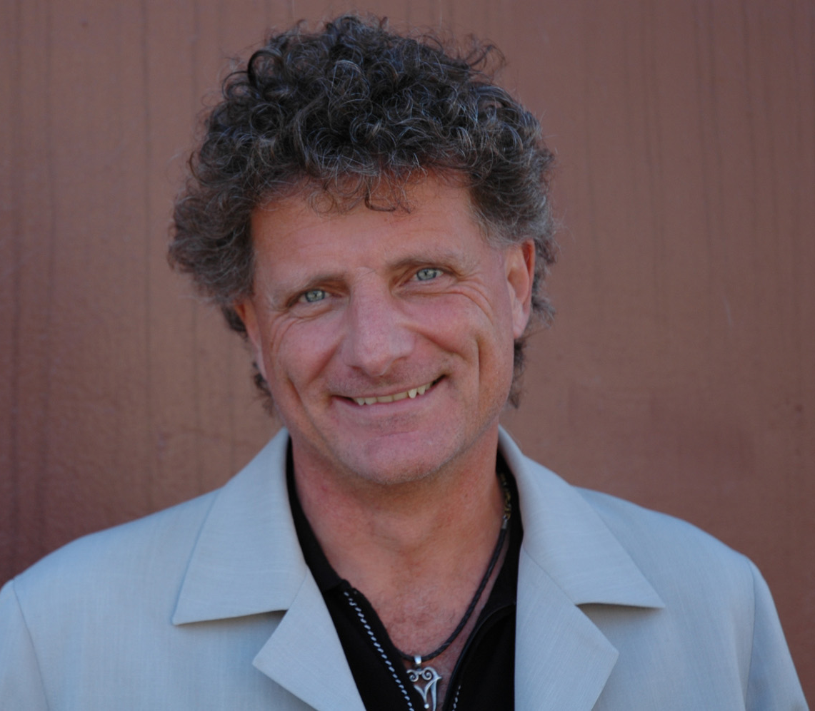

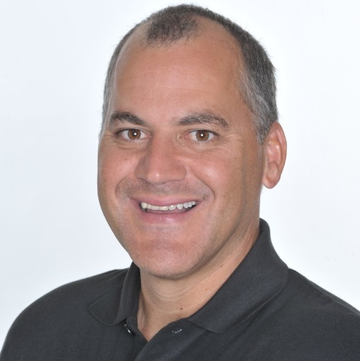
Presenters
Paul Stacey
Associate Director of Global Learning, Creative Commons
Rick Lumadue
Program Manager/Grantee Relations, Skillscommons.org
Gerry Hanley
Director of SkillsCommons.org

Slide 5
Opening Poll
Opening Poll

Slide 6
Agenda
Examine the SGA Requirement for CC-BY Licensing
  Understand the CC BY TAACCCT SGA requirement
  Understand why DOL put this requirement in the SGA
  Learn how to fulfill the SGA requirement
Discover the relationship between CC BY and Open Educational Resources (OER)
  Types of OER
  CC BY Licensing and OER
  Introduce SkillsCommons.org where all TAACCCT grantee content deliverables are uploaded at the end of the grant
Explore the support services available from Creative Commons and Skills Commons and future plans
  Creative Commons: https://open4us.org
  SkillsCommons.org Support Services Center: http://support.taaccct.org/home/getting-started/

Slide 7
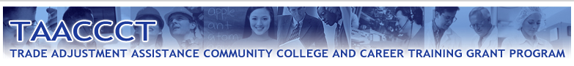
What is the CC BY requirement in the TAACCCT grant?

Slide 8

“To ensure that the Federal investment of these funds has as broad an impact as possible and to encourage innovation in the development of new learning materials, as a condition of the receipt of a TAACCCT grant, the grantee will be required to license to the public all work created with the support of the grant under a Creative Commons Attribution 4.0 (CC BY) license.”

Slide 9
“The purpose of the CC BY licensing requirement is to ensure that materials developed with funds provided by these grants result in Work that can be freely reused and improved by others.”

Slide 10
Applies to:
Only work that is developed by the grantee with the grant funds.

Slide 11
Does not apply to:
Pre-existing copyrighted materials licensed to, or purchased by the grantee from third parties, including modifications of such materials.
Works created without grant funds.

Slide 12
“This license allows subsequent users to copy, distribute, transmit and adapt the copyrighted Work and requires such users to attribute the Work in the manner specified by the grantee. Notice of the license shall be affixed to the Work. For general information on CC BY, please visit http://creativecommons.org/licenses/by/4.0.”

Slide 13




Slide 14
U.S. DOL:
Why did we do this?

Slide 15
“We did this because open licensing increases the impact of our investment and helps us to be more strategic with our future investments.”

Slide 16
“From a public policy perspective, the Department is a better steward of public funds by giving the public access to those things created using public funds, and ensuring that these products have as wide spread a use as possible.”

Slide 17
“TAACCCT is a really big investment. But we expect that OER will allow the impact to be even greater than just the 800 colleges with new curricula and equipment that we directly funded.”

Slide 18
Bottom line:
public access to publicly funded works

Slide 19

What is Creative Commons & CC BY?
creativecommons.org

Slide 20
CC BY is a free copyright license

Slide 21
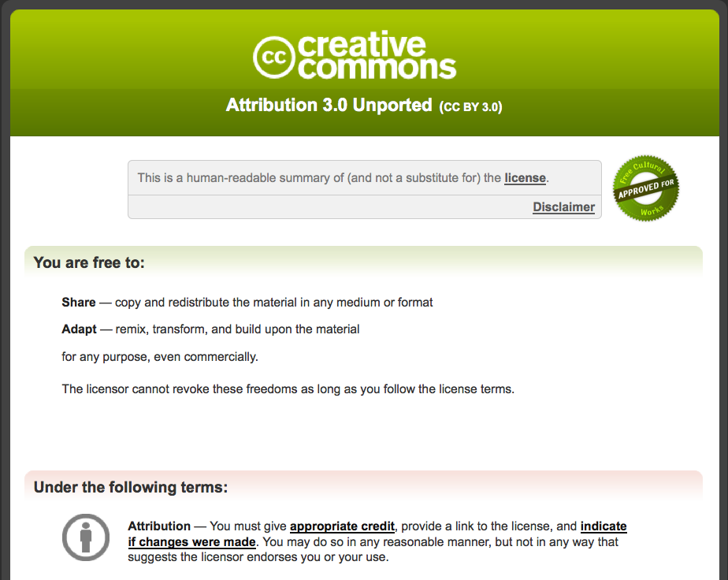

Slide 22
Created by a nonprofit organization
(Creative Commons)
that creates other free legal tools

Slide 23
creativecommons.org

Slide 24
What do we do?
We make sharing content easy, legal, and scalable.

Slide 25
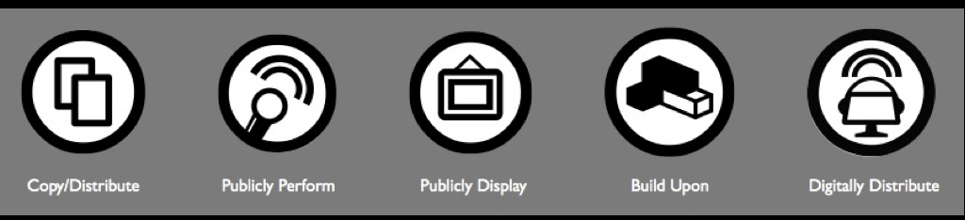

Slide 26
How do we do it?
Free licenses that creators can attach to their works

Slide 27


Slide 28
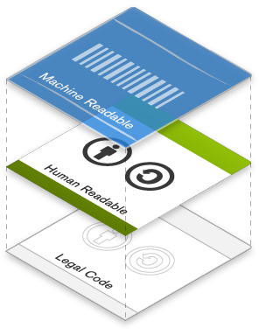

Slide 29
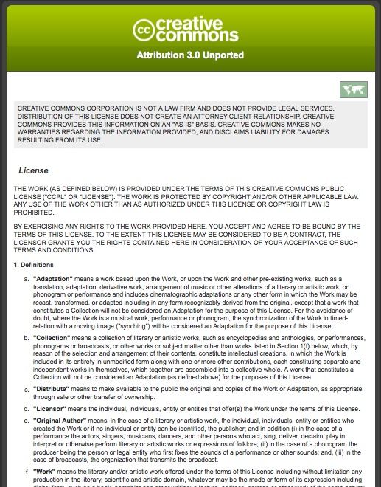
Lawyer
Readable
Legal Code

Slide 30
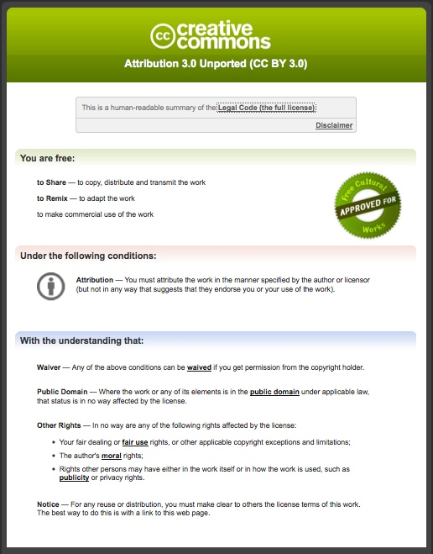
Human
Readable Deed

Slide 31
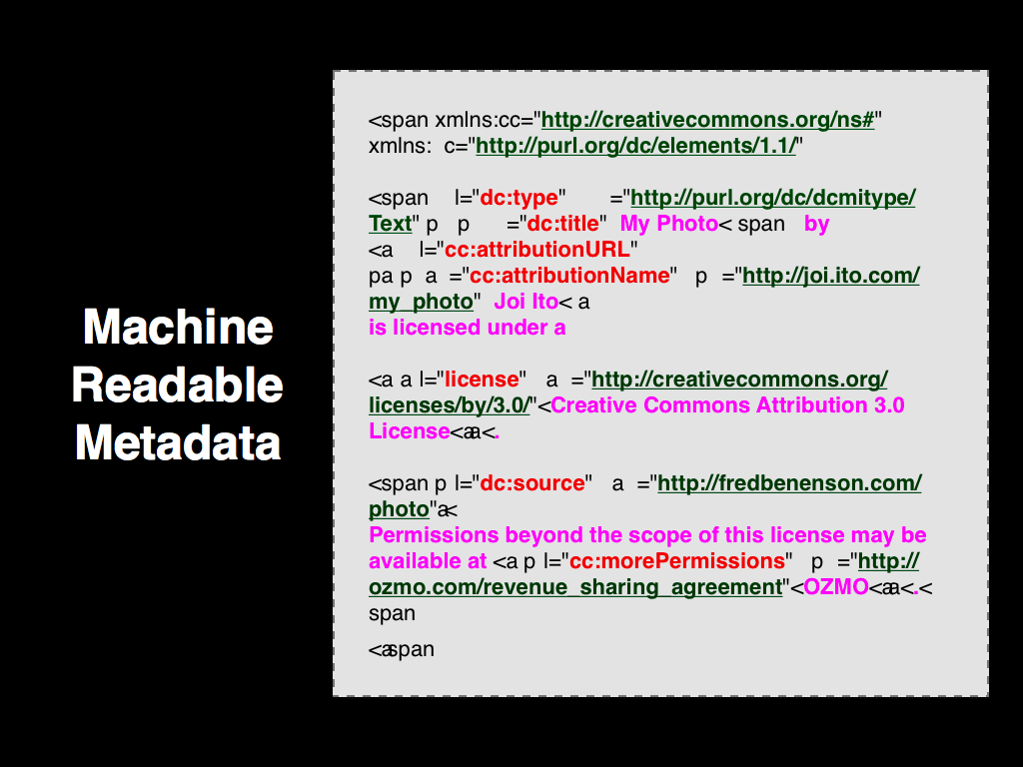
Machine
Readable Metadata

Slide 33

“OER are teaching, learning, and research resources that reside in the public domain or have been released under an intellectual property license that permits their free use and re-purposing by others.”

Slide 34
5Rs: The Powerful Rights of OER
Retain
Use the content in its unaltered form
Revise
Adapt, adjust, modify, improve, or alter the content
Remix
Share your copies of the original content, revisions, or remixes with others
Combine the original or revised content with other OER to create something new
Redistribute
Make, own, and control your own copy of the content
Reuse

Slide 35








most free
TAACCT is
CC BY
&
OER
Not OER
least free

Slide 36
With $2 billion over 4 years, TAACCCT is the largest OER* initiative in the world.
*thanks to CC BY license requirement

Slide 37
TAACCCT Impact of CC BY & OER
As a TAACCCT grantee you are authoring new OER
Use existing OER in your development
  Sourcing OER
  Reusing, revising, remixing OER
Sharing & distributing OER publicly
  Repositories for storage, curation, and distribution
Leveraging OER through open pedagogies
Promoting and marketing to students
Leveraging OER by establishing downstream local, regional, national, and international partners

Slide 38
SkillsCommons.org: TAACCCT Repository
http://skillscommons.org

Slide 39

SkillsCommons Support Services Center

Slide 40
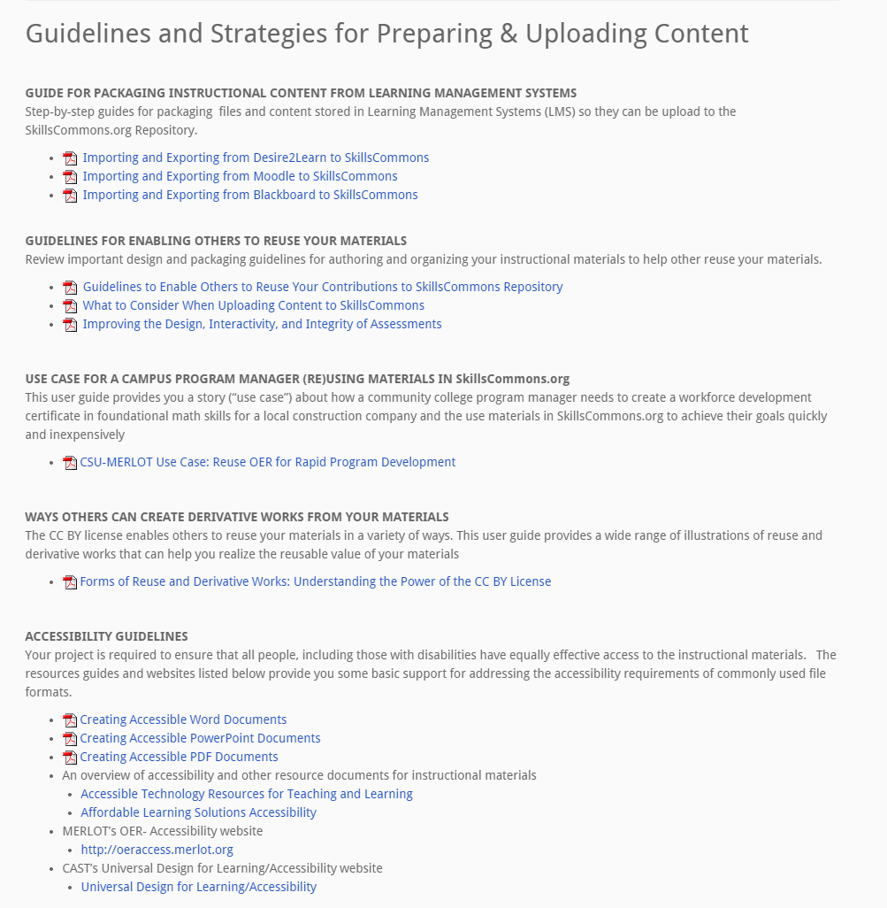
SkillsCommons Support Services Center
Tutorials & User Guides
Packaging Instructional Content
Enabling Others to Reuse
Use Case
Assuring Quality of Resources
Creative Commons Licensing Guidelines

Slide 41
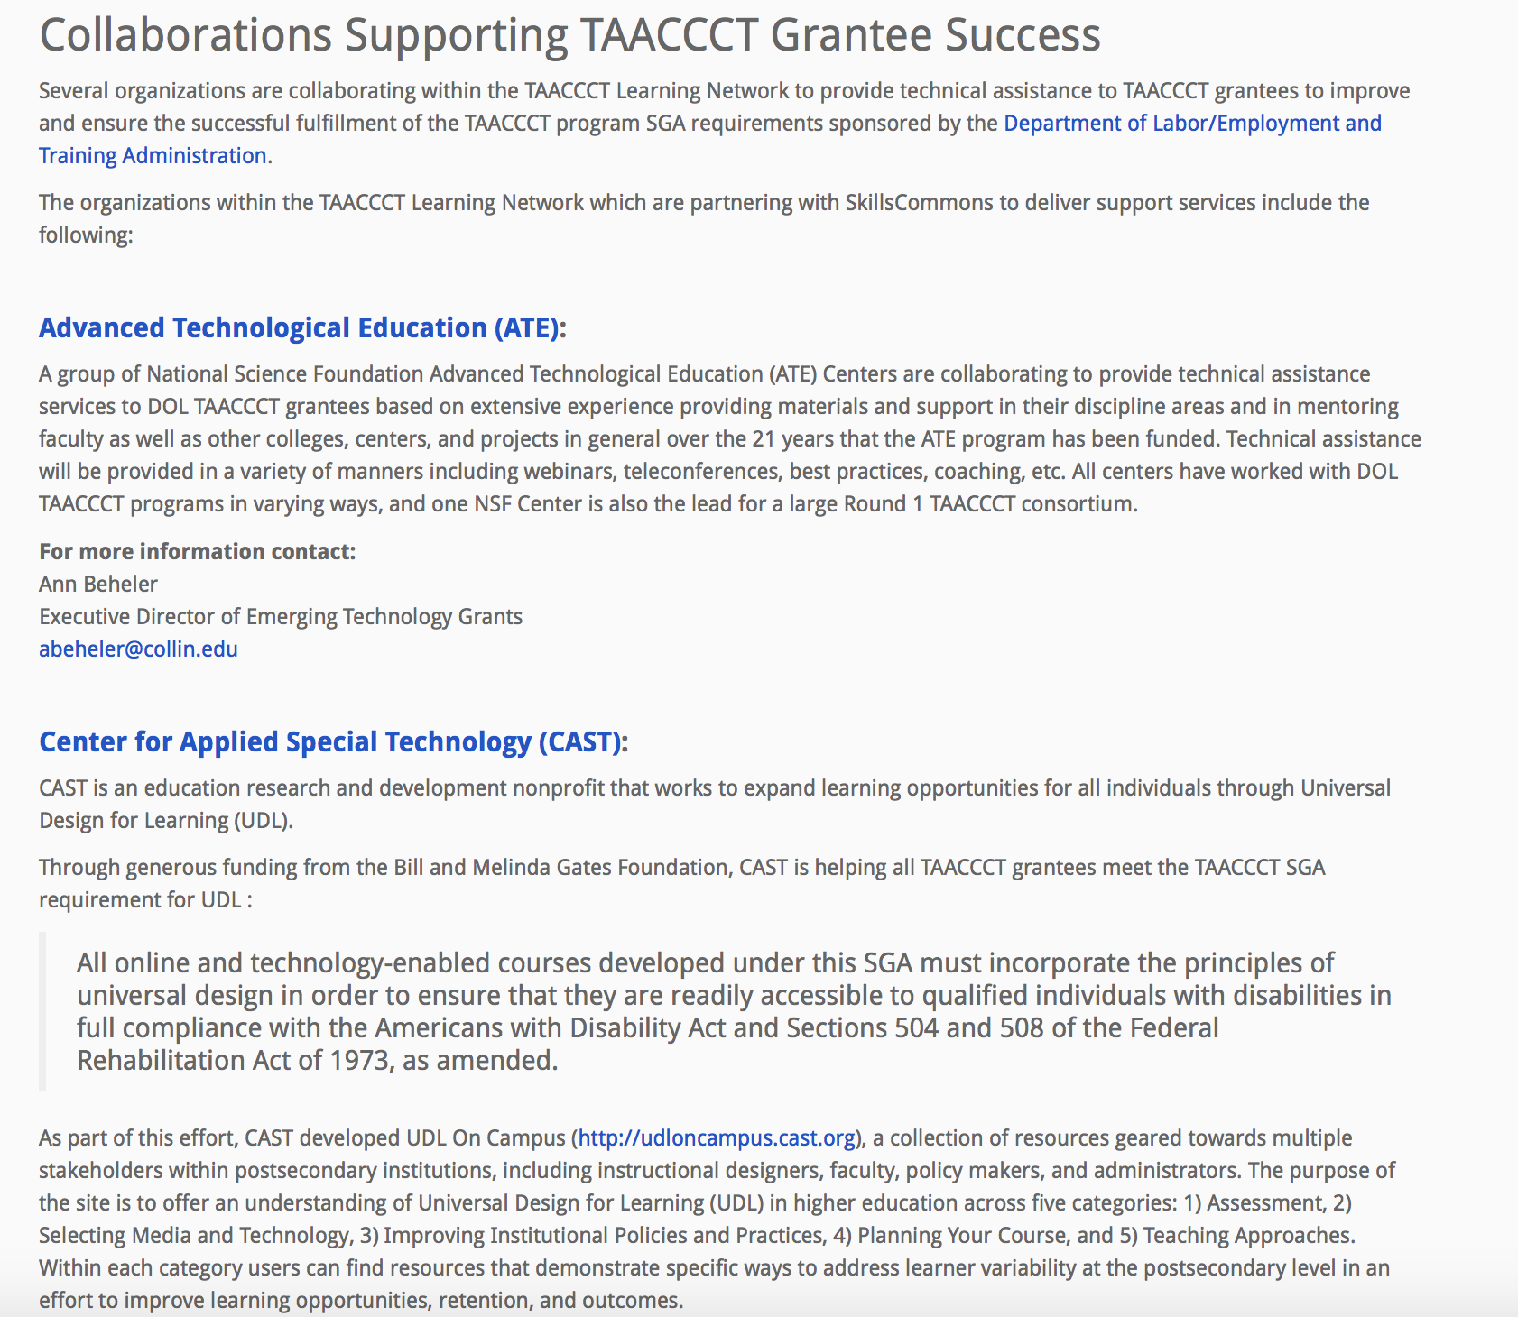
SkillsCommons Support Services Center
Partners
Advanced Technological Education (ATE)
Center for Applied Special Technology (CAST)
Creative Commons
Jobs for the Future (JFF)

Slide 42
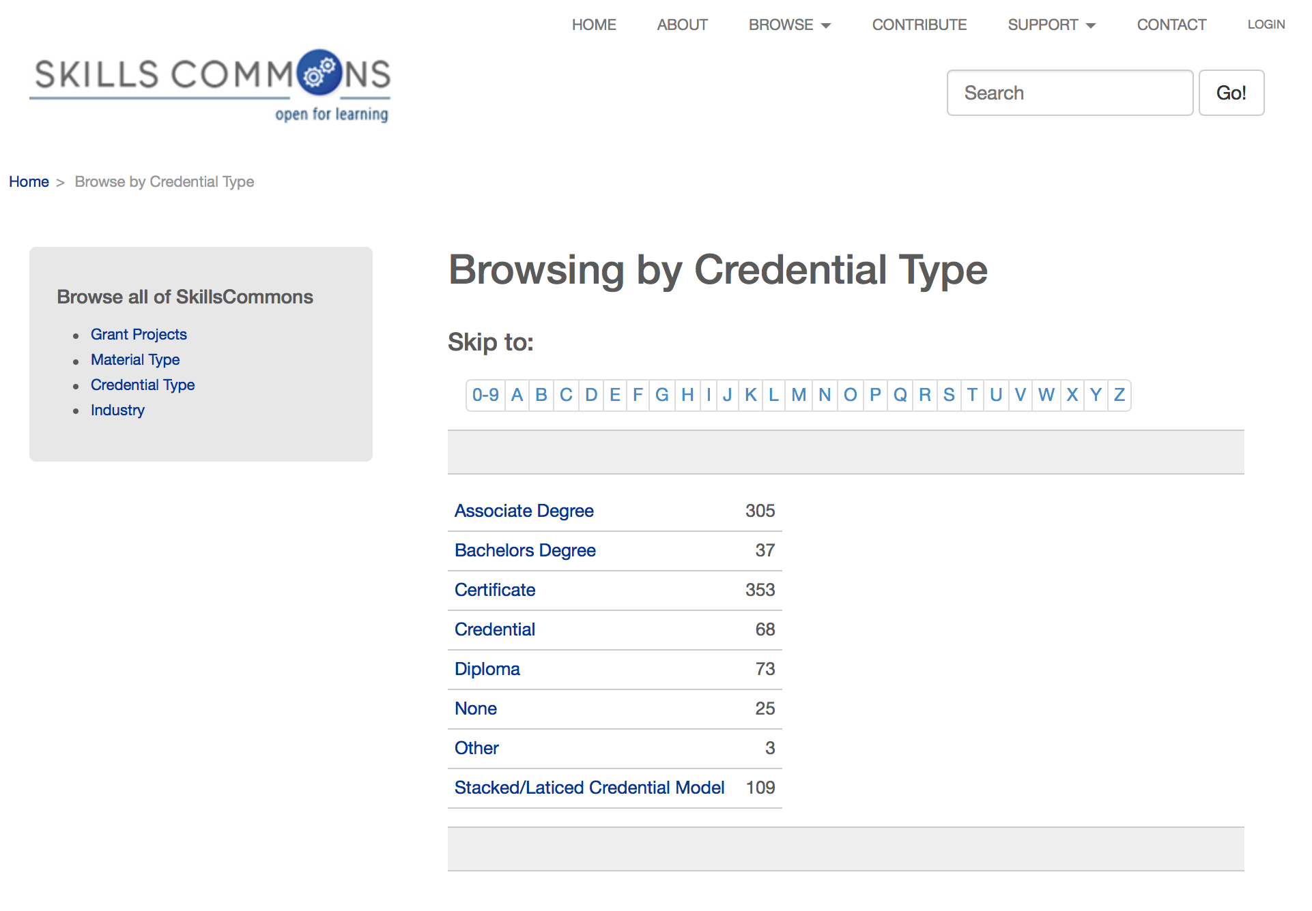
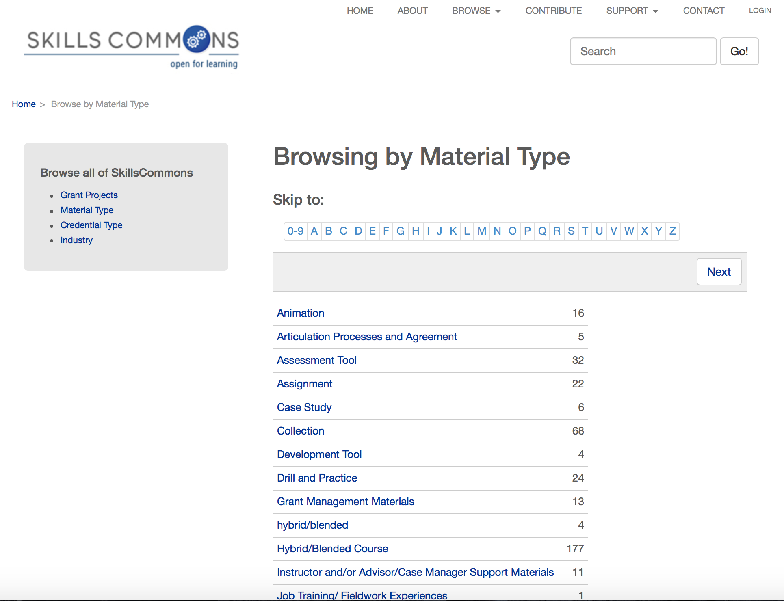
Search for OER Material on SkillsCommons.org
Browse by Credential Type
Browse by Material Type

Slide 43
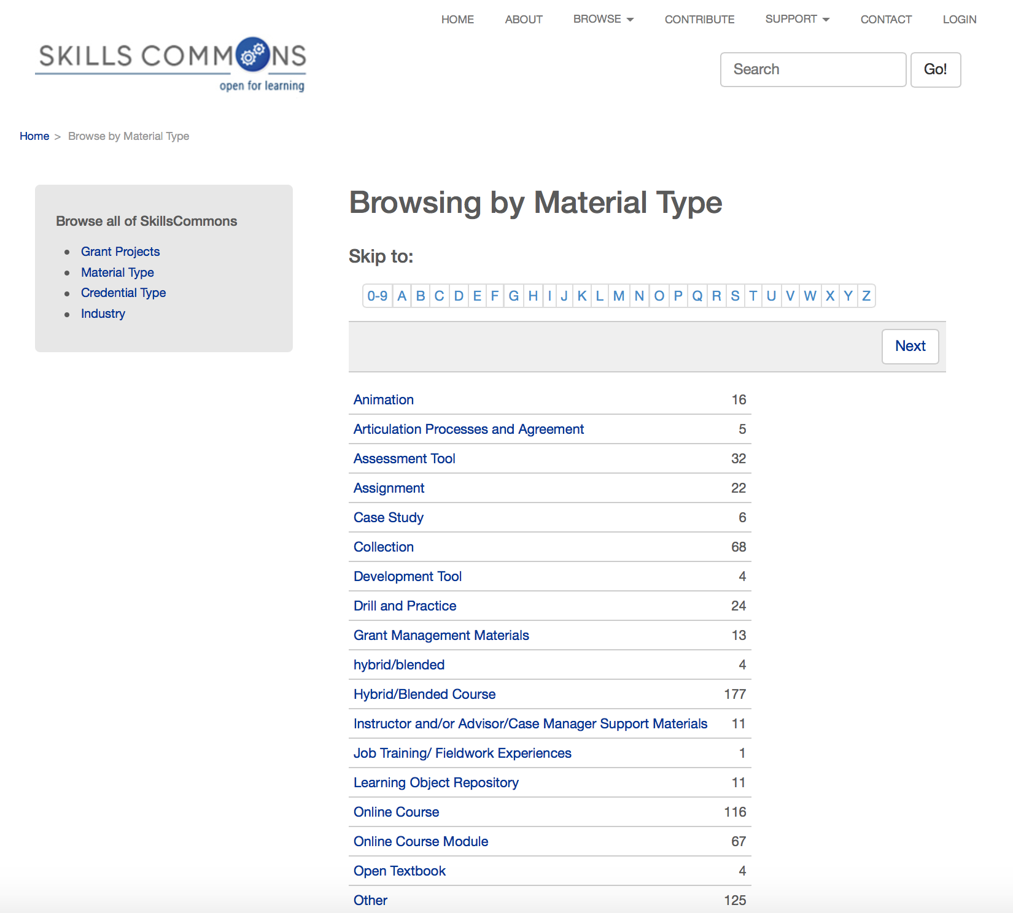
Search for OER Material on SkillsCommons.org

Slide 44
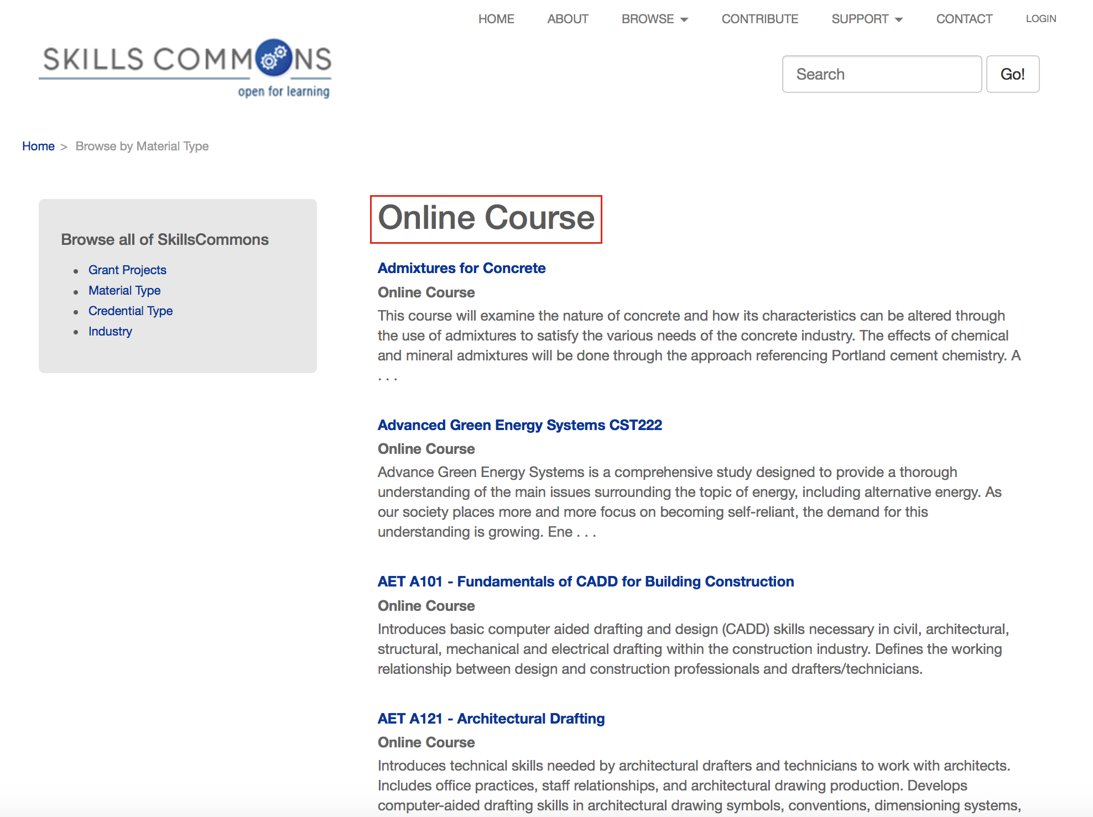
Search for OER Material on SkillsCommons.org

Slide 45
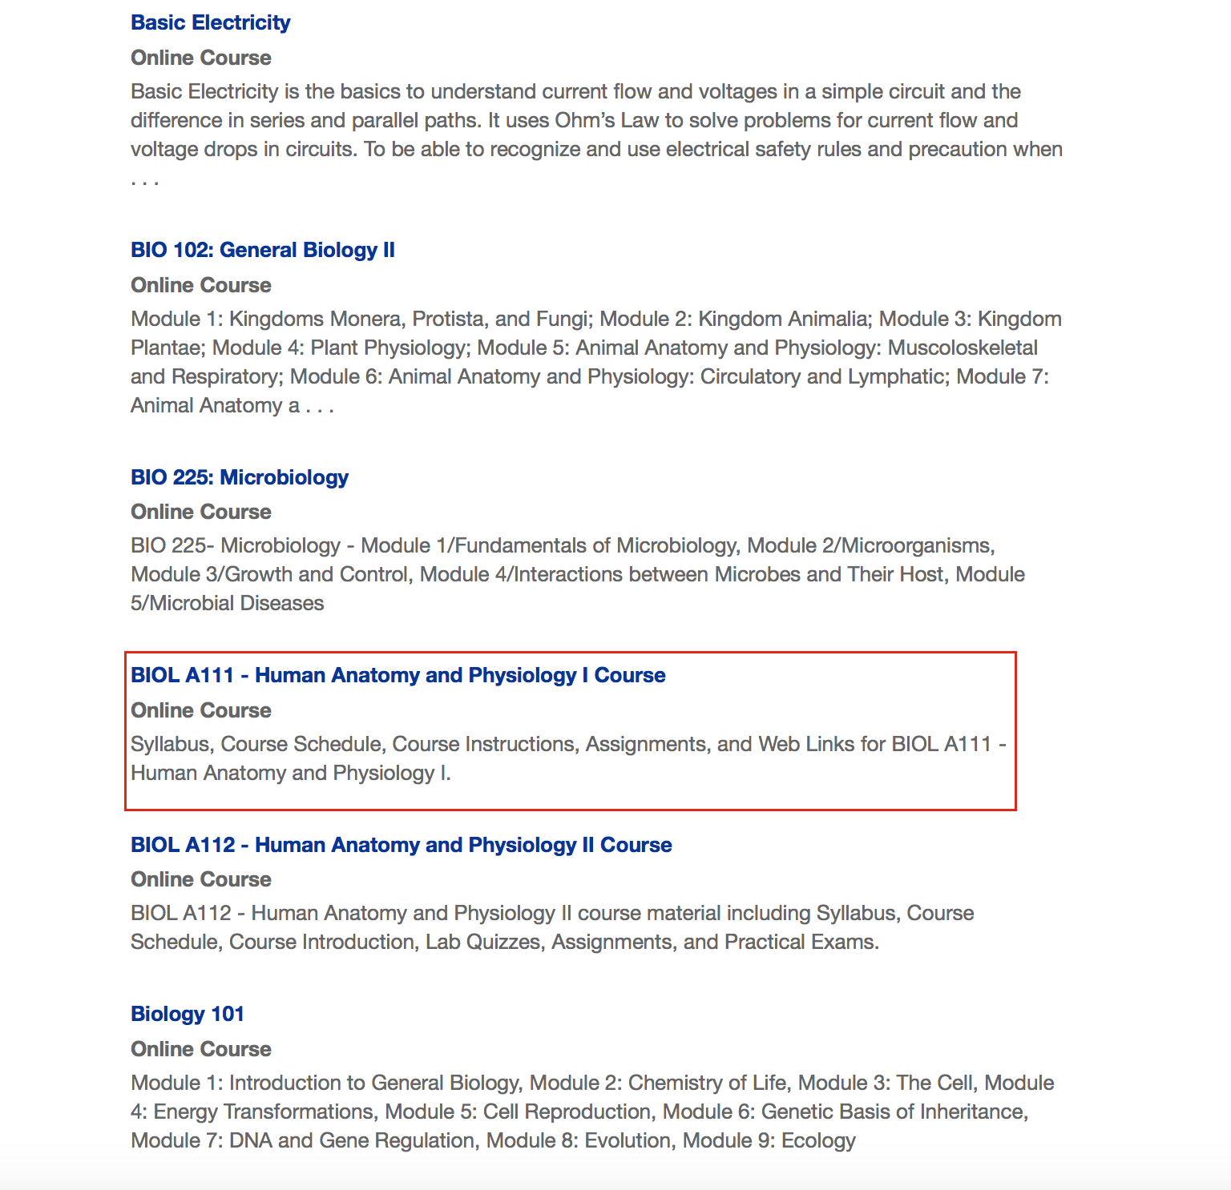
Search for OER Material on SkillsCommons.org

Slide 46
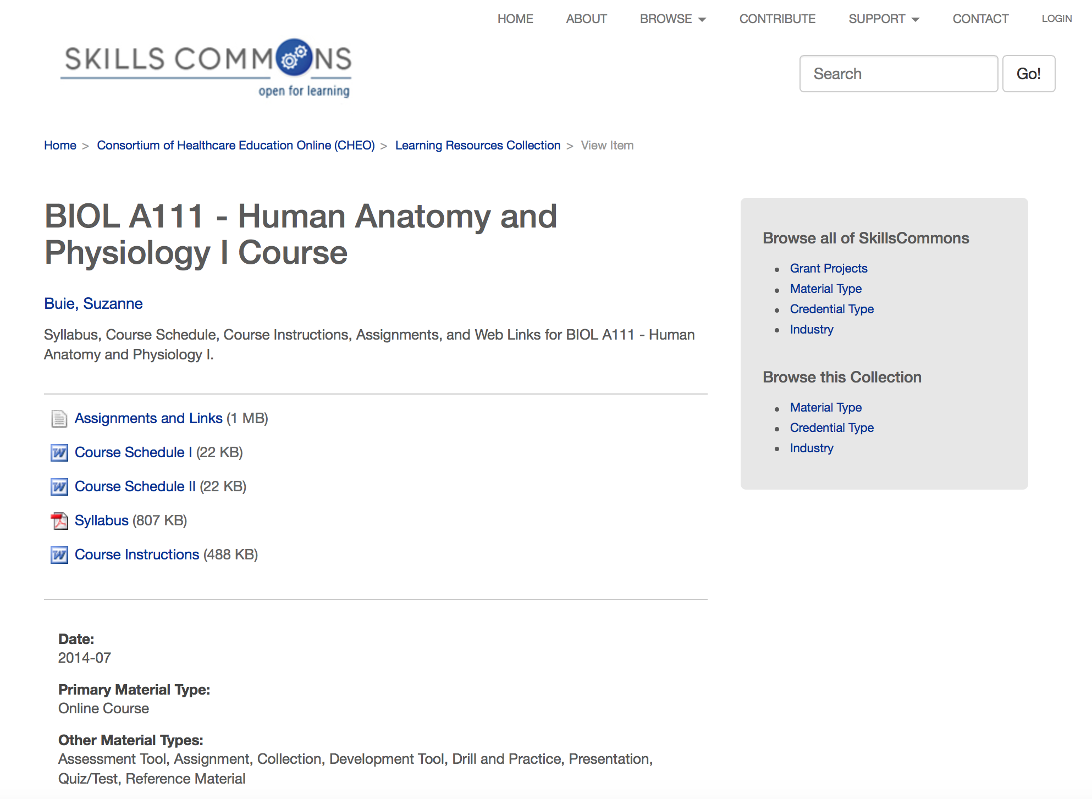
Search for OER Material on SkillsCommons.org

Slide 47
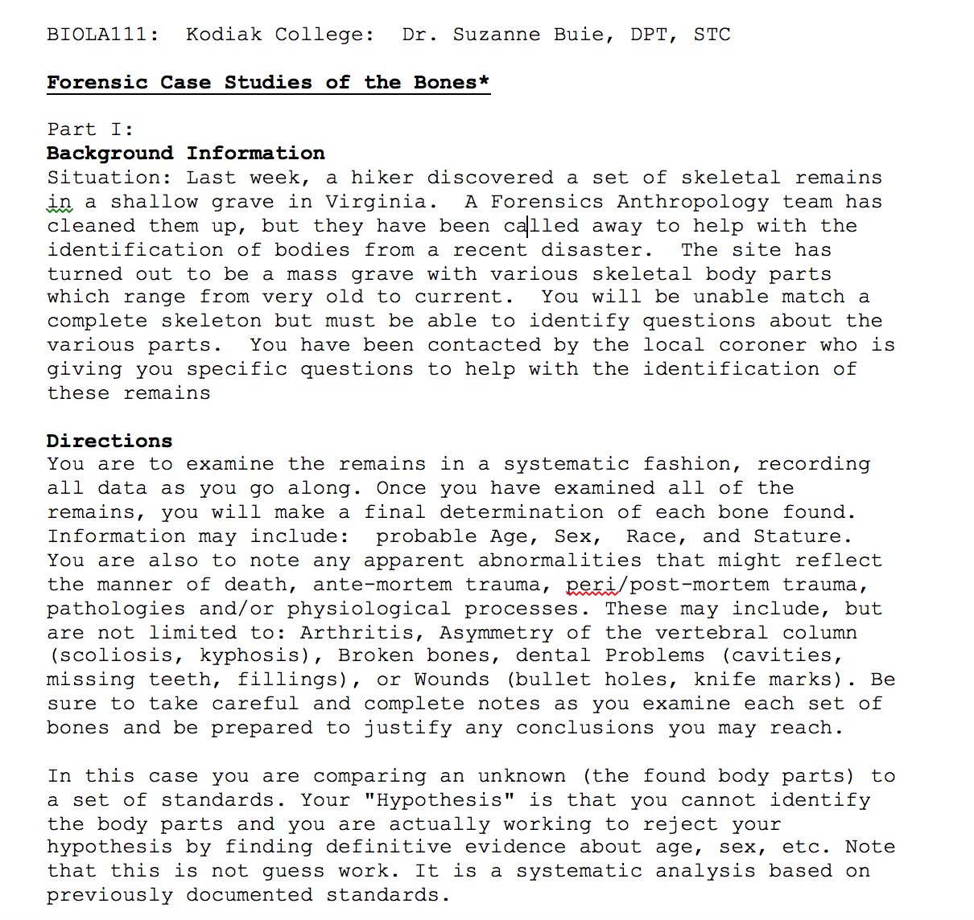
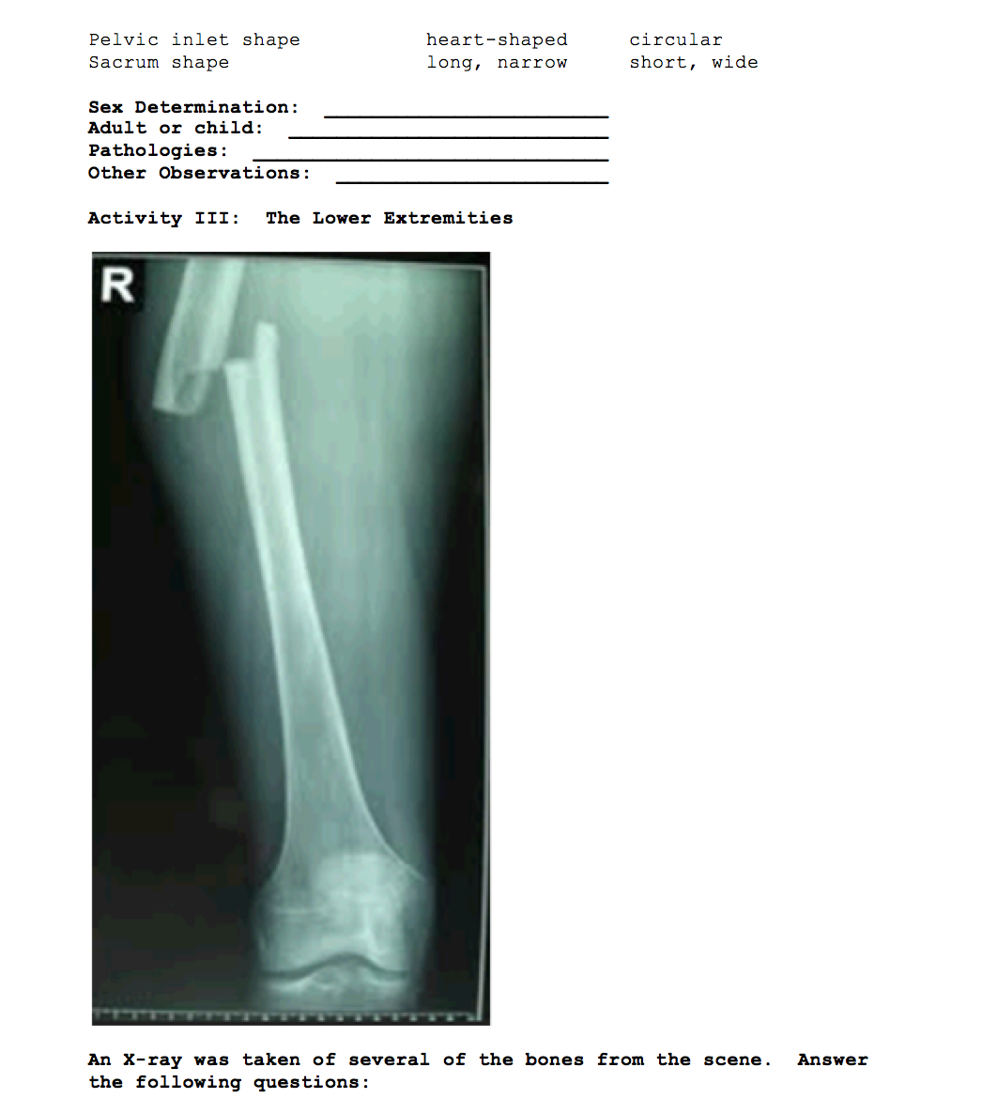
Search for OER Material on SkillsCommons.org

Slide 48
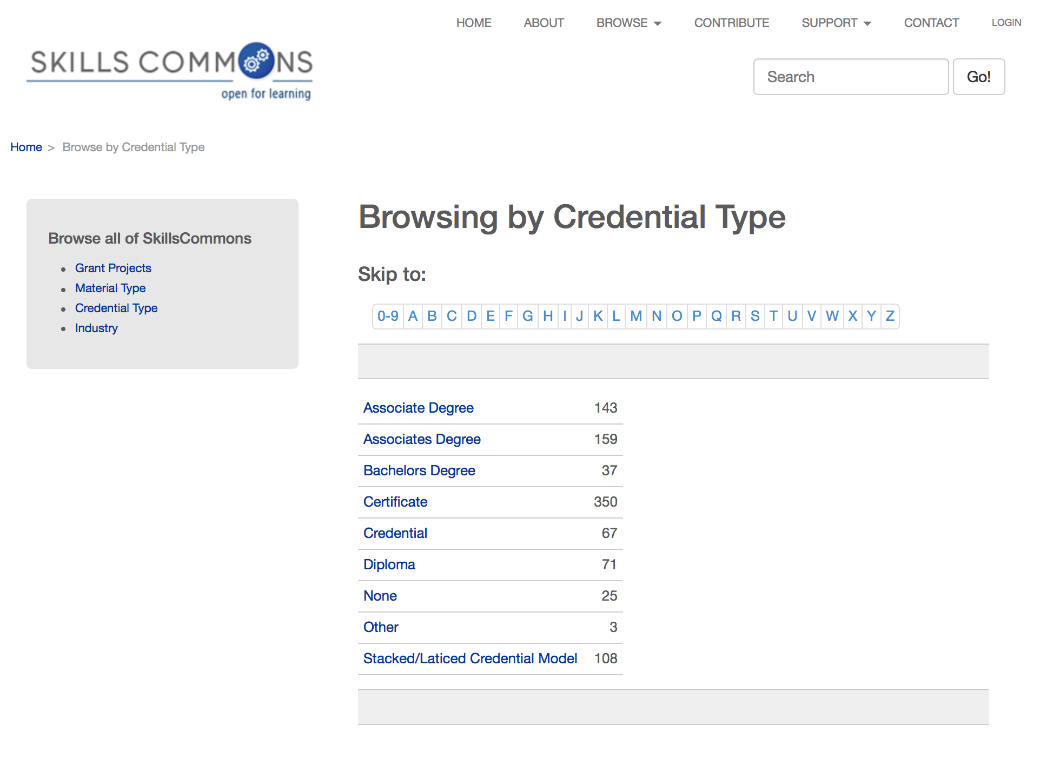
Search for OER Material on SkillsCommons.org

Slide 49
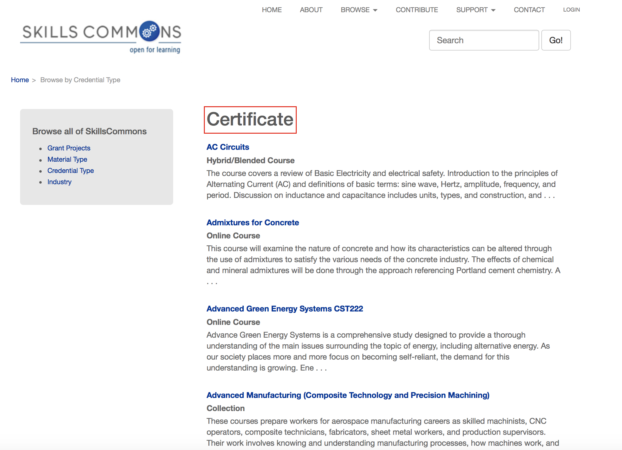
Search for OER Material on SkillsCommons.org

Slide 50
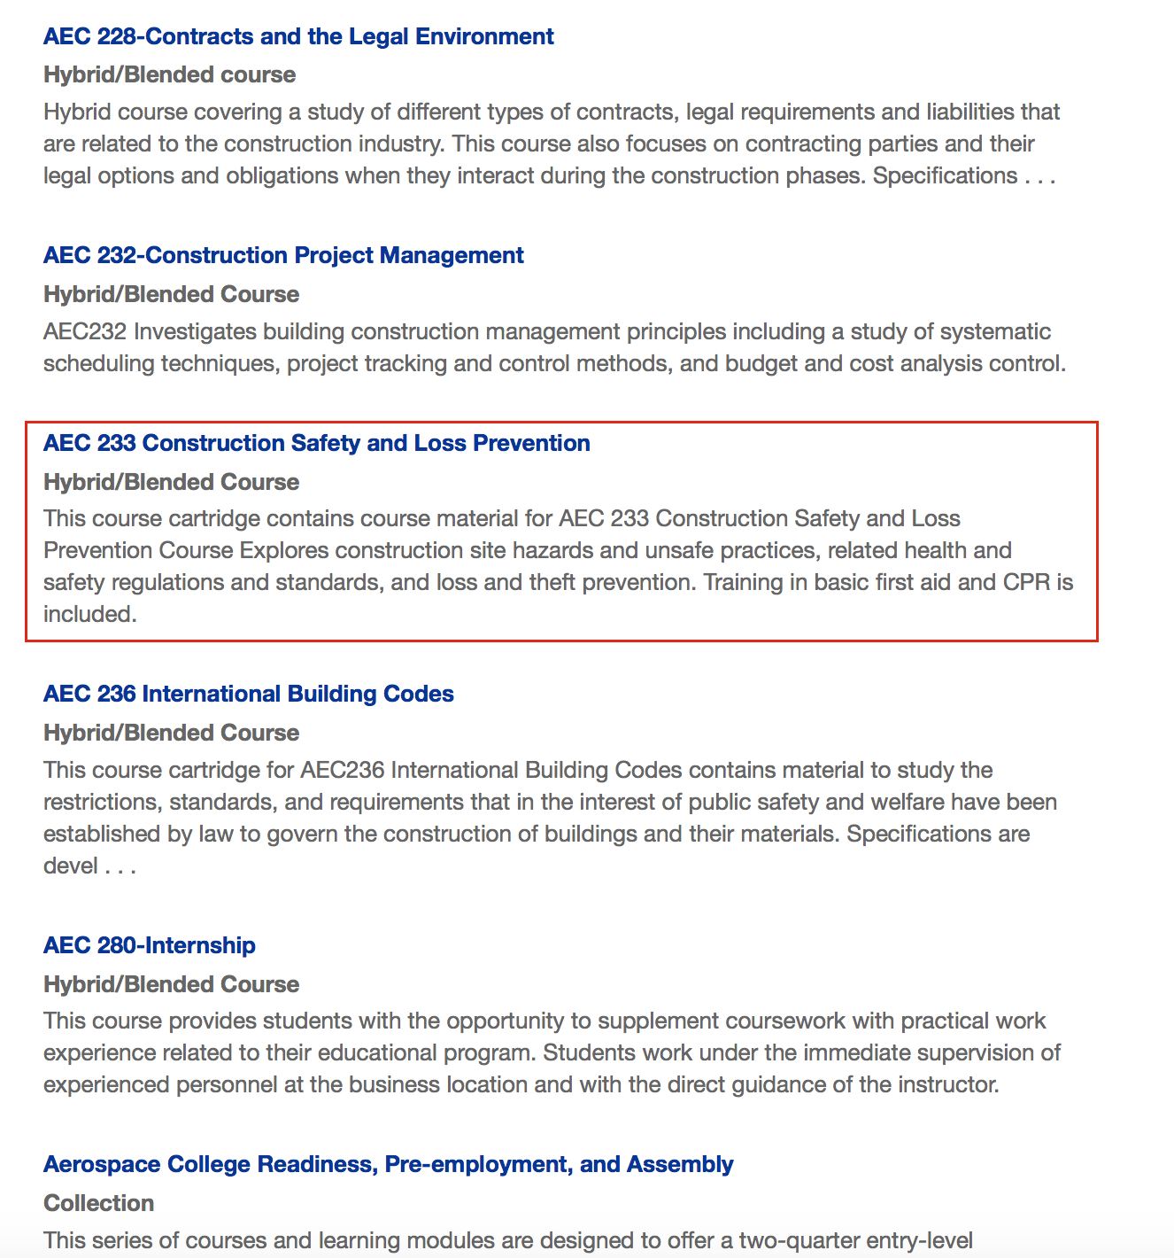
Search for OER Material on SkillsCommons.org

Slide 51
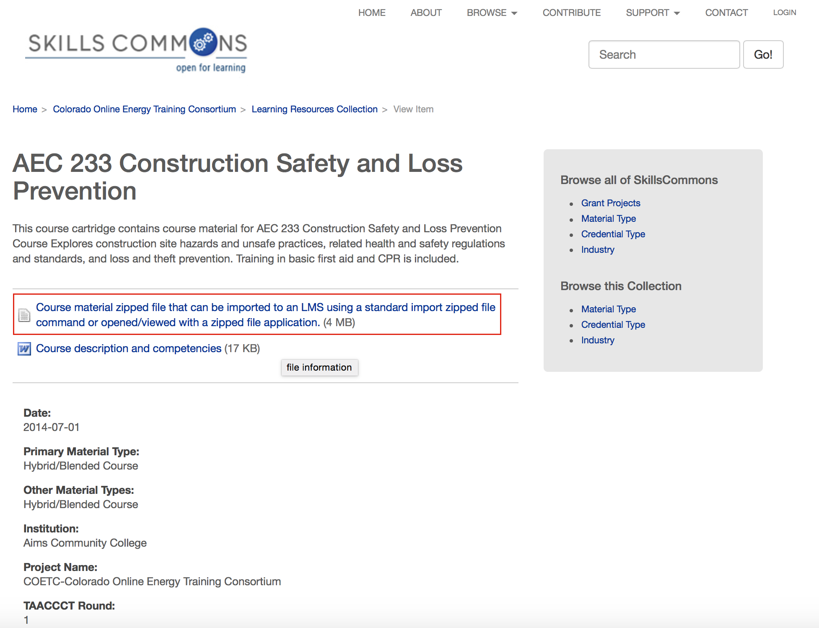
Search for OER Material on SkillsCommons.org

Slide 52
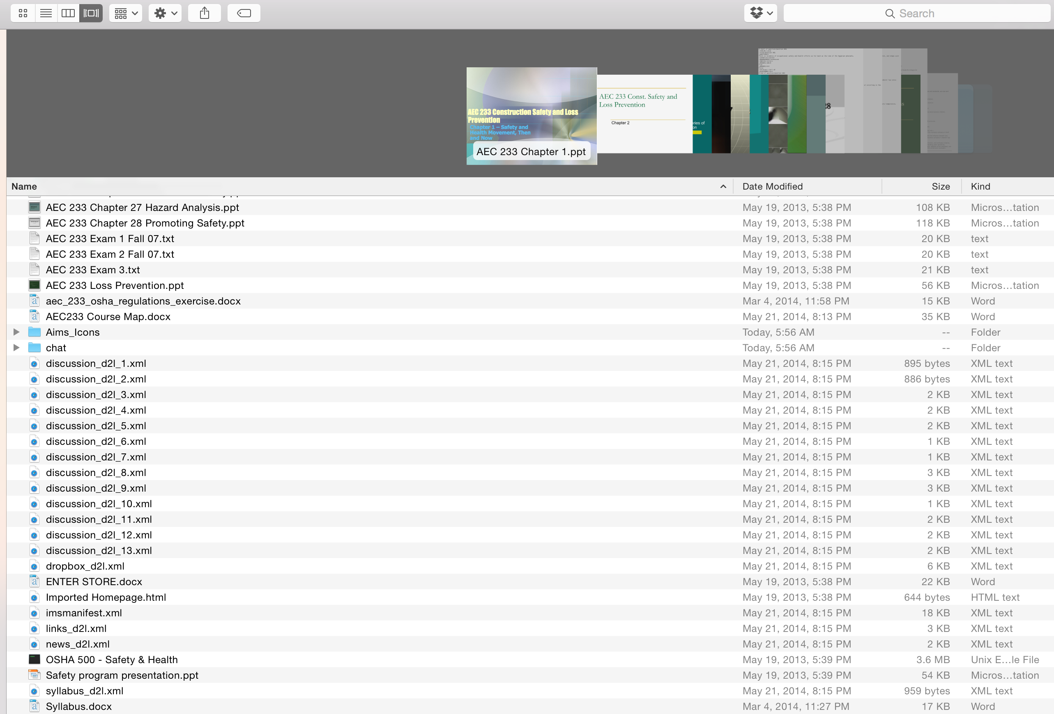
Search for OER Material on SkillsCommons.org

Slide 53
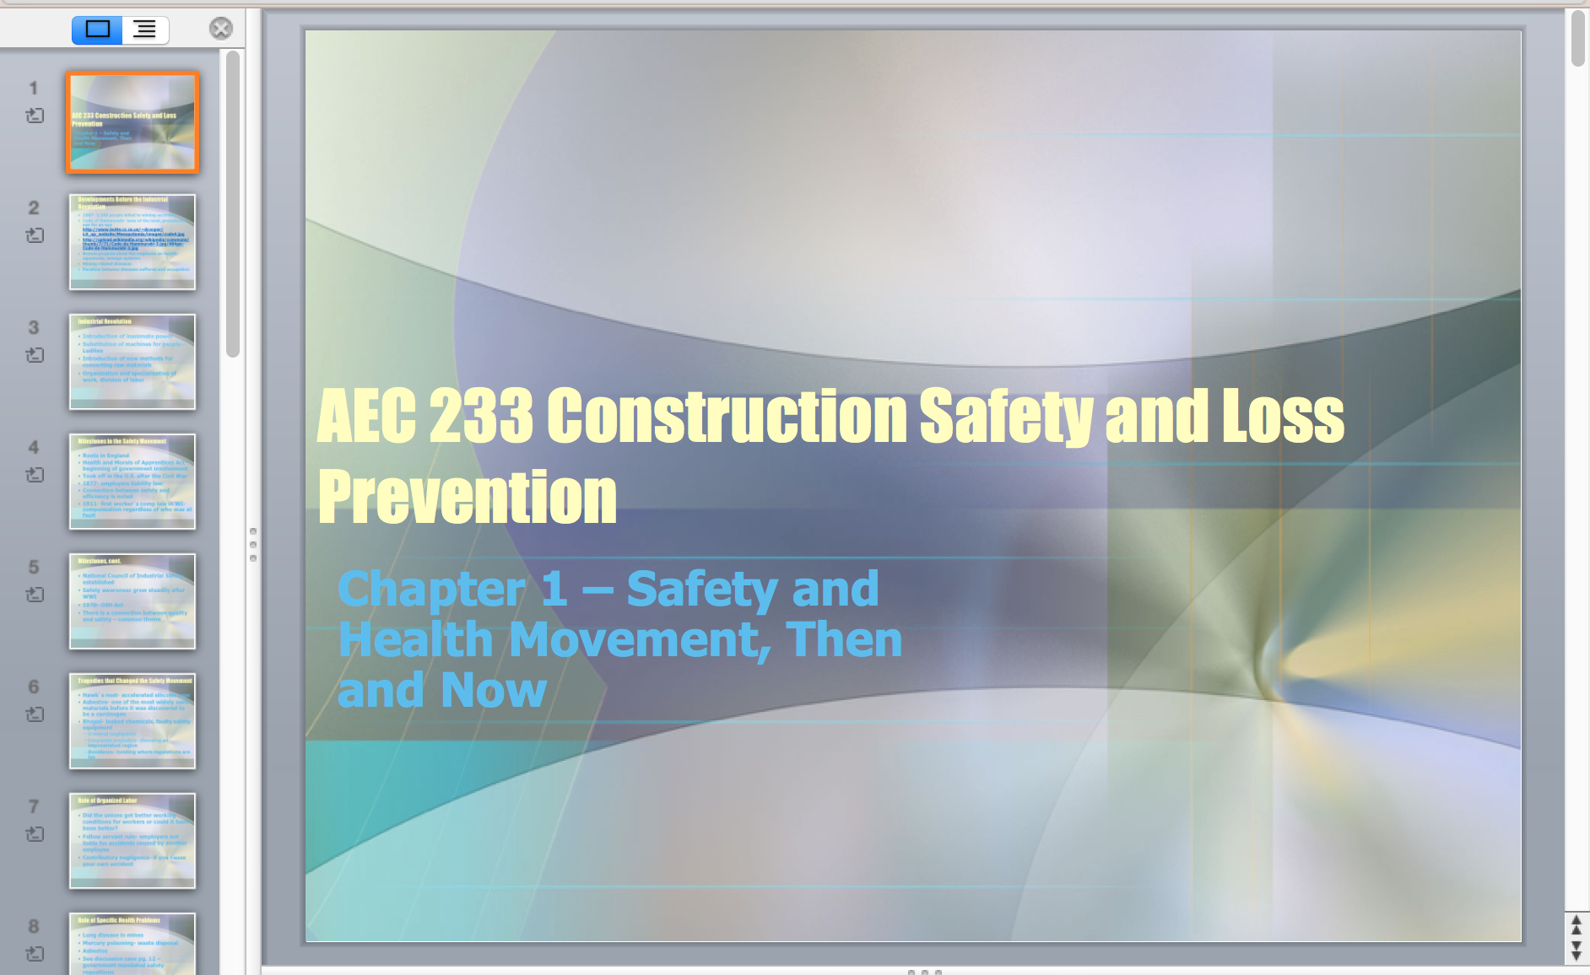
Search for OER Material on SkillsCommons.org

Slide 54
Questions
Explore the support services available from Creative Commons & Skills Commons and future plans
  Creative Commons: https://open4us.org
  SkillsCommons.org Support Services Center:
  http://support.taaccct.org/home/getting-started/
Ask questions:
Creative Commons taa@creativecommons.org
Skills Commons support@skillscommons.org

