Slide 1
Reminders:
Join the audio using your computer or by calling in. Directions can be found under the “Communicate” tab at the top of your screen.
When typing in the chat box, please select “Everyone” so we can all see the question.
Presentations and handouts can be found on the YCC Community of Practice.

Slide 2
WebEx has made some changes!
Event Information
Change the view
Meeting Controls (chat, participant list…)

Slide 3
YCC Celebration!
September 13, 2018

Slide 4
Welcome
Objectives
Celebrate our Success!
Provide a data snapshot through June 30, 2018
Provide updates on the evaluation process
Learn from YCC students and staff as they share their personal experience in the program
Share details on what TA resources will continue to be available

Slide 5
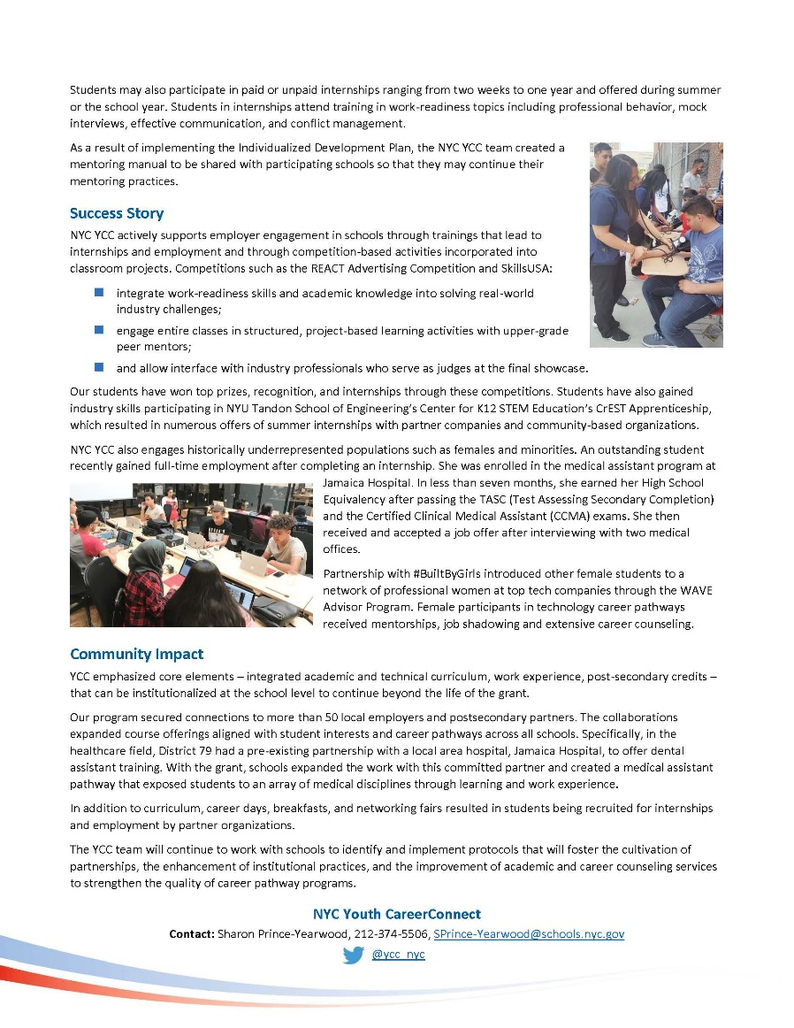
Grantee Highlights

Slide 6
Congratulations!
Amanda Ahlstrand
Administrator, Office of Workforce Investment, Employment and Training Administration, U.S. Department of Labor

Slide 7
YCC Performance And Reporting
Evan Rosenberg
Division of Youth Services, ETA/USDOL

Slide 8
Performance Measures
The ultimate goal for this program is to ensure that all program completers:
Graduate from high school with a high school diploma;
Obtain a degree or industry-recognized credential in an H-1B industry or occupation (or are on the path to attaining one), and have earned college credits towards a degree in the selected high-growth H-1B industry or occupation; and
Move into a positive placement following program participation that includes unsubsidized employment, post-secondary education, long-term occupational skills training, or a Registered Apprenticeship.
Two Sets of Measures (short- and long-term):
The short-term measures will serve as interim indicators of program progress that will help both grantees and DOL ensure that programs are on track for success.
The long-term measures are more outcome-oriented and are a gauge of program success upon completion of the grant.

Slide 9
Target Setting
Each of the 15 performance measures includes a performance target
Purpose of targets: to give grantees and DOL a sense of whether they are successful in various aspects of the program
Most of the performance measures have national targets
Some of the measures (the ones included in the grantee submitted performance matrix) have grantee specific targets set based on individual grantee program models
Grantee specific targets vary based on program year

Slide 10
Short-Term Measures
Short-term Measures:
Enrollment Rate – 100% of grantee target
Mentoring Rate – grantee target
Attendance Rate – 90%
Chronic Absence Rate – below 10%
Yearly Program Retention Rate – grantee target
Internship Placement Rate – grantee target
Internship Completion Rate - 85%
Work Readiness Indicator – 85%
Post-Secondary Credit Attainment Rate – 80%
Average Post-Secondary Credit Hours Attained – grantee target

Slide 11
Long-Term Measures
Long-term Measures:
Final Program Retention Rate – grantee target
Placement Rate – 65%
High School Diploma Attainment Rate – 85%
Credential Attainment Rate – 65%
Diploma and Credential Attainment Rate – 65%

Slide 12
National Data Through 6/30/18 Enrollment
29,323 participants enrolled nationally – far exceeds national target of 25,155 (116.6%)
6,676 participants enrolled in year 4 compared to goal of 6,551 (101.9% enrollment) – exceeds national goal
19 of 24 grantees have exceeded enrollment goals; 22 of 24 grantees either meeting or close to enrollment goal (above 80%)
37.8% of participants have exited YCC program (15.6% if you subtract successful completers) – good exit rate through 4 years
Enrollment Grantee Stars:
Kentucky: 206% (1525/740)
Pike: 164% (2049/1250)
New York City: 136% (3273/2400)
L.A.: 132% (3636/2760)

Slide 13
Attendance
Attendance Rate
95% program to date – exceeds national goal;
95.4% attendance rate for year 4
Chronic Absence Rate
13.8% program to date – not quite achieving national goal
13.2% chronic absence rate year 4
Attendance Grantee Stars:
Laurens County: 98.7% attendance and 0.5% chronic absence
PG County: 98.8% attendance and 1.2% chronic absence
JFF 97.7%: attendance and 2.7% chronic absence

Slide 14
Enrollment and Attendance Over Time

Slide 15
Demographics – Sex, Race, Ethnicity

Slide 16
Additional Demographics
Low Income: 47.7%
Limited English Proficient: 11.9%
Individuals with a disability: 6.5%
Homeless/Runaway: 1%
Pregnant/Parenting: .3%
Foster Youth: .3%

Slide 17
Grade Levels at Enrollment

Slide 18
Service Information
97% of program participants have received services
79% participated in career/academic counseling
77% participated in industry-specific YCC courses
53% participated in work experience
44% participated in leadership development
43% received supportive services
37% participated in employer-provided services
34% participated in mentoring
21% participated in community service learning
21% participated in an internship
4,055 professional development activities conducted

Slide 19
Service Comparison Over Time

Slide 20
Yearly Program Retention
Nationally at 69.4% PTD compared to goal of 82.9% - not achieving national goal
9 grantees achieving year 4 retention goal
Program Retention Grantee Stars:
Bradley County: 97.6% PTD, 98.8% year 4
Westside (Omaha): 92.8% PTD, 95.1% year 4

Slide 21
Mentoring Rate
Program to date through year 4: 34% of participants in mentoring – achieving program to date target of 31.8%!
Nationally in year 4: 25.4% of participants participated in mentoring compared to goal of 21.3%
Rates have increased significantly both program year to date and program to date compared to previous year
12 of 24 grantees meeting year 4 mentoring goals
Mentoring Grantee Stars:
Anson County: 90.3% PTD, 92.3% in year 4
St Paul (ISD 625): 86.5% PTD, 82.4% in year 4
Colorado City: 84.0% PTD, 79.5% in year 4

Slide 22
Internship Placement Rate
Program to date through year 4: 17% of participants placed in internships – not achieving goal of 46.9% program to date
3 grantees achieving internship placement goal program to date
Nationally in year 4: 9.4% of participants participated were placed in internships compared to goal of 28.6%
3 grantees achieving internship placement goal for program year
96.3% work readiness attainment for those who have completed internships
Internship Placement Grantee Stars:
Puerto Rico: 62.2% PTD (96% of goal)
Rosemount, MN (ISD196): 32.8% PTD (106% of goal)
Manufacturing Renaissance: 31.9% PTD

Slide 23
Post-Secondary Credit Attainment
9,470 (32.3%) students have attained postsecondary credit PTD
Significant increase compared to end of year 3 (5,180, 24%)
Average of 10.5 credits per student for those who have earned credit
9 grantees over 50% of participants attaining post-secondary credit (6 over 70%; 3 over 80%)
Post-Secondary Credit Attainment Grantee Stars:
Putnam County: 92.9% PTD, 26.2 average number of credits
Ivy Tech: 87.5% PTD, 11 average number of credits
Pima County: 18.4 average number of credits
3,696 participants have attained an industry-recognized credential
Increased from 2,065 at end of year 3
Credential Grantee Stars:
Anson County 303 (87% of all participants)
Galveston 250

Slide 24
Long-Term Performance Indicators
Program Completion Rate 53.4% program to date
47.5% program completion for year 4
10 grantees have program completion rates at or above 70% (4 above 80%)
Program Completion Grantee Stars:
Putnam County: 86% PTD
East San Gabriel Valley: 83.8% PTD
High School Diploma Attainment Rate 67.6% program to date
17 grantees have HS diploma attainment rates above 70% (12 at or above 80%)
HS Diploma Attainment Grantee Stars:
Upper Explorerland: 98.4% PTD
Putnam County: 91.0% PTD
East San Gabriel Valley: 87.8% PTD

Slide 25
PTS Guidance for Remainder of Grant
If grant is ending on Sep 30, 2018, make sure to submit final QPR for quarter ending Sep 30, 2018
Reminder: PTS has data export feature if you want to export any of your data – instructions for data export sent via email recently and also in PTS handbook
Grantees who have period of performance extensions:
Continue inputting data into PTS and submitting QPRs until grant ends
Make sure to enter participation dates for year 5 to ensure accurate yearly program retention
No new enrollments beyond Sep 30, 2018
PTS will remain live and available for use through Oct 2019

Slide 26
YCC Evaluation Overview
Impact study using lottery-based design in 4 sites and comparison group design in up to 18 sites:
What are the impacts on students’ short-term outcomes associated with education and employment success?
Do impacts vary by student and grantee characteristics?
Implementation study in all 24 sites:
What types of students does YCC serve?
What program components are being implemented?
What distinguishes YCC from other programs?
What challenges do grantees face in implementing YCC?
How do grantees plan to sustain the program beyond the grant period?

Slide 27
YCC Evaluation Timeline
Activity | Timeline
Student follow-up survey in three selected sites | Fall 2018
School records collection in 18 school districts | Summer/Fall 2018
Short report on implementation changes over time and sustainability | Spring 2019
Short report on employer and workforce partnerships | Spring 2019
Final report on YCC impacts | Winter 2019

Slide 28
Grantee-Student Panel
Maisha Meminger (Moderator)
Division of Youth Services, ETA/USDOL

Slide 29
Northeast Iowa Career Learning Link
Gena Gesing, Upper Explorerland Regional Occupational Program, Northeast Iowa Career Learning Link , Iowa
Taylor Hepperle, Senior, West Central High School
Pathway: Advanced Manufacturing
Joseph Lamphere, Senior, West Central High School
Pathway: Advanced Manufacturing

Slide 30
Northeast Iowa Career Learning Link
Program Model: Grades 11 – 12
Industry Focus: Health, Business/Finance, STEM, Advanced Manufacturing and Information Technology
Program to Date (July 2014 – June 2018)

Slide 31
Youth Empowerment for Success (YES)
Katherine Reid, Putnam County high School, Youth Empowerment for Success, Georgia
Hunter Franks, Senior, Putnam County High School
Pathway: Health Sciences

Slide 32
Youth Empowerment for Success (YES)
Program Model: Grades 10 – 12
Industry Focus: Healthcare, Information Technology, and Welding
Program to Date (July 2014 – June 2018)

Slide 33
Pike High School
Kathy Sharpe, Pike High School, Indiana
Martin Dix, Senior, Pike High School
Pathway: Engineering

Slide 34
Pike High School
Program Model: Grades 9 – 12
Industry Focus: Advanced Manufacturing, Engineering, Biomedical and Health Sciences, Information Technology
Program to Date (July 2014 – June 2018)

Slide 35
Grantee-Student Panel
Gena Gesing, Northeast Iowa Career Learning Link, Iowa
Taylor Hepperle, Senior, West Central High School
Pathway: Advanced Manufacturing
Joseph Lamphere, Senior, West Central High School
Pathway: Advanced Manufacturing
Katherine Reid, Youth Empowerment for Success, Georgia
Hunter Franks, Senior, Putnam County High School
Pathway: Health Sciences
Kathy Sharpe, Pike high School Indiana
Martin Dix, Senior, Pike High School
Pathway: Engineering

Slide 36
Technical Assistance
Angella Brown
Project Lead, High Impact Partners

Slide 37
TA Resources
TA Contract extended through March 2019
TA Coaches, limited availability
YCC Community of Practice
National Data Infographic
Webinars, Peer-to-Peer Calls
YCC Mailbox

Slide 38
Thank you!!

