Slide 1
Getting Started with Social Media, Part Two
Webinar Date: May 17, 2016
2:00PM ET
U.S. Department of Labor
Employment and Training Administration
Division of Youth Services

Slide 2
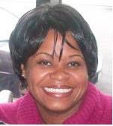
Moderator
Maisha Meminger
Division of Youth Services
U.S. Department of Labor
Employment and Training Administration
Notes:
Miasha intoduce Webinar-Run Through the Agenda then pass to Tressa.

Slide 3
Objectives
How to create your social media plan
Engagement pitfalls and troubleshooting
Management deck set-up

Slide 4
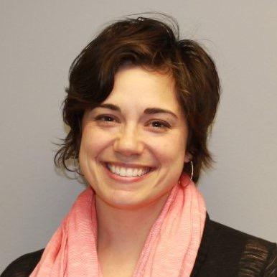
Subject Matter Expert
Elizabeth Vassolo
Director of Marketing and Communications, Women’s Business Development Center
@Liz_Vassolo

Slide 5
The goal is to engage with YOUR network on social media, not with the entire social media network.

Slide 6
You will spend more time on account management than content creation.

Slide 7
Rules of Engagement
If you want people to pay attention to you, you must pay attention to them first.
Make your interactions a combination of original, curated and responsive content.
Follow your in-person network online and then build from there.

Slide 8
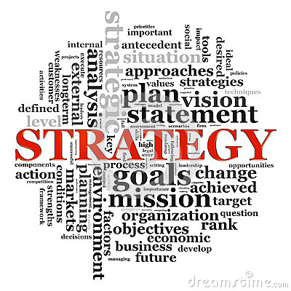

Slide 9
Creating a Social Media Strategy
Roles and Frequency
Metrics
Management Decks
2

Slide 10
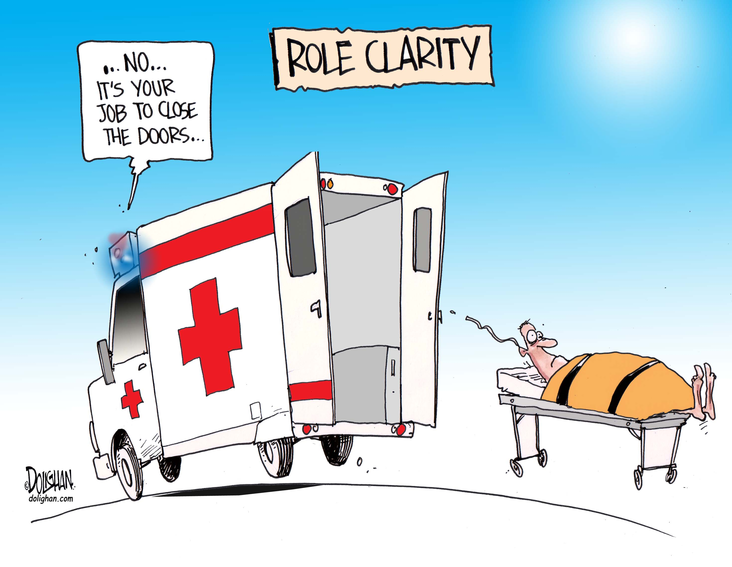
Assigning Roles

Slide 11
Engagement Frequency
Twitter 4 to 10 times a day
Facebook 1 to 4 times a day
Instagram 1 to 2 times a day
LinkedIn 3 to 4 times a week

Slide 12
Metrics
Generate revenue (event attendance)
Network growth
Meaningful interaction (hashtag info, conversation)

Slide 13
Social Media Policy
Negative Comments
Cyberbullying
Content Sources
Approvals
Budget

Slide 14
Facebook

Slide 15
Timing Function

Slide 16
Metrics

Slide 17
Metrics

Slide 18
Hootsuite
4

Slide 19
Hootsuite

Slide 20
Hootsuite

Slide 21
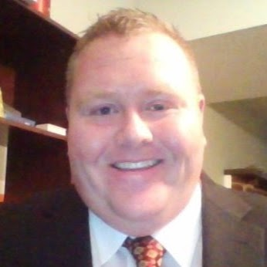
Grantee Speaker
Clabe Slone
YCC Project Director
Kentucky Educational Development Corporation
www.ycc10.webs.com
#ycc10

Slide 22
Contact Us
U.S. Department of Labor
Employment and Training Administration
200 Constitution Avenue, NW, Room N-4456
Washington, DC 20210
Email: ycc@dol.gov
24

Slide 23
June training: TBD YCC National Grantee Conference July 20-21, 2016

Slide 24
Thank you!

