Slide 1
Introduction to the Building Trades Multi-Craft Core Curriculum
overview for YouthBuild Grantees
North America’s Building Trades Unions /YouthBuild USA

Slide 2
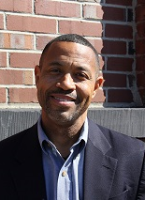
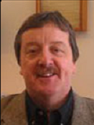
Introduction
Daryl Wright
Vice President , Employer Partnerships
YouthBuild USA
Somerville, MA
Tom Kriger
Director of Research
North America’s Building Trades Unions
Washington, DC

Slide 3
Today’s Objectives
Describe the Building Trades Multi-Craft Core Curriculum (MC3)
Explain the purpose and benefits of MC3
Discuss the steps involved in implementation

Slide 4
Basic Elements of the MC3
120-hour Apprenticeship Readiness Curriculum
Nine Chapters
Delivered in cooperation with local or State Building Trades Councils

Slide 5
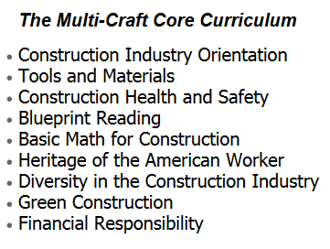
The Multi-craft Core Curriculum

Slide 6
Pillars of the MC3 Coordinators Training
Curriculum Overview
Participatory Teaching Methods
Partnership Development

Slide 7
Benefits of MC3, Building Trades Perspective
Providing opportunities for candidates from diverse backgrounds
Recruiting, supporting and referring candidates
Prepares candidates for labor management-sponsored registered apprenticeship programs

Slide 8
Benefits of MC3, YouthBuild Perspective
MC3 is an industry-recognized credential
MC3 helps grantees meet standards for pre-apprenticeship under WIOA
Enhances participant access to Registered Apprenticeship training

Slide 9
Pre-Apprenticeship Program Strategies
(WIOA Final Rule 681.480)
Approved training and curriculum that aligns with needs of employers
Access to appropriate supportive services
Meaningful hands-on learning activities that are connected to education and training activities
Opportunities to attain at least one industry-recognized credential
A partnership that assists with placing individuals into Registered Apprenticeships

Slide 10
Becoming an MC3 Program:
Steps for YouthBuild grantees
Step #1: Complete the MC3 Coordinators Training
Step #2: Develop an implementation plan with local Building Trades Council
Step #3: Gain access to online learning management system

Slide 11
Contact
Daryl Wright
YouthBuild USA
T: 617-741-1208
dwright@youthbuild.org
Tom Kriger
North America’s Building Trades Unions
202-756-4688
tkriger@buildingtrades.org

Slide 12
Closing

