Slide 1
Working with the Public Workforce System
Webinar Date: April 17th, 2014
Presented by:
U.S. Department of Labor
Employment and Training Administration

Slide 2
Moderators
Thomas Hooper
Program Manager
Department of Labor
Annette Summers
President
Giuffrida Associates

Slide 3

Here’s what you can expect to get out of this webinar!
Learn first-hand accounts of ways peers have overcome challenges and turned them into success stories
Identify ways you can apply successful innovations to your own practice
Recognize key ways to establish effective partnerships through the Workforce System
Understand the value of effectively working with the Public Workforce System and how you can build this into your system

Slide 4

Agenda
Introductions
Presentation by Cynthia Andrews
Presentation by Scott Jedele
Presentation by Carol Weigand
Question & Answer Period
Closing Remarks
  Please join us on April 23th at 3:00pm EDT for a Follow up Teleconference. We’ll answer Q&A from this webinar in a more interactive exchange.

Slide 5
Presenters
Cynthia Andrews
Oregon CASE Consortium
Clackamas Community College
Scott Jedele
Multi-State Advanced Manufacturing Consortium
Henry Ford Community College
Carol Weigand
Air Washington Project
Spokane Community College

Slide 6
Presenter
Cynthia Andrews
Oregon CASE Consortium
Clackamas Community College

Slide 7
Oregon CASE Consortium
Statewide consortium of all 17 Oregon community colleges
CASE targets 6 main industry career-focus areas and multiple occupations within each area: Business and Management, Food and Natural Resources, Health Services, Human resources and Industrial and Engineering Systems
Most training is non-cohort. More than 3800 enrollees to date.

Slide 8
CASE has Positive Workforce Involvement
CASE has had collaboration with workforce partners since its inception. Representatives from TAA, the Employment Department, the state Career Pathways Initiative, WIA and Work Source Centers were involved in grant development. We wanted to address student movement through the system, data-gathering and information sharing barriers.
Active representation from these organizations continues on both the grant Management Team and the statewide Implementation Team.
All 17 local projects were required to work with the TAA liaison, their local Workforce Investment Boards, Work Source Centers, and WIA programs. This became part of their local project evaluation by the Management Team.
IGA’s were developed between the colleges and TAA and with the Oregon Employment Department to address sharing of information and data.
Project leaders are participating in statewide workforce re-design.

Slide 9
Promising Practices (Advice)
Involve workforce partners early in the grant’s development and implementation.
Involve workforce partner representatives in grant management, planning and implementation. Communicate regularly.
Use grant funds to hire a TAA grant liaison to work directly with the grant to provide two- way communication, TAA training to colleges, and data.
Report regularly to workforce partners. Gather and share good data.

Slide 10
Contact Information
CASE Statewide Director: Cynthia Andrews, Clackamas Community College, cyndia@clackamas.edu, 503-594-3025
CASE TAA Liaison: Laura Lausmann, Oregon TAA Central Trade Act Unit, laura.e.lausmann@state.or.us, 503-947-1236
CASE Statewide Data Analyst: Heather Fercho, Clackamas Community College, hfercho@clackamas.edu, 503-5894-6089

Slide 11
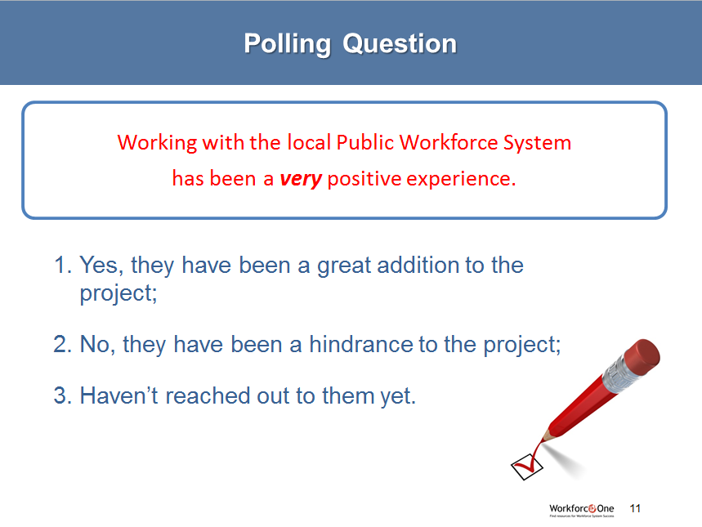

Polling Question
Working with the local Public Workforce System
has been a very positive experience.
Yes, they have been a great addition to the project;
No, they have been a hindrance to the project;
Haven’t reached out to them yet.

Slide 12
Presenter
Scott Jedele
Multi-State Advanced Manufacturing Consortium
Henry Ford Community College

Slide 13


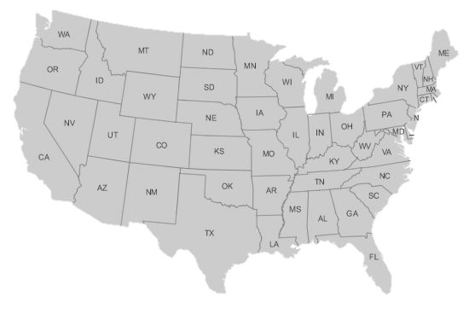











Multi-State Advanced Manufacturing Consortium
Aero Firms
Chrysler
Chrysler
Ford
GM
Ford
Honda
WCOMC
Toyota
WHAT: Improve manufacturing education for Industry & Students
WHO: 13 Colleges &
many Industry Partners
Goodyear
Tire & Rubber
Ford
Toyota
Universal
Woods
DENSO
B&WY12
GM
Kelly Aviation Center
Toyota
BMW
ESAB Welding
Toyota
Honda & CARCAM
Nissan

Slide 14
Opportunity for Improvement
LEAD IMPROVEMENT THROUGH PARTNERSHIP . . .
PRESENT STATE: PREFERRED STATE: (New Model)
INDUSTRY
* Teach “work specific” skills * Validate “Work specific” skills on-the-job
* Request educational topic areas * Verify educational competencies
STUDENTS
* Learn to repair components * Learn to troubleshoot integrated systems
* Receive information * Require information to solve problems
* Success grounded in hours & theory * Success grounded in competence
FACULTY
* Subject Matter Expert (SME) / Lecturer * SME / Mentor / Learning Process Expert
WORKFORCE SYSTEM
* Struggle with System & Service * Partner in Improvement Process
TECHNOLOGY
* Designed for college applications * Equivalent to current Industry technology . . .

Slide 15

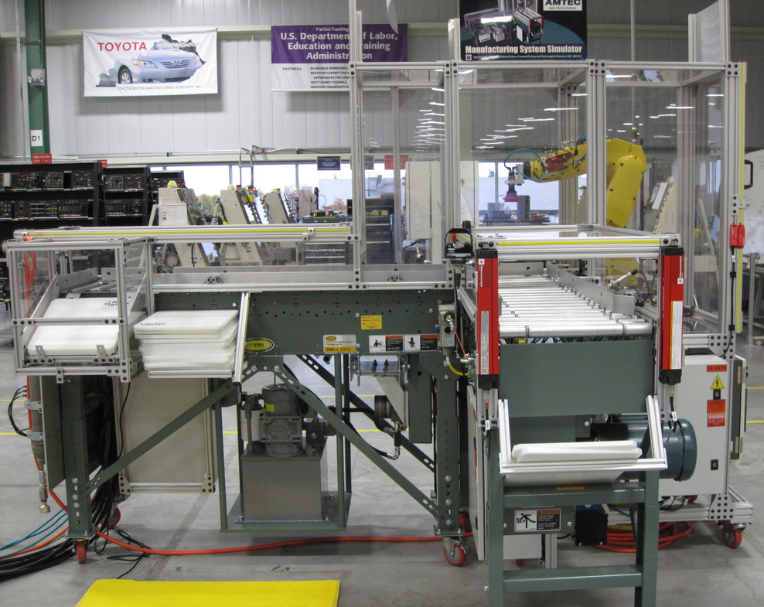
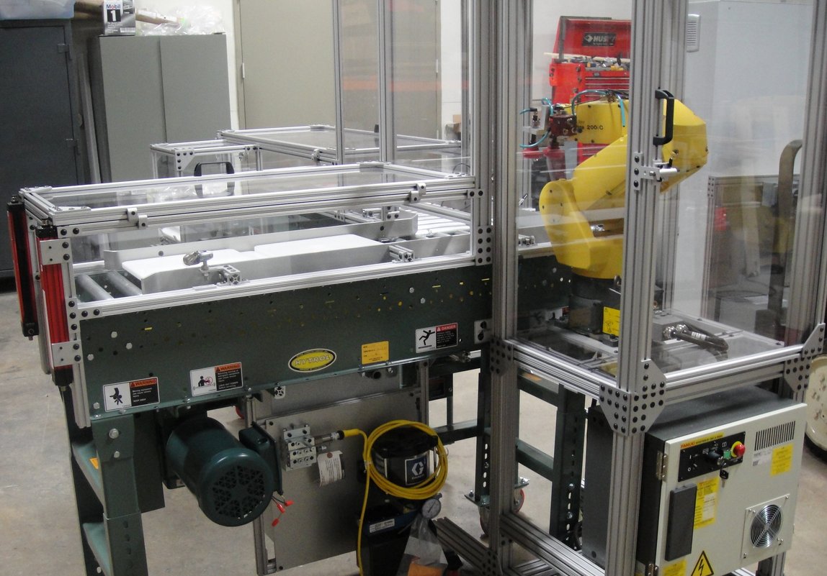
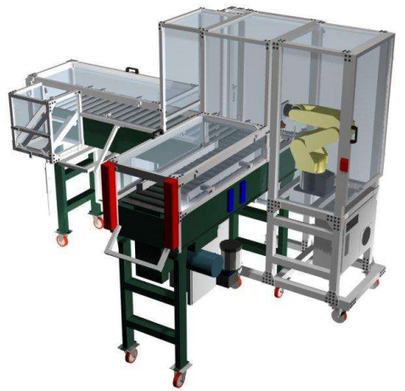
Leading Improvement through Technology
MANUFACTURING SIMULATOR
FAULT BASED – INTEGRATED SYSTEM – (Hands-On)

Slide 16

Contact Information
Multi-State
Advanced Manufacturing Consortium
GARY SAGANSKI
Project Director
313-845-9656
saganski@hfcc.edu
SCOTT JEDELE
Program Manager
313-845-9873
sfjedele@hfcc.edu

Slide 17
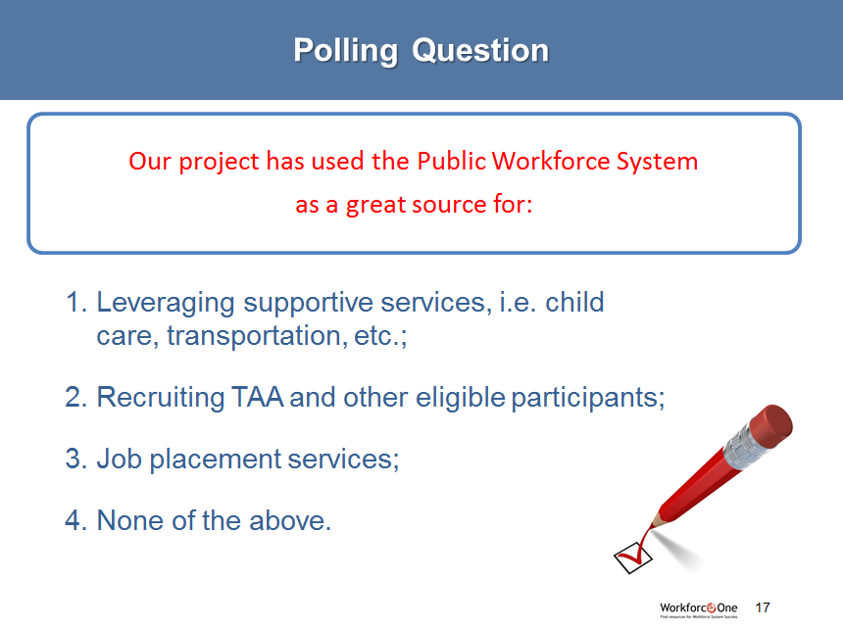
Polling Question
Our project has used the Public Workforce System
as a great source for:
Leveraging supportive services, i.e. child care, transportation, etc.;
Recruiting TAA and other eligible participants;
Job placement services;
None of the above.

Slide 18
Presenter
Carol Weigand
Air Washington
Spokane Community College

Slide 19

Who we are….
A consortium of 11 Community and Technical Colleges, 7 Workforce Development Councils (WIB) and over 100 industry partners linked together to create the most skilled aerospace workforce in the world.

Slide 20
Co-location
Systems/Cultures
Deliverables
Industry Confusion
Who is my contact?
Who knows my workforce needs?
Quantifying Outcomes
Different ways of measuring success
Challenges

Slide 21
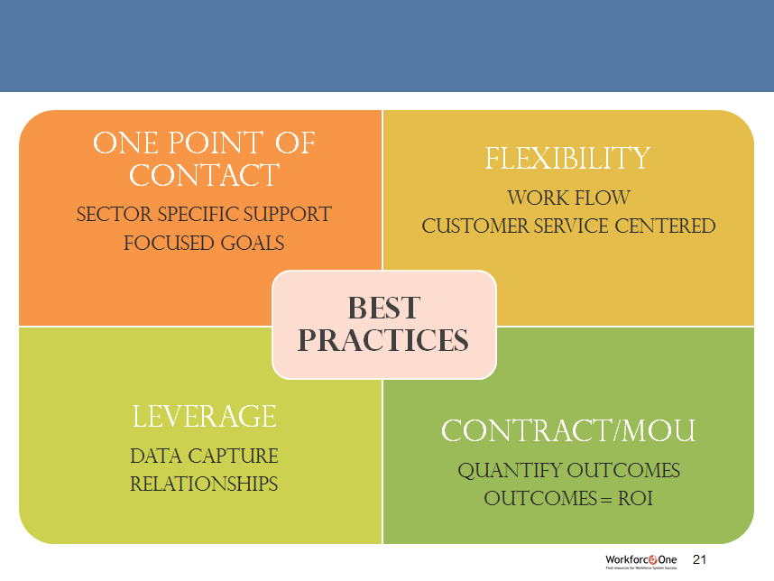
One Point of contact
Sector specific support
Focused goals
Best Practices
flexibility
Work flow
Customer service centered
Leverage
DATA capture
Relationships
Contract/MOU
Quantify outcomes
Outcomes = ROI

Slide 22

For additional information
contact:
Carol Weigand
Air Washington Director
509-533-7344
cweigand@scc.spokane.edu

Slide 23

Reminder…
Follow up Teleconference will be held on
April 23rd from 3:00pm to 4:00 pm EDT
Conference Call-In: 1-866-736-7001
Access Code: 8206573

Slide 24

Resources
Please take a look at the uploaded documents to download valuable materials provided to you by today’s presenters.

Slide 25

Please enter your questions in the Chat Room!

Slide 26

Speakers’ Contact Information
Speaker: Cynthia Andrews
Title: CASE Statewide Director
Organization: Clackamas Community College
Email: cyndia@clackamas.edu
Speaker: Scott Jedele
Title: Industry Program Manager
Organization: Henry Ford Community College
Email: sfjedele@hfcc.edu
Speaker: Carol Weigand
Title: Air Washington Project Director
Organization: Spokane Community College
Email: carol.weigand@scc.spokane.edu

Slide 27
Look for upcoming Webinars in this series!
SAVE
DATE
the
Participant Placement Strategies
May 8th 2:00pm-3:00pm EDT
Performance Management
May 15th 3:00pm-4:00pm EDT
Success Coaches/ TAA Navigators
May 29th 3:00pm-4:00pm EDT

Slide 28
Thank You!
Find resources for workforce system success at:
www.workforce3one.org

