Slide 1
StoryTelling Strategies & Tools to Sustain Innovations
TAACCCT Round 4 Convening 2017
Washington, D.C.

Slide 2
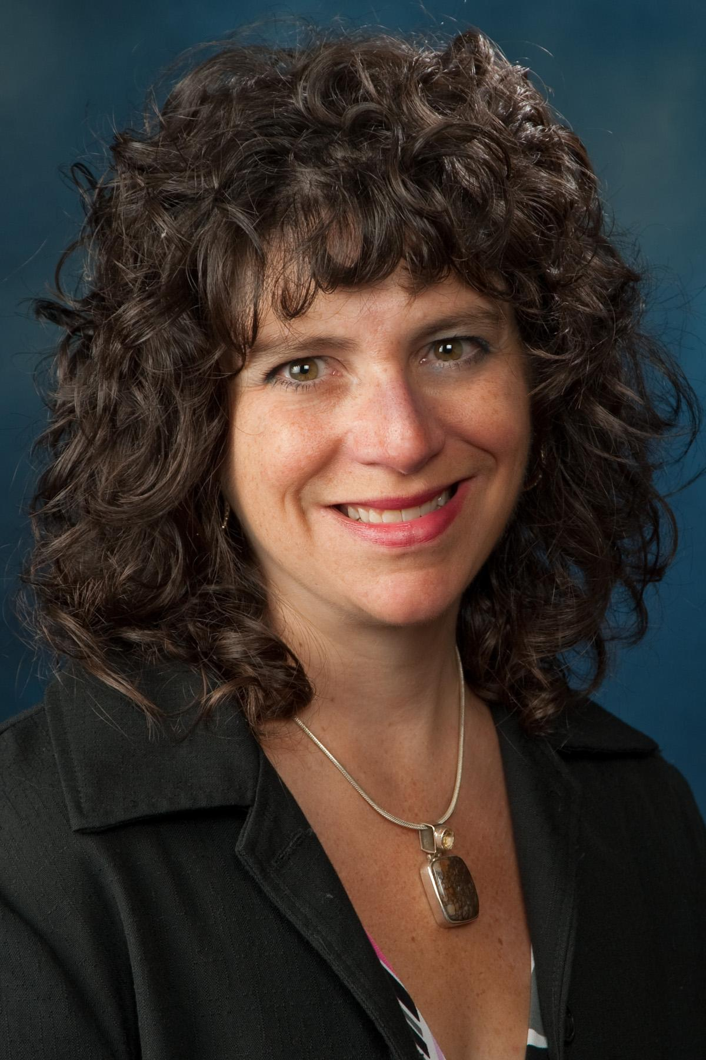
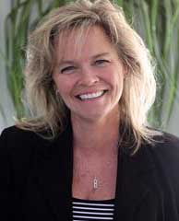
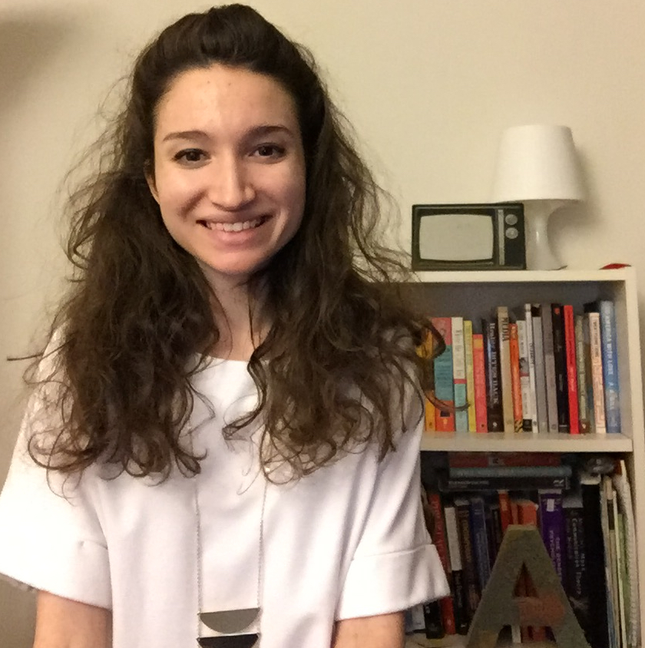
StoryTelling Ambassadors
Helene Mancuso
Project Manager
TAACCCT Grant
Kathy Spada
Project Manager
INTERFACE Consortium
Maria Fieth
Program Manager, Communications & Community
Skills Commons
Nanticoke, PA
Wausau, WI
Long Beach, CA
Alexandra Shinert
Communications/Program Assistant
Northeast Resiliency Consortium
Nicolette van der Lee
Program Coordinator
Office of Continuing Education & Training
Paterson, NJ
Kahului, HI

Slide 3
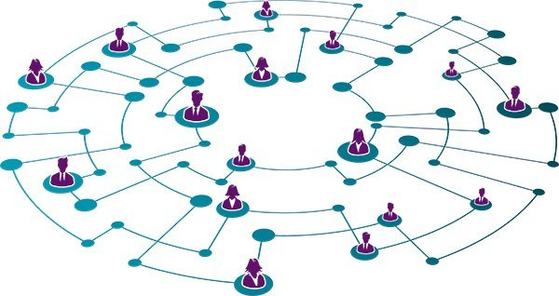
Making the Case for Storytelling

Slide 4
Project, Program and Portfolio Management
Portfolio
Programs
Projects

Slide 5
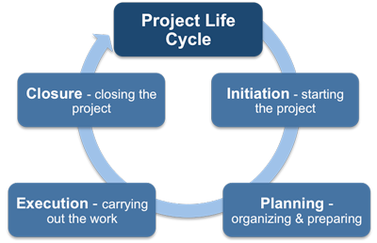
Defining Our Projects (Stories)

Slide 6
Case Study: Story of Food Innovation in Hawaii

Slide 7
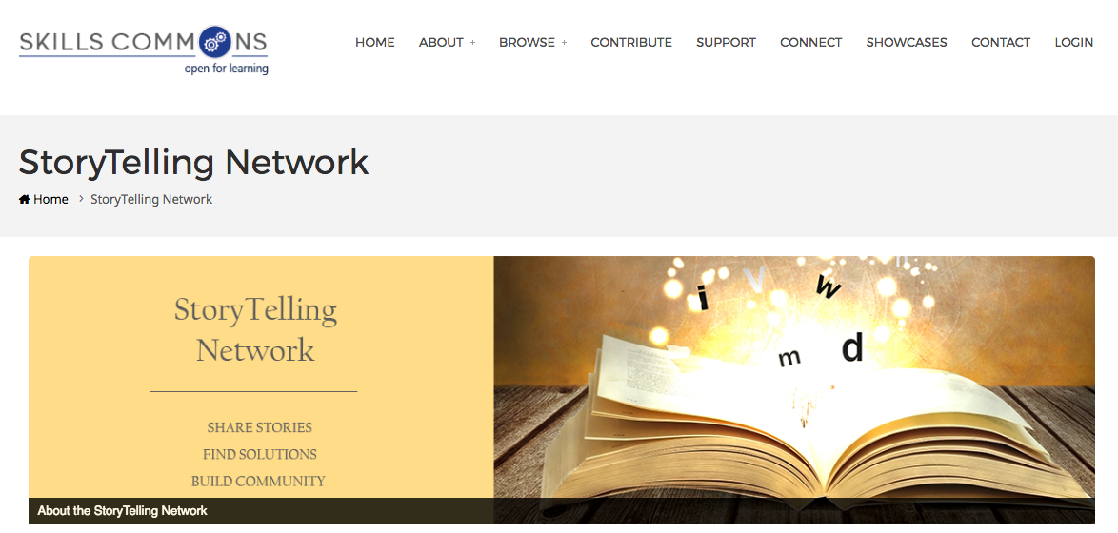
StoryTelling Toolkit
Storytelling Toolkit
Rubric
Project Brief
Script
Lessons Learned
http://support.skillscommons.org/connect/impact-communities/story-telling/

Slide 8
Elements of Good Stories
Character
Plot
Voice
Emotions
A Hook
Engagement

Slide 9
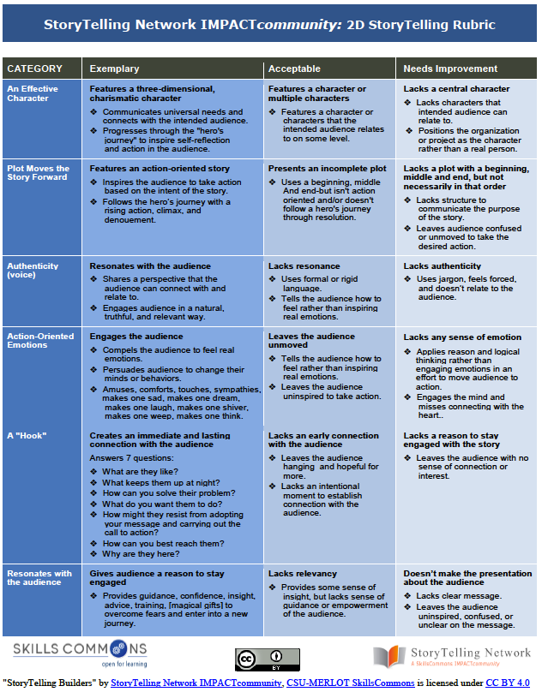
StoryTelling Rubric
Storytelling Toolkit
Rubric
Project Brief
Script
Lessons Learned
Evaluating Your Story
5 Categories
3 Levels
Continuous improvement

Slide 10
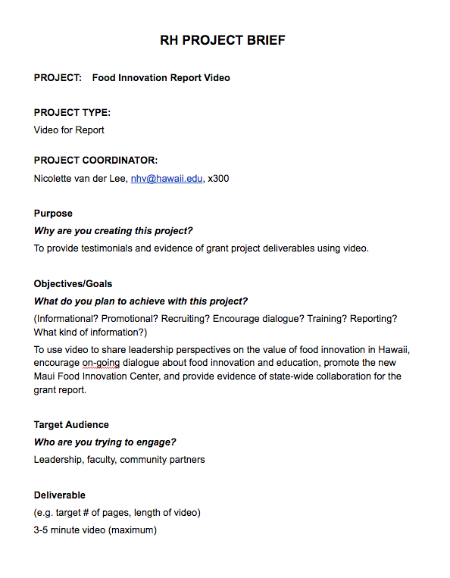
StoryTelling Project Brief
Storytelling Toolkit
Rubric
Project Brief
Script
Lessons Learned
Describe the Project:
Purpose/Objectives/Goal
Target Audience
Deliverable

Slide 11
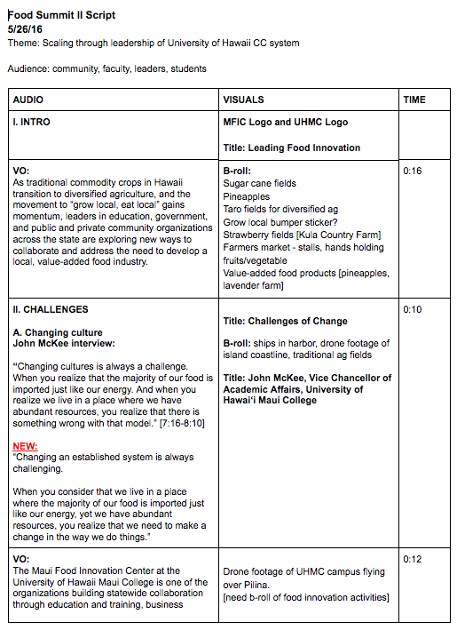
StoryTelling Script
Storytelling Toolkit
Rubric
Project Brief
Script
Lessons Learned
Scripting Your Story:
Write the narrative
Identify the visuals
Time

Slide 12
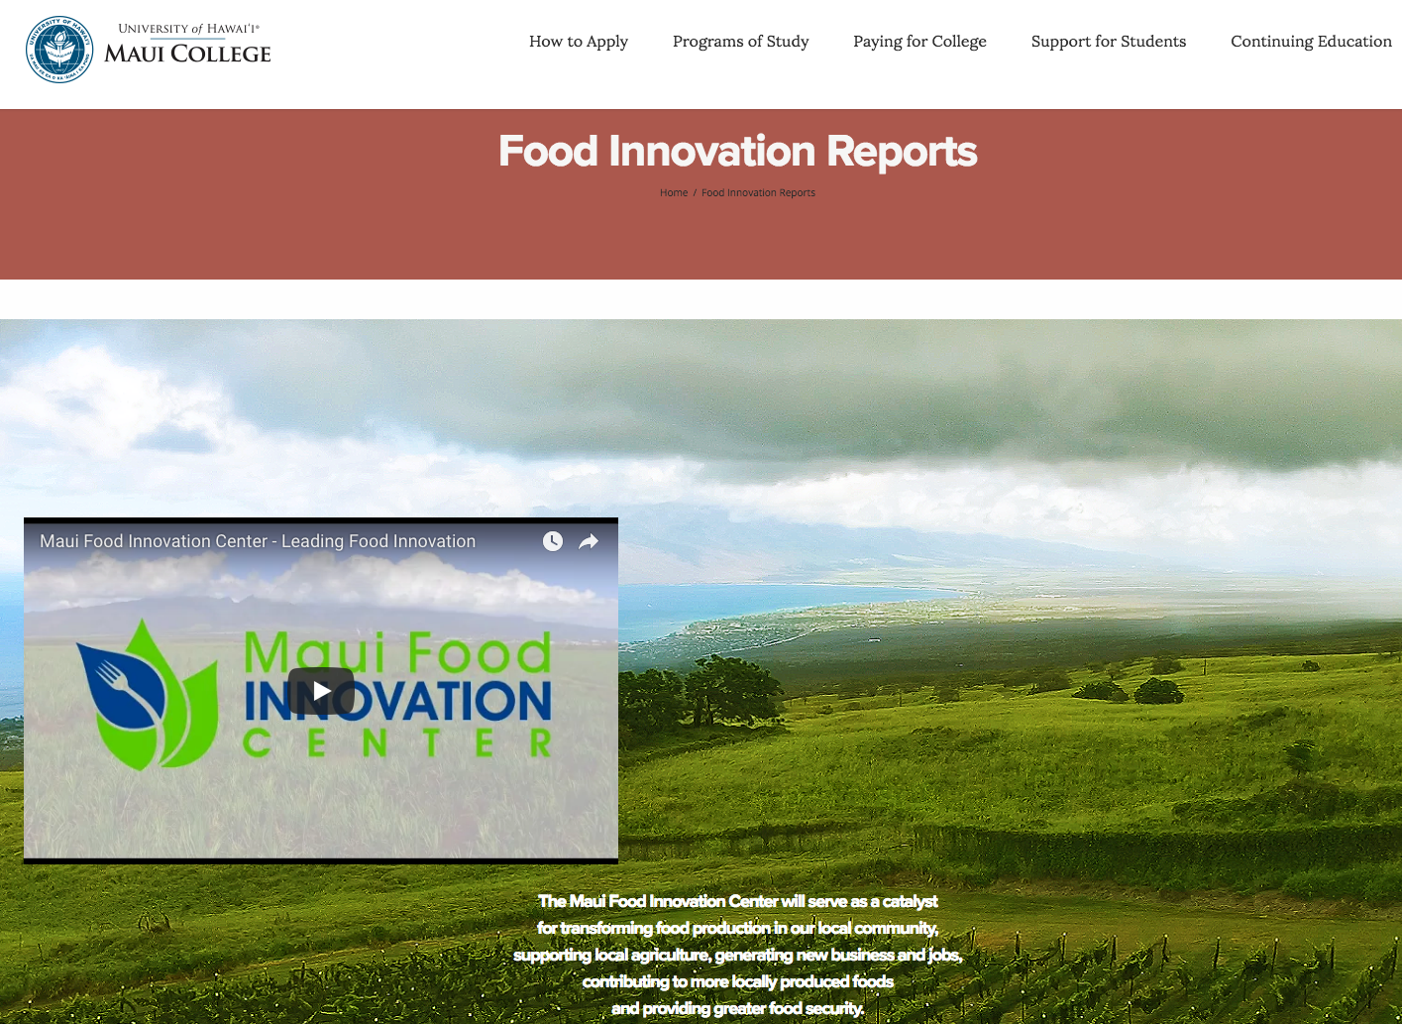
Storytelling Compliments Formal Reporting

Slide 13
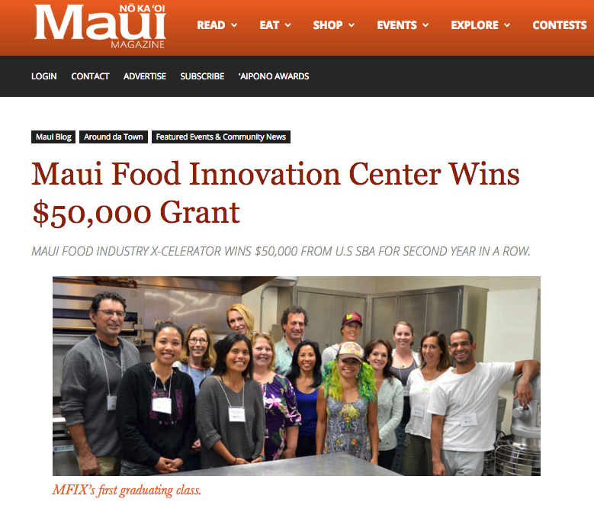
Building a Network
COMMUNITY PARTNERS
MEDIA
NATIONAL PARTNERS
GOVERNMENT AGENCIES
WORKFORCE/ INDUSTRY
EDUCATION

Slide 14
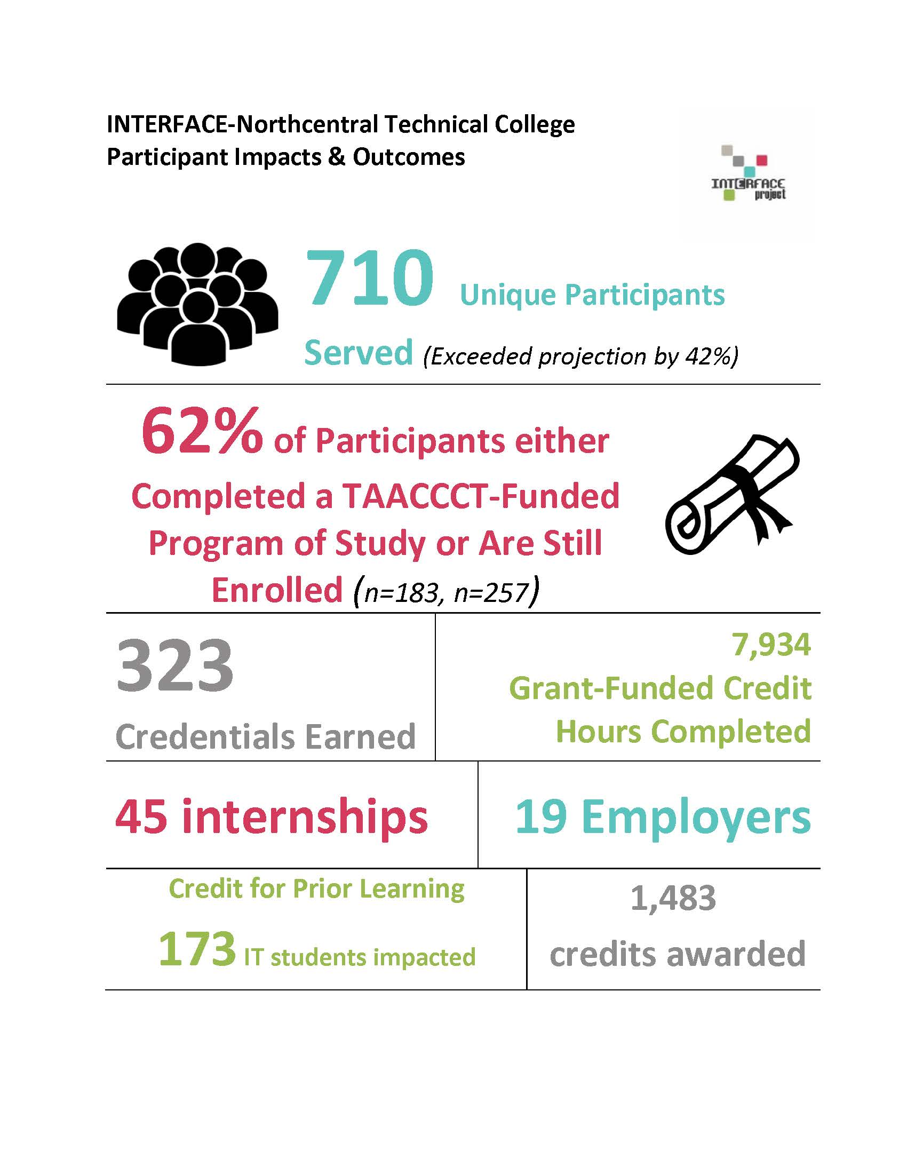
Case Study: Makeover

Slide 15
Lessons Learned
Storytelling Toolkit
Rubric
Project Brief
Script
Lessons Learned
Project Management | Technical Management | Human Factors | Overall
Project Planning | Requirements | Communication | Customer Satisfaction
Resource management | Specifications | Team Experience | Technical Success
Change Control | Test Plan | Interactions | Product Quality
Procurement | Development | Management Support | Product Acceptance
Budget management | Testing | Quality of Meetings | On Time
Quality Control | Rollout | Vendor interactions | Within Budget
Status Reports | Documentation |  | Met Project Objectives
Vendor Selection | Dissemination |  | Met Business Objective

Slide 16
Capturing Lessons Learned
What went well?
What didn’t go well or had unintended consequences?
What recommendations would you make to others doing similar projects?

Slide 17
What’s Next?
http://support.skillscommons.org/connect/impact-communities/story-telling/

Slide 18
For more information please visit the StoryTelling IMPACT community at
http://support.skillscommons.org/connect/impact-communities/story-telling/
Want to tell your TAACCCT project's story to a national audience?
Visit the Connect Center on SkilllsCommons at connect.skillscommons.org
For more information please contact:
Maria Fieth mfieth@calstate.edu

