Slide 1
Building Effective Employer Partnerships in the IT Sector

Slide 2
Today’s Plan
Engaging IT businesses on workforce issues
Various workforce system partners’ roles in business engagement
The what and why of sector partnerships
Successful IT sector partnership characteristics
Real-world spotlight: What’s working/Discussion

Slide 3
Speakers
Gretchen Koch
Executive Director of Workforce Development Strategies,
Creating IT Futures, the Philanthropic Arm of CompTIA
Marguerite Womack
Senior Director of Community Development,
Youth Policy Institute
Shelley Penn
Chief Operating Officer,
Full Employment Council

Slide 4

Getting to know you

Slide 5




Common vision…common goals
Educational Systems
Economic Development
Workforce System
Targeted Growth Sectors
The Talent Pipeline – workforce as an asset for regional prosperity

Slide 6
Sector Strategies = New Way of Doing Business Engagement
Transactional relationship
Transformational relationship
Fill job orders |  | Training provided across occupations, skill levels (often employer/industry-paid)
Place job candidates |  | Focus expanded to worker retention, advancement issues within company/ industry (i.e. career pathways)
Education/training/services loosely informed by employer needs thru survey or one-off engagement |  | Education/training designed in partnership w/ employers
One-to-one relationship |  | One-to-many (sector strategies)

Slide 7
What Makes a High Performing Sector Partnership?
Puts businesses at the middle
Includes system partners
Scope is regional, conversations strategic
Managed by a qualified convener
Sustainable
Notes:
Allows you to dig in deep on a sector partnership and what it actually looks like (partners sitting around a table listening to biz etc etc). You can spend a lot of time on this slide talking about extracting industry-wide needs and competencies…and how everyone has a role etc

Slide 8

What This Looks Like from the
Employer-Customer’s Perspective
Employers have identified talent needs, challenges, and obstacles as well as solutions
Partner training, education,
resources aligned and
coordinated around customized
solutions
Duplication is eliminated and
investments are streamlined
Industry-knowledgeable staff

Slide 9

What This Looks Like from the
Job Seeker-Customer’s Perspective
Receive meaningful career
information
More opportunities (training,
internships) to get to regional
high-growth companies
Seamless and defined career
pathways

Slide 10
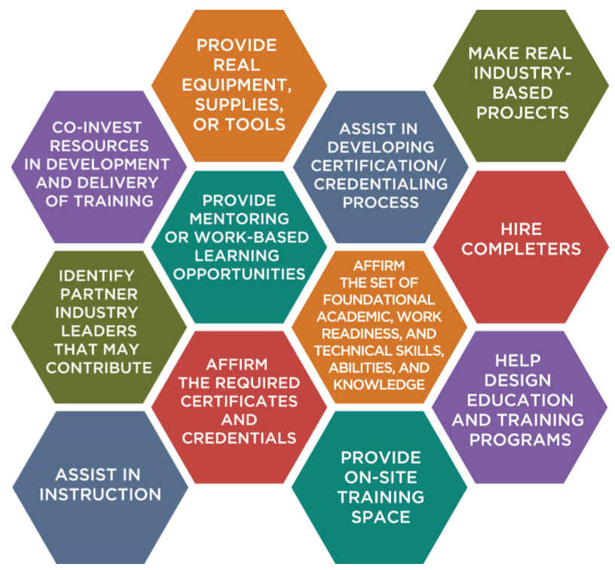
Employer roles as a result of sector partnerships
Notes:
ALLOWS US TO SAY HOW WE AT MAHER HAVE SEEN BUSINESS PLAY THESE ROLES, BUT LIKELY TO OCCUR AS PART OF A SECTOR PARTNERSHIPS

Slide 11

“World-Class” Sector Strategies: Six Key Elements
Are Driven by Great Data
Are founded on a Regional Vision
Are Guided by Industry
Lead to Strategic Alignment
Transform how Services (job seeker and employer) are Delivered
Are Measured, Improved, and Sustained

Slide 12
Building Effective Employer Partnerships in the IT Sector
Gretchen Koch
July 26, 2017

Slide 13
Key Summary Points
Job Postings
During Q1 2017 there were nearly 550,000 core IT job postings in the US, according to Burning Glass Technologies Labor Insights.
In comparison to the entire US job market, there were 6.3m total postings for the same Q1 2017 time period. IT postings represent 9% of all job postings in Q1 (same as Q4 2016).
IT postings have decreased by 29% over the same Q1 last year--during the highs of early 2016 continued from 2015. However, IT ads are back on the upswing from last quarter (+9% over Q4). Note: not all postings translate to a hire. It’s important to also consider net separations (job loss) and net hires (job gains) to fully understand the IT jobs landscape.
Employment / Unemployment
According to the Bureau of Labor Statistics (BLS), the U.S. unemployment rate for March 2017 declined to 4.5 percent (also down from 5.0 percent one year ago March 2016).
Compared to the national unemployment rate, the rate for computer related occupations remains low at 2.1 percent for March (and lower than 2.4 percent March last year). The rate is now lower for Women (1.6 percent) vs. Men (2.2 percent) in March 2017.
An estimated 5.7 million job openings existed the last business day of February versus 7.2 million* unemployed people looking for work. The hires rate (3.6%) and separations rate (3.5%) changed little in February. Over the 12 months ending February 2017, hires totaled 63.0m & separations totaled 60.6m, yielding a net employment gain of 2.4m.
Quarterly Number of Core IT Job Postings
*Note: this excludes the segment of discouraged workers that have stopped
looking for work and thereby not counted in official unemployment statistics.
Source: Burning Glass Technologies Labor Insights, April 2017
Notes:
Note: Data may not match previous reports due to Burning Glass reporting updates for how jobs are categorized or counted. Always refer to the most recent report for the most accurate data. Contact Research dept. for more info.
Sources:
http://www.bls.gov/home.htm
http://www.bls.gov/web/empsit/cpseea30.htm
http://data.bls.gov/timeseries/LNS14000000
http://www.bls.gov/news.release/jolts.nr0.htm
http://www.bls.gov/news.release/empsit.a.htm

Slide 14
Number of IT Job Postings – Quarter over Quarter
Current quarter vs. same quarter last year
ONET Code | Core IT Occupations | # Postings Q1 2017 | # Postings Q1 2016 | # Change | % Change
11-3021.00 | Computer & Information Systems Managers | 5,761 | 8,484 | -2,723 | -32%
15-1111.00 | Computer & Information Research Scientists | 4,934 | 5,950 | -1,016 | -17%
15-1121.00-.01 | Computer Systems Analysts & Informatics Specialists | 39,078 | 51,898 | -12,820 | -25%
15-1122.00 | Information Security Analysts | 24,447 | 31,691 | -7,244 | -23%
15-1131.00 | Computer Programmers | 14,114 | 19,909 | -5,795 | -29%
15-1132.00 | Software Developers, Applications | 156,490 | 219,903 | -63,413 | -29%
15-1133.00 | Software Developers, Systems Software | 2,206 | 3,425 | -1,219 | -36%
15-1134.00 | Web Developers | 33,086 | 59,475 | -26,389 | -44%
15-1141.00 | Database Administrators | 24,395 | 37,801 | -13,406 | -35%
15-1142.00 | Network & Computer Systems Administrators | 26,685 | 37,298 | -10,613 | -28%
15-1143.00-.01 | Computer Network Architects & Telecom Engineers | 20,368 | 27,977 | -7,609 | -27%
15-1151.00 | Computer User Support Specialists | 38,859 | 55,765 | -16,906 | -30%
15-1152.00 | Computer Network Support Specialists | 4,218 | 5,594 | -1,376 | -25%
15-1199.00 -.12 | Computer Occupations, All Other* | 150,273 | 207,675 | -57,402 | -28%
17-2061.00 | Computer Hardware Engineers | 1,586 | 1,942 | -356 | -18%
49-2011.00 | Computer, Automated Teller, & Office Machine Repairers | 540 | 636 | -96 | -15%
 | Total | 547,040 | 775,423 | -228,383 | -29%
*See Appendix for All Other Computer Occupations.
Source: Burning Glass Technologies Labor Insights, April 2017
Notes:
“All Other” Includes others such as Computer Systems Engineers, BI Analysts, Database Architects, IT Project Mgrs., Web Admns., etc.
15-1121.01 = Informatics Nurse Specialists.

Slide 15
Top Locations for IT Job Postings – Q1 2017
Top States for Core IT Job Postings
1. | California
2. | Texas
3. | Virginia
4. | New York
5. | Illinois
6. | New Jersey
7. | Florida
8. | Michigan
9. | Massachusetts
10. | Georgia
Top MSAs* for Core IT Job Postings
1. | New York-Newark-Jersey City
2. | Washington-Arlington-Alexandria
3. | Los Angeles-Long Beach-Anaheim
4. | San Francisco-Oakland-Hayward
5. | Chicago-Naperville-Elgin
6. | Dallas-Fort Worth-Arlington
7. | Boston-Cambridge-Nashua
8. | Atlanta-Sandy Springs-Roswell
9. | San Jose-Sunnyvale-Santa Clara
10. | Seattle-Tacoma-Bellevue
*MSA = Metropolitan Statistical Area
547,040 total US IT job postings in Q1, 2017.
Source: Burning Glass Technologies Labor Insights, April 2017

Slide 16
Employers with the Most IT Job Ads – Q1 2017
547,040 Total US IT job postings during Q1 2017, of which 44% do not specify employer.
Source: Burning Glass Technologies Labor Insights, April 2017
Notes:
Contact the Research Dept. to see a more extensive list of employers hiring IT professionals.

Slide 17





Early College STEM Schools: Joining together to build a new kind of education
Early College STEM Schools (ECSS)
City Colleges of Chicago
Implementation Partners (CompTIA and Lumity)
Chicago Public High Schools
Mayor’s Office
Others recruited by CITF
Notes:
Let’s kick off with a brief reminder about the ECSSs: what they are, who’s involved in the partnership; and the role that CompTIA and its partner, Lumity are playing through the Implementation Grant from the CWFA. The ECSS are really a new kind of educational model—an experiment, really. Each provides a 4-6 year academic program that includes both a HS and an Associates degree in IT. They are STEM schools, with an emphasis on the “T”, based loosely on the IBM P-Tech model in Brooklyn, NY. There are 5 schools, spread geographically across the city, and they are neighborhood schools, not selective enrollment. They are now in their 3rd year of operation, so they have grades 9-11 in place. The key partners in this new educational model include CPS, CCC, and the 5 employer-sponsors, one uniquely dedicated to each school. These include IBM, Cisco, MSFT, Motorola and Verizon. CompTIA’s role is to augment the efforts of CPS & CCC around WBL activities that the students participate during their tenure at the schools. CompTIA’s main focus is to expand employer engagement in these WBL activities over and above that provided by the 5 employer sponsors and to help standardize the quality and content of these WBL programs.

Slide 18
Work-Based Learning Opportunities
WBL
Company Tours
Guest Speaking
Job Shadows
Classroom Projects
Mentoring
Internships
Student Benefits:
Career Exploration
Exposure
Employer Values
Skills Development
Understanding the link between school and work
Transition Preparation
All supported by an online career prep platform
Source: (Benz & Lindstrom, 1997). (Bailey & Hughes, 1999).

Slide 19
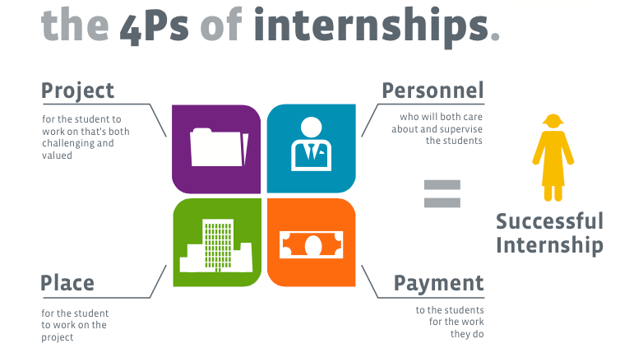
Thinking Beyond the Traditional Internship Model

Slide 20
4Ps of Internship Partners
 | # | Pay |  | Project | Place | Personnel | Training
 | 100 | Hiring | Funding
ASM | 3 | x | x | x | x | x
HCSC | 6 | x | x | x | x | x
IBM | 16 | x | x | x | x | x
Mikan Associate | 2 | x | x | x | x | x
Chicago | 4 | x | x | x | x | x
Rico Enterprise | 3 | x | x | x | x | x
Chicagoland Chamber Foun. | 2 |  | Sponsor | x | x | x
Tech Crew at CVCA | 8 |  |  | x | x | x
Tech Crew at Goode | 1 |  |  | x | x | x
BLUE1647 | 10 |  |  | x | x | x
CPD | 2 |  |  | x | x | x
Chicago Youth Centers | 3 |  |  | x | x | x
Cisco | 8 |  |  | x | x | x
CoderSpace | 3 |  |  | x | x | x
Dr. Truth | 1 |  |  | x | x | x
Earlybird Software | 2 |  |  | x | x | x
Engendering Strength | 3 |  |  | x | x | x
Front and Center | 2 |  |  | x | x | x
G-Ride | 1 |  |  | x | x | x
Honorary Chicago | 2 |  |  | x | x | x
Literacy Chicago | 1 |  |  | x | x | x
Loma Solution | 2 |  |  | x | x | x
Project Exploration | 3 |  |  | x | x | x
Scientist for Tomor. | 4 |  |  | x | x | x
Sky-Farmer | 2 |  |  | x | x | x
Solomon Group | 1 |  |  | x | x | x
Urban Warrior | 1 |  |  | x | x | x
PinkThink | 2 |  |  | x |  | x
TapGenes | 2 |  |  | x |  | x
1871 |  |  |  |  | x
Make Office |  |  |  |  | x
Matter |  |  |  |  | x
CDW |  |  | Sponsor
DeVry |  |  | Sponsor
Microsoft |  |  | Sponsor
Motorola Solutions |  |  | Sponsor
CPS |  |  | Sponsor |  |  |  | x
CITF |  |  | Sponsor |  |  |  | x
CompTIA |  |  |  |  |  |  | x
Deloitte |  |  |  |  |  |  | x
Lumity |  |  |  |  |  |  | x
CWFA |  |  |  |  |  |  | x
Partnerships in 4Ps

Slide 21

Chicago IT Talent Initiative
Strategic Partnerships Leading to Systemic, Positive Change

Slide 22







Initiative Partners & Leading Employers

Slide 23
Initiative Goals & Strategies
Shared Goals among Initiative Partners & Leading Employers
Encourage and increase strategic public-private partnerships within the city’s growing IT sector
Expand employers’ access to the city’s IT talent pipeline and enable them to fulfill their hiring and diversity goals
Offer employers opportunities to influence demand-driven curricula and IT skills
Support under-represented student populations enrolled in associate degree pathways in IT at City Colleges and training programs administered by community-based organizations
Effective Strategies
Employer roundtables (April 21 at Microsoft & May 24 at World Business Chicago)
Peer to peer sharing of best practices and resources
Employer Participation Plan and Guide designed to allow for multiple entry points
Opportunities to lead other employers and support an innovative business solution/larger effort

Slide 24

STRENGTHENING YOUR WORKFORCE
EXPANDING IT-READY TRAINING
CREATING AMERICAN IT CAREERS

Slide 25
OVERVIEW
Notes:
TEMPLATE E

Slide 26

THE PROGRAM
The IT-Ready Program provides the following opportunities:
Competitive admissions
Free classes
Eight weeks of full-time training
Graduation with industry
recognized certifications
Training in employability skills
Job placement
IT industry mentors
Continuing education

Slide 27
UNDERSERVED POPULATIONS
We reach motivated people with an aptitude for technology from multiple underserved populations:
LOW-INCOME
LONG-TERM UNEMPLOYED
MULTIPLE ETHNIC & RACIAL GROUPS
WOMEN
VETERANS
INDIVIDUALS WITHOUT COLLEGE DEGREES

Slide 28

Panel Discussion:
Marguerite Womack, Youth Policy Institute
Shelley Penn, Full Employment Council

Slide 29








Developing & Sustaining
IT Employer Partnerships for the TechHire H-1B Grant Project
Full Employment Council, Inc.
Administrative entity/fiscal agent
Kansas City & Vicinity Workforce Development Board
Eastern Jackson County Workforce Development Board
Audio Engineering Training Cohort
Full Employment Council

Slide 30
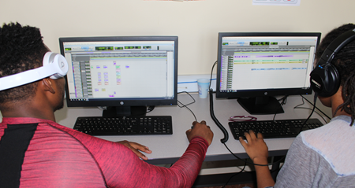
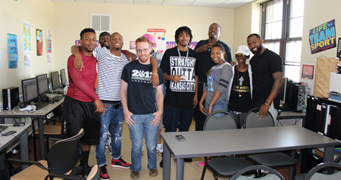

Organizational History
The Full Employment Council (FEC) was founded in 1984
Administrative Entity/Fiscal Agent for two Workforce Development Boards
The Workforce Development Boards operate 5 counties throughout the Greater Kansas City region.
Last year FEC served more than 47,800 job seekers throughout the 5 county region
Targeted sectors – Information Technology, Advanced Manufacturing, Healthcare, Warehouse/Logistics, Business/Financial Services, Construction

Slide 31




TechHire H-1B Grant Project
Full Employment Council awarded in 2016 to serve 2,000 citizens throughout the Greater Kansas City region
Target Sectors – Advanced Manufacturing, Healthcare, Information Technology
Recent IT training cohorts include:
  Audio Engineering Tech Certificate Program, 12 recruited, 10 participants completed
  Security IT Associate Training Program
  Digital Media & Design Specialist Certificate Program
  Introduction to Modern Programming
  Bilingual Coding Class
To Date:
  172 Participants ages 17-29 enrolled in training; 181 Participants ages 30 & older enrolled

Slide 32
Employer Engagement Strategies
Partnership with FEC gives employers the following benefits:
  Increased brand visibility with job seeker population & supply chain
  Accelerated real time trainings that matches employer needs
  Leadership in the IT industry
  Customized On-the-Job Training combined with classroom training
  Pipeline to highly skilled workers
  Extends Human Resources range & activity
  Expanded outreach & recruitment options through the Career Center network
  Assists employers in growing & training their own staff

Slide 33




Workforce Development + Employer Partners =
Industry Informed Training
FEC builds invested relationships with employers
  To gather real-time, on-going workforce intel
  To understand current & future hiring needs
  To understand what skills employees need
  To get a pulse on workplace culture
Employer Network User Groups – IT Employer Roundtable Events
IT Employers design industry informed, customized, credentialed training
  Industry experts become Adjunct Instructors
  Customized training - 4 Year Degrees no longer required
  Increased employability of targeted applicants – minorities & women are fast-tracked into high paying occupations
  High-wage placement – Solution Designer, $44.65/hour at Cerner Corporation
  Mid-wage placement – Computer User Support Specialist, $22.00/hour at Insight Global
  Low-wage placement – E-Commerce/Selector, $10.20/hour at Darden Restaurants
  Grows applicant pool to include non-traditional potential candidates
This is critical for industry training, IT sector changes rapidly

Slide 34







Systems Realignment
Workforce Development & Education
FEC enlists IT Employers to design industry informed, customized, credentialed training curriculum
“Just in Time Training” – 6-8 weeks; educational partners get curriculum certified by Missouri Department of Secondary and Elementary Education (DESE)
IT Industry Experts serve as Adjunct Instructors
Employer partners COMMIT to hiring trained graduates of the program
Educational Institutions – Workforce Development – Employer Partners

Slide 35

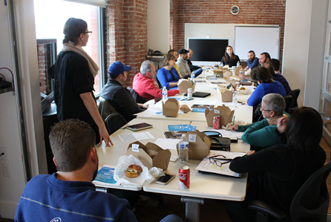
Convening Employers – Four Efforts
“Feet on the Street” – Job Development efforts conducted by FEC
Employer convenings connected through the workforce system with intermediary support
Designated employer user groups
Partnerships with local governments – city, county & state

Slide 36



Creating Regional Investment
Office of KC Mayor Sly James – Digital Literacy campaign
KC Chamber of Commerce
Employer Intermediaries in Information Technology, Advanced Manufacturing & Healthcare support employer outreach - FEC convenes
Secondary & Post-secondary schools
Regional Workforce Partners
Committed IT Employers
FEC belongs to the Midwest Urban Strategies Workforce Consortium,
here at a press conference led by the Mayor of Milwaukee, WI in July 2017

Slide 37
Thank you!
Lynn Bajorek, Senior Consultant
Maher & Maher
517-899-0085; lbajorek@mahernet.com

