Slide 1
Strengthening Working Families Initiative
Plenary Session:
Opening Remarks and SWFI Year 1 Review
Speakers
Robin Fernkas, Director, Division of Strategic Investments (DSI), ETA
Monica A. Evans, Ph.D., SWFI Program Lead, DSI, ETA
SWFI Grantee Representatives
EMPLOYMENT AND TRAINING ADMINISTRATION
UNITED STATES DEPARTMENTOF LABOR

Slide 2
Strengthening Working Families Initiative
SWFI Goals
A fundamental goal of SWFI is to assist in the removal of child care barriers faced by working parents in need of training to secure better jobs.
Program-level activities: recruiting and providing customized training and supportive services to the target population
System-level activities: improving coordination amongst workforce development and child care systems and leveraging public and private resources to better serve the target population
EMPLOYMENT AND TRAINING ADMINISTRATION
UNITED STATES DEPARTMENTOF LABOR

Slide 3
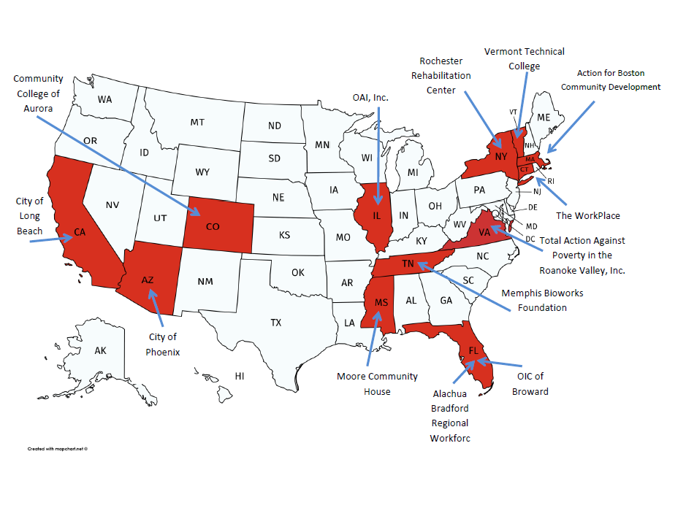
Strengthening Working Families Initiative
Plenary Session:
Opening Remarks and SWFI Year 1 Review
Speakers
Robin Fernkas, Director, Division of Strategic Investments (DSI), ETA
Monica A. Evans, Ph.D., SWFI Program Lead, DSI, ETA
SWFI Grantee Representatives
EMPLOYMENT AND TRAINING ADMINISTRATION
UNITED STATES DEPARTMENTOF LABOR

Slide 4
Strengthening Working Families Initiative
As of June 2017:
All grantees have begun recruitment;
11 grantees have started conducting classroom trainings;
2 grantees have established job clubs or mentoring programs;
5 grantees provided participants services and activities that support skill development, training retention, and employment; and
7 grantees have provided or connected participants to child and/or dependent care.
EMPLOYMENT AND TRAINING ADMINISTRATION
UNITED STATES DEPARTMENTOF LABOR
Notes:
Good Morning, SWFI grantees. Again, my name is Monica Evans, and I am the SWFI program lead. I am so excited to finally meet you all in person, and I look forward to interacting with you over the next couple of days.
The SWFI program office uses lots of different data sources to keep track of your grant activities, including your quarterly narrative reports, or QNRs. According to the QNRs that you submitted, as of June 2017, all grantees had begun recruitment. Eleven grantees have started conducting classroom trainings, and two grantees had established job clubs or mentoring. Five grantees have provided participants services and activities that support skill development, training retention, and employment. Seven grantees also have also connected participants child and/or dependent care, in a variety of ways, including providing child care directly, distributing funds for child care, and connecting participants with child care navigators, to ensure that participants are able to access all the child care resources that are available to them.

Slide 5
Strengthening Working Families Initiative
Innovative Approaches and Success Stories
Offering mid-semester cohorts and holding engagements workshops to increase participant retention (Community College of Aurora)
Provision of child care services for participants attending night courses (Moore Community House)
Participants have completed training, received credentials, and obtained employment
EMPLOYMENT AND TRAINING ADMINISTRATION
UNITED STATES DEPARTMENTOF LABOR
Notes:
Your QNRs and your discussions with the TA coaches highlight the great work that you are doing, your innovative approaches to service delivery, and your grant success. I’ve listed a few of them here. I encourage you to meet with Community College of Aurora to discuss how they are offering mid-semester cohorts and holding engagement workshops to increase participant retention.
I know that securing after-hours child care is a challenge for many program participants. During the convening, talk with Moore Community House about how they have been able to provide child care services for participants attending night courses.
And be sure to share with your fellow grantees your success in getting participants trained, credentialed, and employed!

Slide 6
Strengthening Working Families Initiative
SWFI Technical Assistance
Monthly coaching calls
Webinars: Introduction to Technical Assistance; Understanding Workforce Development and Child Care Systems and Their Intersection
Peer Learning calls: Peer to Peer calls; TA Office Hours
Written resource materials: TANF eligibility
Community of Practice (CoP)
EMPLOYMENT AND TRAINING ADMINISTRATION
UNITED STATES DEPARTMENTOF LABOR
Notes:
We know that there are areas where you need technical assistance support. Our technical assistance partners, Mathematica Policy Research, have provided you with a plethora of high-quality TA activities. You have received monthly coaching calls, where you’ve been able to discuss and address TA needs with your TA coach. Two webinars have been conducted, one was an introduction to the types of TA that Mathematica provides, and the second focused on the intersection of the workforce development and child care systems.
Some grantees have participated in peer-to-peer calls set up by your coaches so that grantees with similar issues can learn together and from each other to address a specific issue or challenge. Others have participating in our TA Office hours, which was a follow-up to the systems integration webinar. Mathematica produced a TANF eligibility tipsheet, and additional tipsheets are forthcoming. These tipsheets, along with the webinar recordings, slides, and transcripts, and related reference materials, can all be found in the SWFI Community of Practice on Workforce GPS.
I want to pause here and say this: we want to ensure that you TA needs are being met. SWFI is your program, and you are the drivers of the TA we provide. We base technical assistance on your needs, as evidenced by your QNRs, your emails, and your feedback. We encourage you to continue to participate in the technical assistance activities and provide us with feedback on the effectiveness of TA. That includes filling out the evaluation forms after each session during the convening. Please be sure to fill out the forms, which are in your convening folder, and turn them in at the end of the convening.

Slide 7
Strengthening Working Families Initiative
SWFI CoP
SWFI-related TA products
Curated TA resources and tools
Online discussion boards
Address: https://swfi.workforcegps.org/
EMPLOYMENT AND TRAINING ADMINISTRATION
UNITED STATES DEPARTMENTOF LABOR
Notes:
The SWFI CoP is the place to go for your technical assistance needs. How many have registered for the CoP? How many have utilized the resources on the CoP? You can interact with your fellow grantees on the CoP as well. There is a discussion board with multiple open discussion threads available. You can start your own discussions there as well. The Workforce GPS team is also rolling out a chat feature. We will provide you with more information about that after the convening, so that you can continue the wonderful conversations that I am sure you will have with your SWFI colleagues over the next two days!

Slide 8
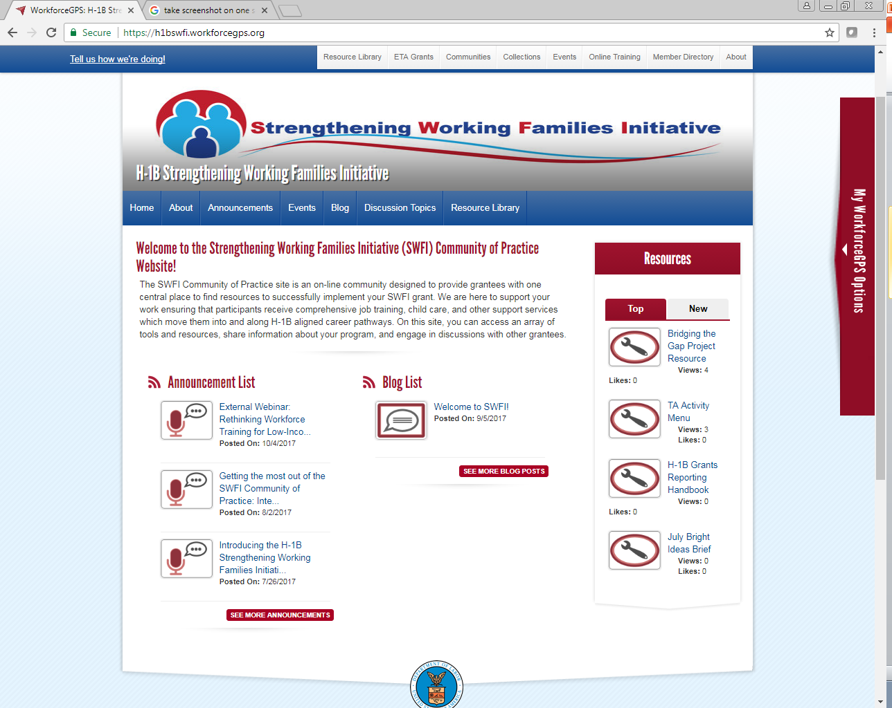
Strengthening Working Families Initiative
SWFI CoP
EMPLOYMENT AND TRAINING ADMINISTRATION
UNITED STATES DEPARTMENTOF LABOR
Notes:
Here is a screenshot of the SWFI CoP. All convening handouts and slides will be posted onto the CoP following the convening. So, If you have not already done so, please register, subscribe to receive updates, and utilize the SWFI CoP!

Slide 9
Strengthening Working Families Initiative
SWFI Grantees’ Elevator Speeches
One representative from each project pick a candy from the treat bag
The number on your treat is the order in which you present
30 seconds to one minute
Please use the microphone
EMPLOYMENT AND TRAINING ADMINISTRATION
UNITED STATES DEPARTMENTOF LABOR
Notes:
Now that we’ve provided you with an overview of SWFI and what has been happening at the program level for the past year, we want to hear from you. You’ve worked with your coaches to develop your elevator speeches. I know that you’ve shared an early version with your colleagues, but now you have an opportunity to share more about your project, and to put a face to the project name so that you can network throughout the convening.
Please raise your hand if you are the designated speaker for your program. Danielle and Megan are going around with the treat bags. Pick a numbered treat to determine the order in which you will present. I will call the numbers, in order. When your number is called, just raise your hand, and Danielle or Megan will pass you the mic so that you can share your elevator speech. Does that make sense to you? Does everyone have a number? Are you ready? Ok, person one:
Thank you to all of you for sharing a little about your program. If you have materials or resources that you would like to share, please place them on the Resources table outside the Auditorium. There are some technical assistance resources on the table as well, so please be sure to stop by and pick them up.

Slide 10
Strengthening Working Families Initiative
SWFI Convening Roadmap Day 1 October 31, 2017
Performance Help Desk
Peer Learning on Childcare and Supportive Systems Mapping
Overview of Federal Programs
Evaluation Update
Participant Engagement
Interactive Peer Consultancies with Industry Representatives and Coaches
EMPLOYMENT AND TRAINING ADMINISTRATION
UNITED STATES DEPARTMENTOF LABOR
Notes:
Your convening packet includes an agenda. I’m going to walk you through what will occur over the next two days.
Throughout both days, there will be opportunities for you to visit the performance helpdesk, which is located on the 4th floor, in room N-4437D. If you have not already done so, please sign up for a performance help desk session. The signup sheet is at the registration table.
After this session, and in between most sessions, you have networking opportunities/breaks. We’ve allotted enough time to let you take a quick break or spend a little time chatting with your colleagues while moving from one room to the next, if needed. After this session we will move to the fourth floor for the Peer Learning on Child care and supportive systems mapping session. Staff is on hand to help you navigate to this session. All of our sessions will either be here in the Auditorium or on the 4th floor.
After the breakout session, we will return to the Auditorium for the plenary session on Federal Workforce, Education, and Child Care programs. Leadership and staff from a number of Federal agencies will present on their programs and answer your questions.
Following the Federal programs session you are welcome to have lunch in the DOL cafeteria, which is on the 6th floor. There are tables reserved in the cafeteria for SWFI grantees. You are also free to have lunch outside of DOL.
After lunch, you will return here to the Auditorium, to hear an update on the SWFI evaluation. Next you will head back to the forth floor for a session on participant engagement.
The final session of the day, which is also on the fourth floor, is a plenary breakout session with industry representatives. You will also meet with your TA coaches during this time.

Slide 11
Strengthening Working Families Initiative
SWFI Convening Networking Event @ The Alibi
237 2nd Street Northwest
Washington, DC 20001
(202) 347-2237
EMPLOYMENT AND TRAINING ADMINISTRATION
UNITED STATES DEPARTMENTOF LABOR
Notes:
After Day one closes, please feel free to join your SWFI colleagues, Federal staff, and TA teams for an informal networking event at the Alibi restaurant, which is right behind this building. You entered the building through the front. In order to get to the Alibi, you have to exit through the doors which are right across the hall from where you entered.
Staff will be on hand to help you navigate to the restaurant.
We are not able to provide you food and beverages, but there will be ample offerings for you to purchase.

Slide 12
Strengthening Working Families Initiative
SWFI Convening Roadmap Day 2 November 1, 2017
Performance Reporting Help Desk
SWFI Grants Management and Fiscal Policy
Performance Reporting
Foundation Perspectives
Child Care Systems Mapping Peer Learning and Ask the Systems Expert
Sustainability
Closing Plenary Session
EMPLOYMENT AND TRAINING ADMINISTRATION
UNITED STATES DEPARTMENTOF LABOR
Notes:
Moving on to Day Two. Again, you can sign up for a performance reporting help desk session. Day Two starts with a plenary session here in the Auditorium. Federal staff will provide an overview of grants management and fiscal policy. There will be opportunities to ask questions about monitoring and grant modifications. Following that session is a session on performance reporting. Next, representatives from foundations that run programs and networks with objectives that are similar to SWFI will present on some promising practices and lessons learned when addressing the issues that SWFI projects are tackling. These first three sessions are all in the Auditorium.
There will be a networking opportunity and break, and then the last morning session will take place here in the Auditorium. During this session, you will build on the “Peer learning on child care and supportive services systems mapping session” from Day One and have a chance to engage with a systems subject matter expert.
Lunch again can be either in the DOL cafeteria or on your own.
After lunch, there will be a session on sustainability, on the fourth floor, followed by the closing plenary session, also on the fourth floor.

Slide 13
Strengthening Working Families Initiative
Feedback Opportunities
Evaluations forms for each session and the convening
Key takeaways sticky notes
Program staff
EMPLOYMENT AND TRAINING ADMINISTRATION
UNITED STATES DEPARTMENTOF LABOR
Notes:
As I mentioned earlier, there are evaluation forms in your convening packets. We encourage you to provide feedback on each session and on the convening as a whole.
You will also find sticky notes in the breakout rooms and on the resource table. Please take some and jot down some interesting things that you learn either in a session, or through networking. You can give those to your session facilitators or place them on the easel pad located out in the hall. We will revisit some of those takeaways during the closing plenary and share them on the SWFI Community of Practice.
Additionally, please feel free to grab any member of the SWFI Program team if you have any questions, concerns, or feedback during the convening. Or you can write us at SWFI@dol.gov following the convening.

Slide 14
Strengthening Working Families Initiative
Logistics
Snack Bar on the 4th floor
Cafeteria on the 6th Floor
Wi-Fi Access: ENT_Guest
Restrooms
EMPLOYMENT AND TRAINING ADMINISTRATION
UNITED STATES DEPARTMENTOF LABOR
Notes:
There is a snack bar located on the 4th floor, near the breakout rooms. The Cafeteria as I mentioned before, is on the 6th floor.
You should have received your Wi-Fi access information via email. I’ve listed the network name here as a reminder.
And restrooms are located outside of the auditorium and to the right, near the Child Care center. The Logistics team staff at the registration desk can direct you to the restrooms.
There are also restrooms on the fourth floor, just down the hall from the breakout rooms.
Also, in the case of an emergency, exits are located in the north, east, central, and south corridors of the building. However, please follow directions if instructed to shelter in place.

Slide 15
Strengthening Working Families Initiative
HAVE A GREAT CONVENING!!!
EMPLOYMENT AND TRAINING ADMINISTRATION
UNITED STATES DEPARTMENTOF LABOR
Notes:
Once again, welcome to DOL, and we look forward to engaging with you over the next two days. We are now going to break for our first networking opportunity. The next session starts at 10:00 am. We will all meet in room N-4437 A for the start of that session.
Thank you.

