Slide 1













APRIL/MAY 2024
Apprenticeship Grants
WIPS’ Office Hours
Facilitated by:
Shelia F. Lewis
Jess Williams
Natasha Douglas
Notes:
Shelia Lewis

Slide 2

Agenda
About WIPS’ Office Hours
  Three sessions added
Announcements
  New/Revised Logical Values
  Proposed Aggregation Rules
  WIPS Newsletter
  Participant Social Security Numbers
  Grant Solutions grant numbers
  General Informa
Reminders:
  WIPS’ Access
  Are you reporting Credentials?
  Are you reporting ALL of your active participants each quarter?
Appendix I – WIPS’ Tips
Appendix II – Qs & As
Appendix III – Performance and Reporting Resources
Notes:
Shelia

Slide 3


Slide 4
About Office Hours…
Submitter/Certifiers should attend
Ask your data upload questions
Use this time to upload a small data file
Use this time to trouble-shoot file upload issues, data preparation issues, etc.
Bring data element, WIPS, performance, and reporting issues to ETA’s attention
Ask other grantees/peers questions
Frequency - 3 times after the end of the reporting quarter/before report due date
This is your time to ask questions, run test files, etc. Please take advantage of this opportunity.

Slide 5
Announcements: New Logical Values (as of 7.31.2023) (2)
If PIRL 2901 (Pre-Apprenticeship Program Status) = 4 THEN PIRL 2907 (Apprenticeship Program Status) is mandatory.
If PIRL 2901 (Pre-Apprenticeship Program Status) = 1,2,3, or 4 THEN PIRL 2914 (Apprenticeship Grants Program Status) = 1.
Created new logical validation edit checks 900D, 901D, 2907B and 2914C for Apprenticeship program.
Updated logical validation edit check 2917A for Apprenticeship program.
Deactivated logical validation edit check 2700D for Apprenticeship program.
Updated logical validation 901D (Date of Program Exit (WIOA)) so that it executes when Apprenticeship is the only selected target program.
Notes:
Jess

Slide 6
Announcements: Logic Values and Revised Specs
(as of 11.30.2023) (3)
New Edit Check for PIRL 2907: C) If Pre-Apprenticeship Program Status (PIRL 2901) = 1, 2, or 3 THEN Apprenticeship Program Status (PIRL 2907) must be blank.
Revised WIPS Specs
  More than one race
  Unemployment Status
  In a Pre-apprenticeship with an Articulated Agreement
  Total Exiters
Notes:
Jess

Slide 7
Announcements: Proposed Aggregation Rules (4)
Youth and Young Adults, Ages 16-24 | Count of UNIQUE RECORDS where (APPRENTICESHIP GRANT NUMBER [PIRL 2920] is not null) AND (APPRENTICESHIP GRANTS PROGRAM STATUS [PIRL 2914] = 1) AND ((DATE OF PROGRAM ENTRY [PIRL 900] is not null) AND (DATE OF PROGRAM ENTRY [PIRL 900] is within the reporting period) AND (DATE OF PROGRAM EXIT [PIRL 901] is within the reporting period OR DATE OF PROGRAM EXIT [PIRL 901] is null) AND DATE STARTED APPRENTICESHIP [PIRL 2908] DATE OF PROGRAM ENTRY [PIRL 900] - DATE OF BIRTH [PIRL 200] >= 16 years AND DATE STARTED APPRENTICESHIP [PIRL 2908] DATE OF PROGRAM ENTRY [PIRL 900] - DATE OF BIRTH [PIRL 200] < 25 years))
Adults, Ages 25-54 | Count of UNIQUE RECORDS where (APPRENTICESHIP GRANT NUMBER [PIRL 2920] is not null) AND (APPRENTICESHIP GRANTS PROGRAM STATUS [PIRL 2914] = 1) AND ((DATE OF PROGRAM ENTRY [PIRL 900] is not null) AND (DATE OF PROGRAM ENTRY [PIRL 900] is within the reporting period) AND (DATE OF PROGRAM EXIT [PIRL 901] is within the reporting period OR DATE OF PROGRAM EXIT [PIRL 901] is null)) AND ((DATE STARTED APPRENTICESHIP [PIRL 2908]DATE OF PROGRAM ENTRY [PIRL 900] -DATE OF BIRTH [PIRL 200] >= 25 years) AND (DATE STARTED APPRENTICESHIP [PIRL 2908] DATE OF PROGRAM ENTRY [PIRL 900] - DATE OF BIRTH [PIRL 200] < 55 years))
Older Adults, Ages 55+ | Count of UNIQUE RECORDS where (APPRENTICESHIP GRANT NUMBER [PIRL 2920] is not null) AND (APPRENTICESHIP GRANTS PROGRAM STATUS [PIRL 2914] = 1) AND (DATE OF PROGRAM ENTRY [PIRL 900] is not null) AND (DATE OF PROGRAM ENTRY [PIRL 900] is within the reporting period) AND (DATE OF PROGRAM EXIT [PIRL 901] is within the reporting period OR DATE OF PROGRAM EXIT [PIRL 901] is null)) AND ((DATE STARTED APPRENTICESHIP [PIRL 2908] (WIOA) DATE OF PROGRAM ENTRY [PIRL 900] - DATE OF BIRTH [PIRL 200] => 55 years)
Notes:
Jess

Slide 8
Announcements: Proposed Aggregation Rules (5)
Youth, Ages 16-18 | Count of UNIQUE RECORDS where (APPRENTICESHIP GRANT NUMBER [PIRL 2920] is not null) AND (APPRENTICESHIP GRANTS PROGRAM STATUS [PIRL 2914] = 1) AND (DATE OF PROGRAM ENTRY [PIRL 900] is <= end of the report period) AND (DATE OF PROGRAM ENTRY [PIRL 900] is within the reporting period) AND (DATE OF PROGRAM EXIT [PIRL 901] is <= the end of the reporting period) OR (DATE OF PROGRAM EXIT [PIRL 901] is null) AND (DATE STARTED APPRENTICESHIP [PIRL 2908] DATE OF PROGRAM ENTRY [PIRL 900] - DATE OF BIRTH [PIRL 200] >=16 years) AND (DATE STARTED APPRENTICESHIP [PIRL 2908] DATE OF PROGRAM ENTRY [PIRL 900] - DATE OF BIRTH [PIRL 200] <19 years))
Youth, Ages 19-24 | Count of UNIQUE RECORDS where (APPRENTICESHIP GRANT NUMBER [PIRL 2920] is not null) AND (APPRENTICESHIP GRANTS PROGRAM STATUS [PIRL 2914] = 1) AND (DATE OF PROGRAM ENTRY [PIRL 900] is <= end of the report period) AND (DATE OF PROGRAM ENTRY [PIRL 900] is within the reporting period) AND (DATE OF PROGRAM EXIT [PIRL 901] is <= the end of the reporting period) OR (DATE OF PROGRAM EXIT [PIRL 901] is null) AND (DATE STARTED APPRENTICESHIP [PIRL 2908] DATE OF PROGRAM ENTRY [PIRL 900] - DATE OF BIRTH [PIRL 200] >=19 years) AND (DATE STARTED APPRENTICESHIP [PIRL 2908] DATE OF PROGRAM ENTRY [PIRL 900] - DATE OF BIRTH [PIRL 200] <25 years))
Notes:
Jess

Slide 9
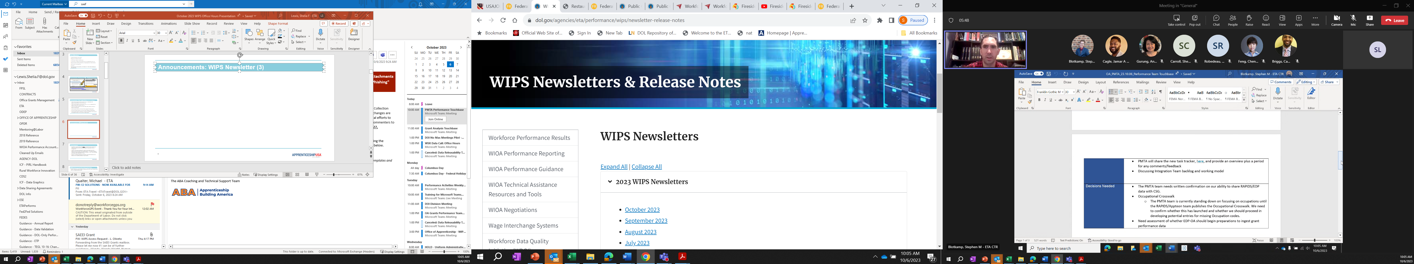
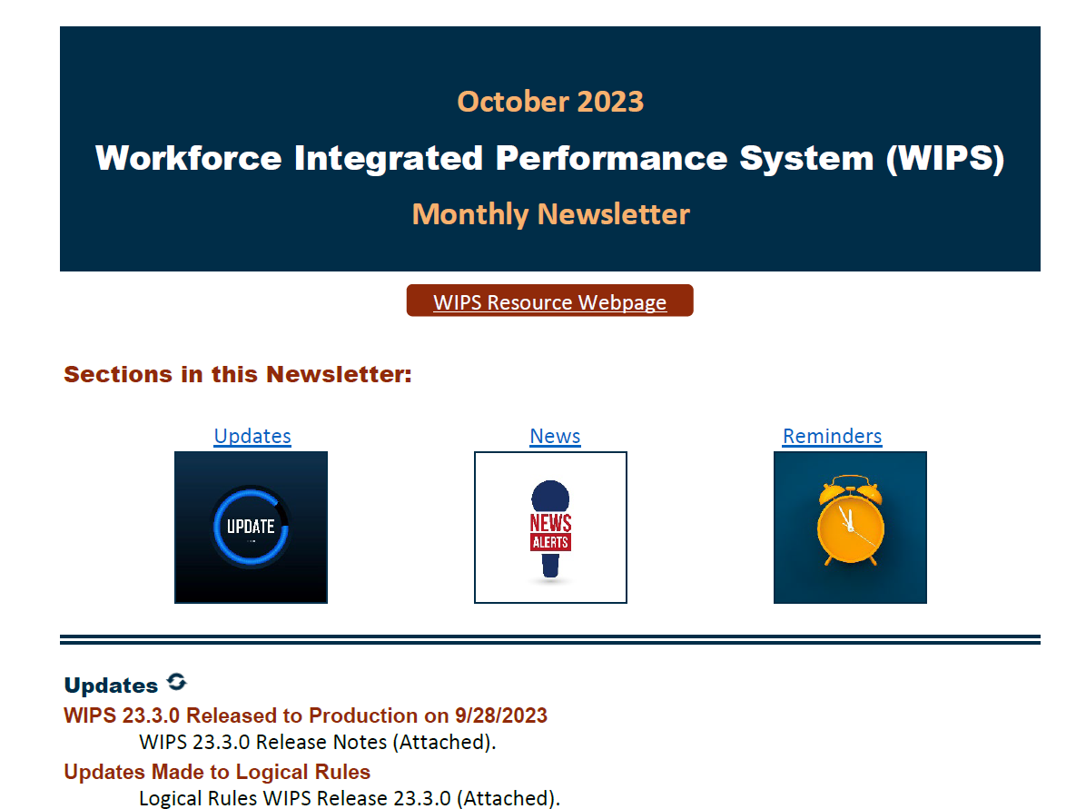
Announcements: WIPS Newsletter (6)
WIPS Newsletter Contents:
Updates
News
Reminders
Notes:
Shelia

Slide 10
Announcements: WIPS Newsletter (6)
WIPS Newsletter Contents:
Updates
News
Reminders
NEW Newsletter
Notes:
Shelia

Slide 11
Announcements: Grant Solutions Apprenticeship Grant Numbers (7)
Grant Solutions is the new grant management system used by ETA.
New grant numbers generated by Grant Solutions are not compatible with the Participant Individual Record Layout (PIRL) and the field length requirement for PIRL 2920 (Apprenticeship Grant Number).
TradesFutures and SAEF grantees are impacted by this change and will receive an alternate grant number for performance reporting purposes.
    Converted 7-Digit Grant Number Example – AP00099
Notes:
Shelia

Slide 12
Announcements: Grant Solutions Apprenticeship Grant Numbers (8)
ADDITIONAL QUESTIONS:
  Is there an edit check on PIRL 2920 that would prevent either of those two grant numbers from going through WIPS for PY23 Quarter 1 reporting?
  Do we need to change (reprogram) our case management system to accommodate the new grant number sequence for PIRL 2920?
  In reviewing the proposed changes that are out for public comment for the DOL-Only PIRL, it does not appear that there is any changes to the format of the Registered Apprenticeship Grant number.
  Answer: WIPS checks for the first 7 characters of the value entered for PIRL 2920 to match the list that we have. Our list in WIPS is based on either (a) the first 7 characters of the old grant format or (b) the converted grant number for grants in the new format. This reporting process will continue for the near future. Any proposed changes in the version of the PIRL out for public comment will not be implemented for some time.
Notes:
Shelia

Slide 13

Announcements: Participant Social Security Numbers (9)
Grantees must attempt to collect participant SSNs
SSNs are needed for the exit-based employment and income performance indicators—especially for non-State grantees
Notes:
Shelia

Slide 14
Announcements: General (10)
All grantees should submit and certify the data/information uploaded for QPRs and QNRs into WIPS by 11:59pm EST on Thursday, February 15, 2024.
Grantees can begin uploading PIRL data files and QNR information into WIPS anytime after the last day of the reporting quarter. For example, grantees could have begun uploading data files on January 1, 2023, for the reporting period that ended December 31, 2023.
Data files containing participant information of any kind should never be attached to the Quarterly Narrative Report (QNR).

Slide 15
Reminders: WIPS/AI Demographic Portal Designation Form (1)
Grantee Authorized Representatives should use the PDF form to request WIPS access for Apprenticeship Grants.
The form is used to designate staff who can submit data into WIPS and certify the data to produce the Quarterly Performance Report (QPR) and Quarterly Narrative Report (QNR).
Submitter/certifiers authorized to report for other ETA grant programs must also receive authorization to report for apprenticeship grants. Authorization must be granted for each grant program.
Notes:
Jess

Slide 16
Reminders: Notes on the AI Demographic Portal (2)
  Grantee Authorized Representatives can request access to the RAPIDS Apprenticeship Information (AI) Demographics Portal as source documentation for certain data elements as indicated in the data validation guidance, TEGL 23-19 Change 2.
  The AI Demographics Portal will not be used by State Apprenticeship Agencies (SAA) that do not use RAPIDS.
  Access to the portal does not also grant full access to RAPIDS.
Notes:
Jess

Slide 17
Reminders: Obtaining WIPS Access (3)
Do not submit a Help Desk ticket to obtain WIPS’ access.
Office of Apprenticeship is only able to grant WIPS’ access when your grant’s Authorized Representative (AR) submits a complete and signed WIPS’ Designation Form.
The WIPS’/AI Demographic Portal Designation Form is found here on WorkforceGPS
Submit the form to your grant-specific mailbox and copy your federal project officer (FPO).
If there is no option on WIPS to upload your Quarterly Narrative Report, please submit a help desk ticket. This probably means that the QNR option needs to be added to your WIPS’ profile.
Notes:
Jess

Slide 18
Reminders (4)
Submit the WIPS/AI Portal Designation form at least 10 days before reports are due
Make sure submitters are not uploading the .csv file/QPR data in the QNR section of WIPS
  Note that .csv files for the QPR should be uploaded in the File Upload section of WIPS. QNRs and corresponding attachments like the Indicator Table should be uploaded under the My Reports section of WIPS where it says, “Quarterly Narrative Reports”.
Different sections of the QPR will have different totals
  E.g., Section F2. of the QPR will only count apprentices who started or exited apprenticeships that quarter. Section F3. of the QPR will count all apprentices who are still in the program.
Notes:
Jess

Slide 19
Reminders: Data Elements Used for Pre-Apprentices (5)
Complete the Following PIRL Data Elements for Pre-apprentices
OBS Number | PIRL 201 | PIRL 214 | PIRL 408 | PIRL 1800 | PIRL 1811 | PIRL 2903
PIRL 100 | PIRL 202 | PIRL 215 | PIRL 409 | PIRL 1801 | PIRL 1813 | PIRL 2904
PIRL 101 | PIRL 210 | PIRL 300 | PIRL 900 | PIRL 1807 | PIRL 2700 | PIRL 2905
PIRL 102 | PIRL 211 | PIRL 400 | PIRL 901 | PIRL 1808 | PIRL 2900 | PIRL 2913
PIRL 103 | PIRL 212 | PIRL 402 | PIRL 907 | PIRL 1809 | PIRL 2901 | PIRL 2914
PIRL 200 | PIRL 213 | PIRL 407 | PIRL 923 | PIRL 1810 | PIRL 2902 | PIRL 2920
Notes:
Jess

Slide 20
Reminders: Data Elements Used for Pre-Apprentices (6)
Data ​ Element​ | Also Use for ​ Pre-Apprenticeship​
PIRL 2900​ | ​
PIRL 2905​ | ​
PIRL 2907​ | ​
PIRL 2908​ | ​
PIRL 2909​ | ​
PIRL 2912​ | ​
PIRL 2913​ | ​
PIRL 2914​ | X​
PIRL 2918​ | ​
PIRL 2920​ | X​
Transition from Pre-Apprentice to Registered Apprentice
Use these Data Elements
NOTE: These data elements are no longer used when a pre-apprentice transitions to a registered apprentice.
PIRL 2901
PIRL 2902
PIRL 2903
PIRL 2904
Notes:
Jess

Slide 21

Upcoming Events
WIPS’ Office Hours for OA-Managed Grants
  Thursday, February 1, 2024; 3pm – 4:30 pm EST
  Thursday, February 8, 2024; 3pm – 4:30 pm EST
Notes:
Shelia

Slide 22
Thank You For Joining Us Today!
Let’s continue to explore ideas
to grow Registered Apprenticeships
Any Questions?
The Office of Apprenticeship is here to help!
Contact us at:
Apprenticeship.Grants@dol.gov
SAEEI.Grant@dol.gov
YouthAsReady.Grants@dol.gov​
ABA.Grant@dol.gov
​SAEF.Grant@dol.gov
Notes:
Shelia

Slide 23



APPENDICES
1 - WIPS Tips
2 - Qs and As
3 - Resources

Slide 24
APPENDIX - 1
WIPS Tips

Slide 25
APPENDIX 1: WIPS TIPS (1)
Columns that have leading zeros should be formatted as text. If you save your file as a .csv file, every time you open the file Excel will remove the leading zeros, so you must reformat it before closing out the file again.
The data file uploaded for your Apprenticeship grant must have all columns indicated in the most recent Apprenticeship schema. (Schema is short for ‘schematic’, or the combination of PIRL data elements for Apprenticeship.)
CSV files must have exactly 102 columns for the Apprenticeship Schema.
Column headers and extra rows or footers must be removed prior to uploading data file in WIPS.
WIPS will accept .txt, .csv or .gzip files. We recommend utilizing the .csv format whenever possible.
When testing your PIRL file, instead of uploading all participant records, try a smaller number like 5 – 10 records.
Notes:
1. Converting leading zeros
2. Jess can you add the tips about saving the files
3. Ask participants if they have any excel tips they’d like to share

Slide 26
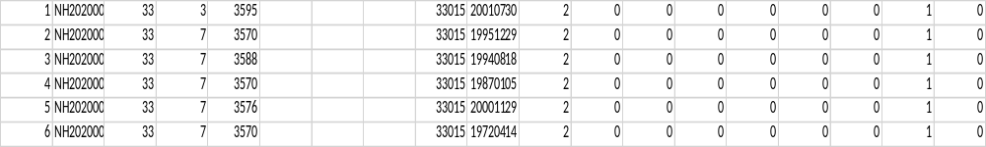
Converting Participant Records into a .csv File
APPENDIX 1: WIPS TIPS (2)
.csv means – comma separated value file
Converting participant-level data entered into an Excel spreadsheet or case management system to be saved into a table structured format that WIPS will be able to read
Those who use an Excel file to input their participant level data will save their Excel files as a .csv file prior to uploading the file into WIPS
The file should not contain any “header rows”
The file should contain 102 columns

Slide 27
APPENDIX - 2
Qs & As

Slide 28
Q / A
Question:
Are WIPS Office Hours sessions applicable to all apprenticeship grants?
Answer:
WIPS Office Hours sessions are specifically for apprenticeship grants managed by the Office of Apprenticeship. A listing of applicable grants are:
  ASE
  SAE20
  SAEEI
  ABA
  SAEF
  YARG
Notes:
Jess

Slide 29
Q / A
Question:
Is the QPR/QNR quarterly submission process changing from WIPS to another system?
Answer:
No. WIPS is the official performance reporting system for OA quarterly performance reports. All apprenticeship grantees should upload and certify their reports utilizing WIPS.
Notes:
Jess

Slide 30
Q / A
Question:
How can grantees gain access to WIPS and/or the AI Demographic Portal?
Answer:
A grantee authorized representative should complete the Apprenticeship Grants WIPS/AI Demographics Portal Designation Form located at WorkforceGPS - Performance Reporting
Grantees should submit the form to the following email addresses and copy the FPO.
  ASE and SAE 2020: Apprenticeship.grants@dol.gov
  YARG: YouthAsReady.grants@dol.gov
  SAEEI: SAEEI.grant@dol.gov
  ABA: ABA.Grant@dol.gov
  SAEF: SAEF.grant@dol.gov
Notes:
Jess

Slide 31
Q / A
Question:
Have there been any changes to the Apprenticeship Schema or Edit Checks?
Answer:
Yes, the logic rule for data element 2917 Wage at Exit has been removed.
The logic rule: B) If Apprenticeship Program Status (PIRL 2907) =2 or 3, THEN Exit Wage (PIRL 2917) must be >= Wage at Entry into Apprenticeship (PIRL 2918).
Notes:
Jess

Slide 32
Q / A
Question:
Why is the quarterly QPR view the same as the program to date QPR view in WIPS?
Answer:
When you toggle between different views of the QPR in WIPS (e.g., Quarterly and Program to Date), it's not going to change because it isn't looking at a database where all the previous quarters' data is stored.
Instead, it's simply looking at the data from the single file that you have uploaded. This decision was made by the WIPS team awhile back.
Notes:
Jess

Slide 33
Q / A
Question:
How do I complete post-exit data elements (PIRL 1600-1608)?
Answer:
For these data elements, please double check the accepted values for these elements.
For example, if the value you input for 1600: Employed in 1st Quarter After Exit Quarter (WIOA) is “0”, then you must input “0” for 1601:Type of Employment Match 1st Quarter After Exit Quarter (WIOA).
If the value you input for 1600: Employed in 1st Quarter After Exit Quarter (WIOA) is “9”, then you must input “5” for 1601:Type of Employment Match 1st Quarter After Exit Quarter (WIOA).
“0” represents “No” for data elements 1600, 1602, 1604, and 1606 and “Not employed” for data elements 1601, 1603, 1605, and 1607.
While “9” represents “Information not available yet” for data elements 1600, 1602, 1604, and “5” represents this for data elements 1601, 1603, 1605, and 1607.

Slide 34
Q / A
Question:
Do I have to certify my QPR in WIPS?
Answer:
Grantees are certifying that their data is complete, true and accurate. Apprenticeship grantees should click on the certify button regardless of whether the QPR results are what is expected.
This step is important so that grantee data is transferred into the WIPS data warehouse. When data is transferred into the data warehouse, it becomes available for:
1) Evaluation studies;
2) WIPS’ QPR testing; and
3) Apprenticeship online data dashboard (future)

Slide 35
Q / A
Question:
Can I upload reports for past quarters into WIPS?
Answer:
In most cases, yes. However, you cannot upload reports before the quarter ending in 9/30/21. Since the PIRL (and the Apprenticeship Schema) was updated effective July 1, 2021. Any reports before 9/30/21 will not be accepted by WIPS.
Also, the earliest reports that are available in WIPS are from the 12/31/2020 quarter.

Slide 36
Q / A
Question:
Should grantees report on all required data elements in the Apprenticeship Schema?
Answer:
Apprenticeship grantees should report on the required (“R”) Data Elements under the Apprenticeship column (column W) as shown in Tab 1 ETA-9172 (Full PIRL). Tab 2 AP Schema shows the PIRL Data Elements collected by Apprenticeship Grants using WIPS for reporting. Tab 2 is a subset of Tab 1 and represents the apprenticeship schema. Grantees should collect each data element in the apprenticeship schema, as applicable to each participant/individual*. In other words, every data element may not apply to each participant. Therefore, grantees should follow the instructions for each data element.
*Both reportable individuals and pre-apprentices have specific data elements that must be completed for each.

Slide 37
Q / A
Question:
Do we only need to fill out the "Apprenticeship Section" on Section E.10 of the Full PIRL Schema?
Answer:
Data elements required to be collected by Apprenticeship grantees are indicated by an ‘R’ in the Apprenticeship column (column W) of the Full PIRL Schema. The PIRL data elements listed in Section E.10 are all selected with an ‘R’ in column W; therefore, are required to be collected by Apprenticeship grantees, as applicable to each individual enrolled.

Slide 38
Q / A
Question:
Why am I getting a file format error when my file only has 102 columns?
Answer:
Sometimes certain cells are formatted to have wrap-around text. Please make sure you do the following to avoid getting a column error in WIPS:
Remove headers from your file
Delete/clear anything after the 102nd column in your file
Highlight your rows and columns and de-select the Text Wrap formatting in Excel

Slide 39
Q / A
Question:
Will Reportable Individuals need to be reported through WIPS or via the narrative report?
Answer:
In order to include Reportable Individuals in overall service counts for registered apprentices, grantees will report on four (4) data elements in their PIRL file:
PIRL 100 (Unique Individual Identifier)
PIRL 1007 (Date of Most Recent Reportable Individual Contact)
PIRL 2914 (Apprenticeship Grant Program Status)
PIRL 2920 (Apprenticeship Grant Number)
Resources:
Performance Reporting TA – Interpretation/Application of Reportable Individuals Across Apprenticeship Grants
Performance Reporting TA – Types of Individuals

Slide 40
Q / A
Question:
If DOL asks grantees to submit the data file by email, how should PII be protected?
Answer:
DOL will not ask grantees to submit a raw data files (i.e., .csv) via email. Electronic mail systems do not support the secure transmission of PII. Grantees should never transmit raw data files containing protective individual information via email or any other electronic transmission not designed to transmit such information. Grantees should submit their data files only through WIPS. The WIPS Help Desk exists on an email platform, so data files should not be transmitted when seeking assistance from the Help Desk. If Grantees are not able to certify their QPR in WIPS, they should seek technical assistance from ETA, a TA coach, or TA provider. Data files should never be transmitted via email and should never be attached to the Quarterly Narrative Report (QNR)!

Slide 41
Q / A
Question:
Each quarter, are grantees supposed to update all participant information and add new participants?
Answer:
Yes. Grantees should report on ALL participants—new and existing—every quarter until individuals are no longer enrolled in the program. Each quarter, individual records for each participant is updated with new information, as appropriate. PII is not likely to change, but information on services received is likely to change from one quarter to the next, as the participant progresses through the program.
In summary, each data files should contain both new enrollees AND existing participants from previous quarters. Participants who were enrolled in a previous reporting quarter AND who are also still enrolled in the current reporting quarter are also known as “carryover”.

Slide 42
Q / A
Question:
Responsibilities of the reporting staff
Answer:
All organizations/grantees are different and often manage more than one grant. I am not in a position to provide a job description for their reporting staff. I work with several reporting/performance professionals; they all have completely different duties which literally run the gamut! This question would be best answered by other grantees that have a similar organizational structure.

Slide 43
APPENDIX - 3
Resources

Slide 44
Performance Reporting Resources
DOL ETA Resources
  ETA Performance Page
  WIPS Resource Page
  WIPS Monthly Newsletter
Apprenticeship.gov
  Funding Opportunity Announcement (FOA)
Grant-specific landing pages on WorkforceGPS
Performance Reporting Landing Page
  Performance Reporting for Apprenticeship Grants
    Past Webinars
    Apprenticeship Reporting Resources
    TA Aids

Slide 45

Data and Performance and Best Practices Center
The Council for State Governments (CSG)
Process Modeling
  Creates a visual representation of process of data collection mapped to the data reporting fields
Trainings:
  Broad trainings on high level topics
  Peer-to-Peer trainings with organizations that have superb reporting
  One-on-One trainings
Desk Guides and Technical Support
  CSG will work with you to identify your needs and develop the relative guides and support
Data mapping and migration
  If you have existing systems, CSG can work with you to map the data fields and/or assist with migration to new systems

Slide 46

CSG Technical Assistance
The Council for State Governments (CSG) provides 1:1 Technical Assistance to apprenticeship grantee with:
    Creating data files
    Uploading data files
    Troubleshooting data files
Contact CSG – Apprenticeship Data Alignment and Performance Technical Assistance Center (csg.org)

