Slide 1

OA Grants Performance and Reporting Workshop
January 26, 2022
Presented by:
Shelia F. Lewis, Office of Apprenticeship
With Michaela Malloy Rotert
Workforce Program Coordinator WIOA Title I/Trade Act
Workforce Services Division
Iowa Workforce Development

Slide 2

Today’s Objectives
  Part I
    Purpose of this Workshop (Revised Aggregation Rules and Edit Checks, Grants, Audience, Purpose)
    Announcements (Reporting Deadlines, WIPS Uploads, Upcoming Events, Distribution Lists)
    Basic Definitions
    PIRL and Performance Reporting Resources
    Obtaining Access to WIPS
    Data Collection & Preparation
    2021 PIRL
    Uploading your PIRL data and QNR

Slide 3
Today’s Objectives
  Break – 10 minutes
  Part II
    Edit Checks
    System Errors
    Tips and Best Practices – Advice from Reporting Staff
    Qs & As
Notes:
This workshop is specifically designed for WIPS’ submitter/certifiers and other grant reporting and performance staff—especially new staff who are new to reporting and performance. If you have questions about the process, reporting resources, performance measures, and the Workforce Integrated Performance System (WIPS), this meeting is for YOU!

Slide 4
Applicable Grants
Applicable Grants
Apprenticeship State Expansion (ASE) Grants
State Apprenticeship Expansion 2020 (SAE 2020) Grants
Youth Apprenticeship Readiness Grants (YARG)
State Apprenticeship Expansion, Equity and Innovation Grants (SAEEI)

Slide 5

Who Should Attend this Workshop
Notes:
Grantee reporting staff and performance staff who collect, prepare, upload, and certify data. All others are welcome to attend, but the content is more relevant to those who work with data.
This workshop is specifically designed for WIPS’ submitter/certifiers and other grant reporting and performance staff—especially new staff who are new to reporting and performance. If you have questions about the process, reporting resources, performance measures, and the Workforce Integrated Performance System (WIPS), this meeting is for YOU!

Slide 6

Announcements
Aggregation Rules and Edit Checks are being revised
Begin uploading PIRL data into WIPS after January 31, 2022; Applies to the QPR only, not the QNR; upload the QNR anytime until the due date, February 15, 2022
Revised Reporting Resources – Published on WorkforceGPS
WIPS Office Hours:
  February 3, 2022; 3 – 4pm ET
  February 10, 2022; 3 – 4pm ET
Performance Reporting Workshop II – PIRL Data Elements – TBD in March

Slide 7



Quarterly Performance Reporting Due Dates
Quarter Start Date | Quarter End Date | Report Submission Due Date
January 1 | March 31 | May 15
April 1 | June 30 | August 15
July 1 | September 30 | November 15
October 1 | December 30 | February 15
Note: the due date doesn’t change regardless of day of week or if it falls on a weekend
Notes:
Grantees may begin uploading PIRL data into WIPS starting on the first day of the new quarter
This is a good way to practice uploading reports before the reporting deadline
Any new uploads into WIPS will replace any current uploads that are not certified

Slide 8



Announcement & Information Resources
Newsletters
  Apprenticeship Connections Newsletter
  Youth Apprenticeship Readiness Grants Newsletter
  Workforce Integrated Performance System Monthly Newsletter
FPO
Grant Manager
Emails from Grant Mailbox
  Apprenticeship.Grants@dol.gov
  SAEEI.Grant@dol.gov
  YouthAsReady@dol.gov
WorkforceGPS
DOL.ETA/Performance

Slide 9
PIRL and Data Reporting Available Resources
Resource | What it Contains
DOL/ETA Website | WIPS - https://www.dol.gov/agencies/eta/performance/wips Technical Assistance Resources and Tools - https://www.dol.gov/agencies/eta/Performance/resources
Apprenticeship Performance Reporting Tab on WorkforceGPS | PIRL v2021 with the apprenticeship schema and QPR QNR Template WIPS Designation Form Links to individual apprenticeship grant pages on WorkforceGPS
Technical Assistance Aids on WorkforceGPS | Interpretation/Application of Reportable Individuals (Revised November 2021) Apprenticeship Definition of Exit (Released July 2021) Types of Individuals (Released July 2021)

Slide 10

Basic Definitions
WIPS – Workforce Integrated Performance System
PIRL – Participant Individual Record Layout
RAPIDS – Registered Apprenticeship Partners Information Data System
Why can’t we use RAPIDS instead of WIPS for reporting?
Notes:
WIPS: The reporting system through which all grantees will report their data is the Workforce Integrated Performance System (WIPS). When required data are submitted by grantees, WIPS generates two types of quarterly programmatic reporting formats, both of which are necessary to support accountability and grants management. One report is the Quarterly Performance Report (QPR), which is document containing aggregate quantitative data that is based on the individual-level data received from grantees. The Quarterly Narrative Report (QNR) contains narrative information and information not otherwise presented in the QPR. Both are necessary to paint a complete picture of activities and outcomes during the quarter.
PIRL: The list of data elements collected by a program for data collection and analysis.
WIPS VS PIRL: WIPS is a reporting tool used to calculate grant performance.
The Workforce Integrated Performance System (WIPS) is the mechanism in which Participant Individual Record Layout (PIRL) files are submitted. ETA created WIPS as an integrated performance reporting system for DOL’s workforce employment and training programs, in order to both align reporting mechanisms and definitions, but also streamline reporting for grantees that operate more than one program.
The PIRL provides a standardized set of data elements, definitions, and reporting instructions that grantees use to describe the characteristics, activities, and outcomes of WIOA participants.
Data provided in through WIPS are used for a variety of purposes, but the foremost is for grantee performance reporting and accountability. The data are used by the Department to track program performance, identify opportunities for program improvements, identify problems or issues and corrective actions and update procedures.
RAPIDS vs WIPS: RAPIDS and WIPS are two systems built for different purposes. Per the ASE TEGL (ETA-TEGL-17-18), RAPIDS is not a source for grant-related reporting because of some of these differences. Additionally, RAPIDS is neither a case-management, a grants-management, nor a reporting system. Therefore, for the purpose of apprenticeship performance reporting, it is necessary for grantees to develop and/or procure a suitable grants-related system (MIS).

Slide 11
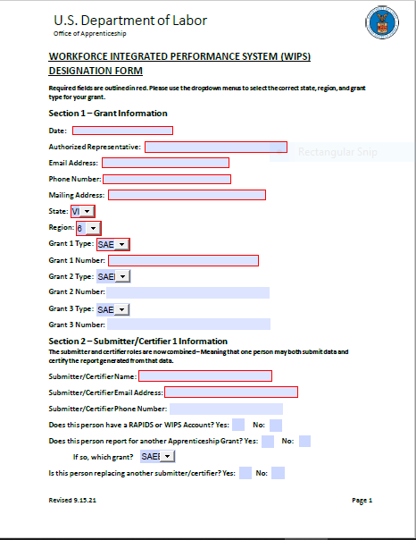
Getting WIPS Access
  Do not submit a Help Desk ticket to get WIPS access
  Office of Apprenticeship can only grant WIPS access if the Authorized Representative (AR) submits a WIPS Designation Form
  The WIPS’ access form can be found here on WorkforceGPS
  Submit the form via email to your grant email inbox; copy your FPO.
Notes:
Grantee may select more than one submitter/certifier for multiple grants
Submitter and certifier are now the same role
Do not submit a Helpdesk ticket – email your AR signed form to the appropriate grant inbox
Two situations where you would need to submit a form
The submitter/certifier needs to set up a WIPS account
The submitter/certifier has a WIPS account but needs a new grant added to their account

Slide 12

Apprenticeship Reporting Resources – PIRL v2021
This resource has been revised and shows edit check and aggregation rule revisions.
Download it from WorkforceGPS
Revisions should be complete by 1/31/2022
Contents include:
  Tab 1: ETA-9172 (Full PIRL)
  Tab 2: Apprenticeship (AP) Schema
  Tab 3: File Format Schema
  Tab 4: Validation Rules
  Tab 5: Duplicate Rules
  Tab 6: Logical Values
  Tab 7: Valid Values
  Tab 8: Adult QPR Template (used by ASE, SAE2020, and SAEEI)
  Tab 9: Adult QPR Aggregation Rules (i.e., Specifications)
  Tab 10: Youth QPR Template (used by YARG Grantees)
  Tab 11: Youth QPR Aggregation Rules (i.e., Specifications)

Slide 13
Overview: Data Collection Requirements
Grantees are required to collect and report on the following:
Participant-level data for all participants who receive grant-funded services.
Training outcomes for all participants.
Performance follow-up and tracking activities during the period of performance.

Slide 14

Tips for Collecting and Tracking Participant Data
These tips will help improve the data collection process between program grantees, employer partners, and education and training providers:
Develop or procure an electronic case management system that can be securely accessed by appropriate staff and program partners to support your data collection and reporting efforts.
Provide training to all partners to ensure consistency in data & understanding of:
  The PIRL
  Definition of key data elements and how they are reported for a participant
  Grant performance outcomes in the SOW

Slide 15
Tips for Collecting and Tracking Participant Data (2)
These tips will help improve the data collection process between program grantees, employer partners, and education and training providers:
The electronic case management system should have the capability to capture information about each participant receiving grant-funded services and track their outcomes.
The electronic case management system should capture the participant's progress throughout the life of the grant.
  Including program begin and end dates, measurable skill gains and credential attainment, and other data elements needed to report outcomes.

Slide 16
Tips for Collecting and Tracking Participant Data (3)
These tips will help improve the data collection process between program grantees, employer partners, and education and training providers:
Ensure relevant partners (both program and training partners) understand why certain information is collected, where it is sent, and for what purpose.
Add disclaimer language and guidance to the program enrollment process/intake forms so participants will understand why certain information is being collected on them.
Develop/revise your participant enrollment/intake forms to align with the data elements.

Slide 17
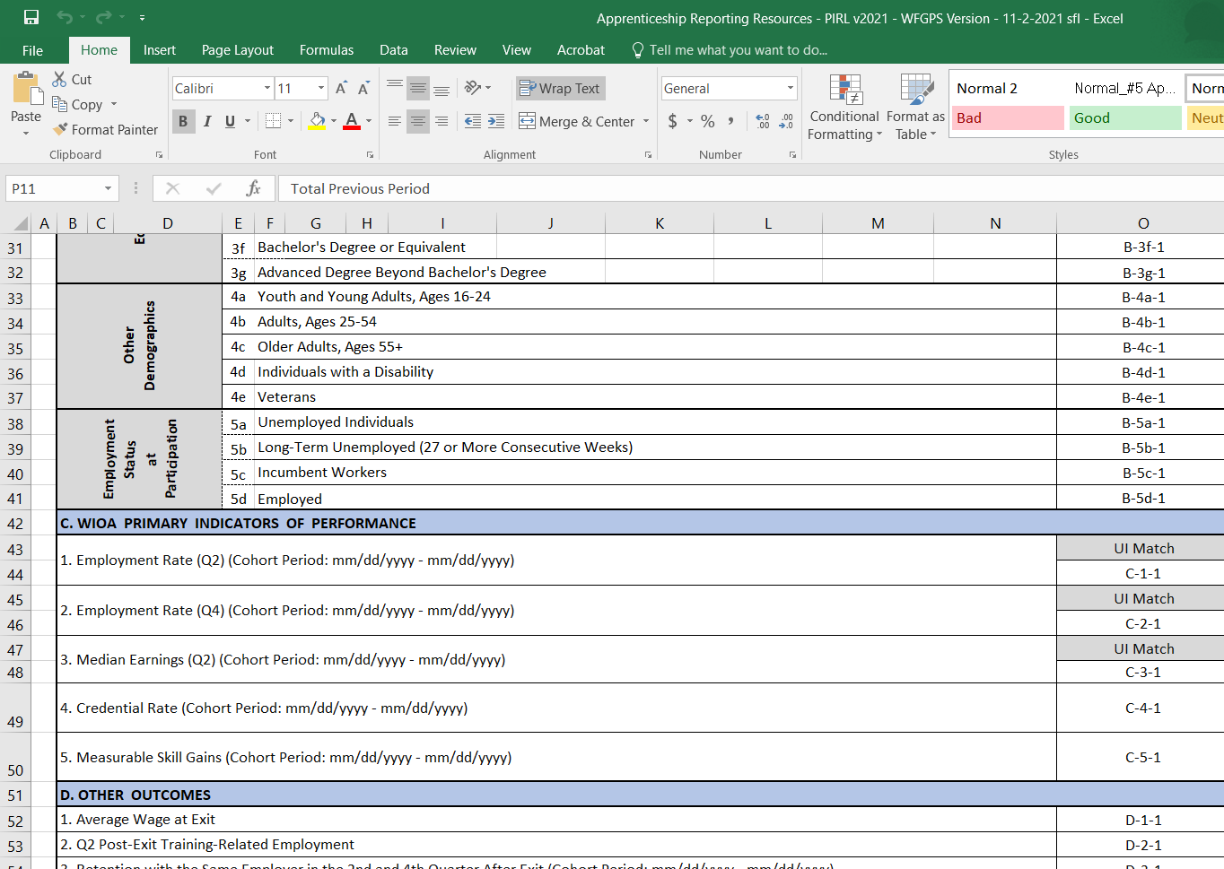
QPR Section C:
WIOA Primary Indicators of Performance
Please note: C1, C2, and C3 will not be populated. DOL will use SS#s to match wages via the State Wage Interchange System (SWIS).
This section will be completed if you enter Measurable Skill Gains and Credential attainment data in the PIRL
Notes:
Mention SWIS and CRIS agreement for wage match

Slide 18



Securing Personally Identifiable Information (PII)
Participant-level data will always need to be stored and transmitted securely.
Grantee staff should ensure that participants are informed of why they are being asked to provide their Social Security Number (SSN).
Transmitting PII via email is prohibited! The WIPS upload environment has protections in place for PII, but email does not.
Notes:
All participant data at every level will need to be stored and transmitted securely – and if being gathered electronically, that process must be sure also.
Grantee staff needs to be sure that participants are informed of WHY their SSNs are being collected, at intake and beyond. ASE grantees have sample language in their interim reporting handbook, and language will also be provided in the reference guide you’ll receive next week.
Remember that transmitting PII via email or fax (if anyone still has a fax machine?) is absolutely prohibited – for more on PII remember TEGL 39-11 provides Guidance on the Handling and Protection of PII – check the resource section of the Resource Guide and the PowerPoint booklet for a link

Slide 19

10 Minutes Be back @

Slide 20
PIRL 2021 Apprenticeship Schema
The revised apprenticeship schema can be found here on WorkforceGPS under tab 2 in the PIRL v2021 Excel file
  The PIRL 2021 Apprenticeship Grants Reporting Resources contains:
  The Full PIRL schema
  The PIRL 2021 Apprenticeship Schema
  A horizontal version of the Apprenticeship Schema
  Two QPR templates – one for adult programs and one for youth programs
Which schema you should use?
  Full PIRL vs SIRS Schema vs Apprenticeship Schema – If you are reporting for more than one ETA grant, you may use the Full PIRL
Notes:
TBD
State grantees can use FULL, SIR, or Apprenticeship Schema
YARG (non state) grantees are encouraged to use the Apprenticeship Schema

Slide 21

Preparing Data Files for WIPS
The data file uploaded for your Apprenticeship grant must have all columns indicated in the most recent Apprenticeship schema.
  Grantees should only have 102 columns in their CSV file
  Schema is short for ‘schematic’, or the combination of PIRL data elements for Apprenticeship
Column headers and extra rows or footers must be removed prior to uploading your data file in WIPS.
WIPS will accept .txt, .csv or .gzip files
  We recommend utilizing the .csv format whenever possible

Slide 22
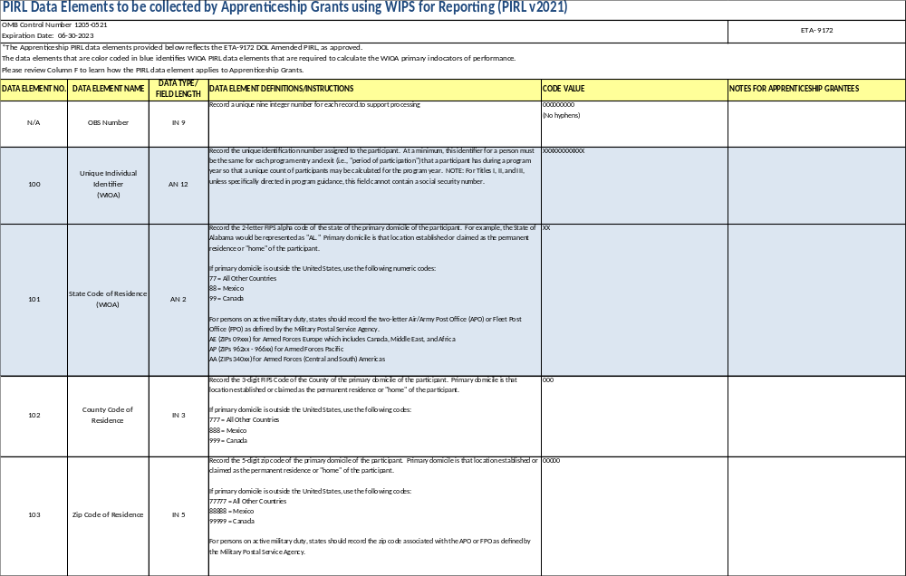
Apprenticeship Schema
The Schema is the format that the data file must be in for upload:
With the PIRL data elements in individual columns, and
Corresponding participant level data in rows
Specific data element definitions and instructions are included in column D of the Apprenticeship Schema.

Slide 23
Apprenticeship Schema
DATA ELEMENT NO. | N/A | 100 | 101 | 102 | 103
DATA ELEMENT NAME | OBS Number | Unique Individual Identifier (WIOA) | State Code of Residence (WIOA) | County Code of Residence | Zip Code of Residence
DATA TYPE/ FIELD LENGTH | IN 9 | AN 12 | AN 2 | IN 3 | IN 5
CODE VALUE | 000000000 (No hyphens) | XXXXXXXXXXXX | XX | 0 | 00000
Each Data Element has
An identifying number
An identifying name
An indicator of data type/size
  IN = integer
  AN = alpha/numeric
  DT = date
Code value
  An example of the data field parameters

Slide 24
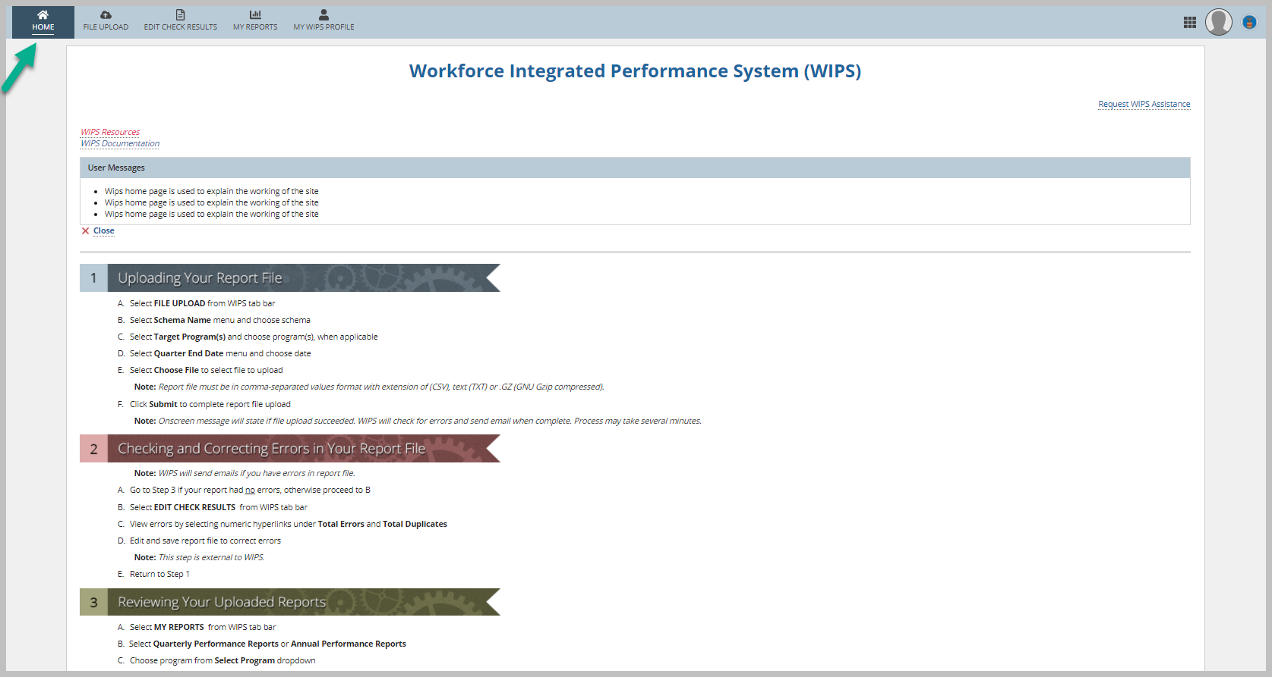
Grantee Login to WIPS
    Logon to WIPS
    Click on the Home Tab

Slide 25
Submitting Data Files in WIPS
If your organization was awarded multiple OA grants, and you use the Apprenticeship Schema, performance data must be submitted as separate data files.
Inactive users will be automatically logged out of WIPS after 30 minutes of inactivity.
To stay active, refresh the page or navigate between the Home, File Upload, and Edit Check Results tabs.
WIOA Reporting Agency grantees may use the full WIOA PIRL, or SIRS Schemas
Certifiers/submitters may have multiple grants assigned to their accounts.
Be aware that accounts will be deactivated after 60 days without a login
All other grantees must submit using the Apprenticeship Schema.
Grantees must choose a schema, request access accordingly and submit data utilizing that same schema for the period of performance

Slide 26
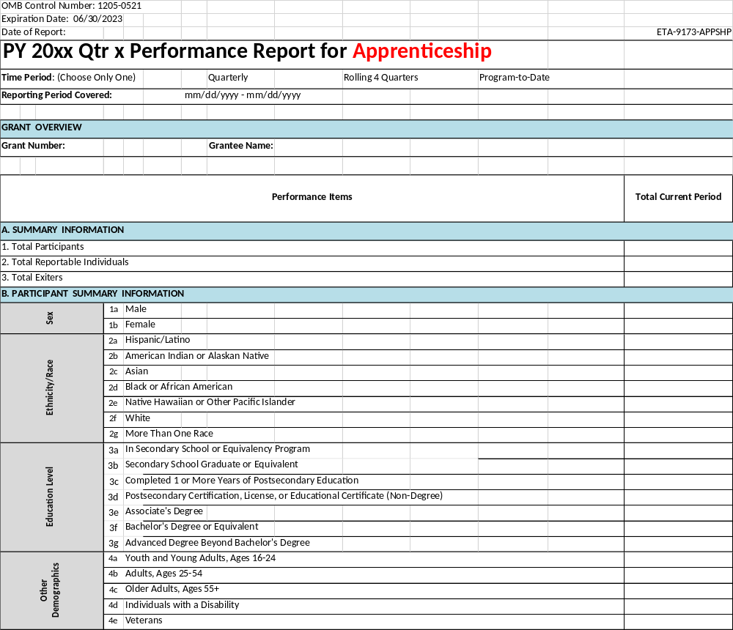
Generating Quarterly Performance Reports (QPRs)
  WIPS has data aggregation rules that generate the performance outcomes reported in the QPR form based on the data file submitted by each grantee.
  Each rule correlates with various data elements and code values, as well as key dates entered for each participant.
  Once your data file passes the validation process, WIPS will generate the QPR.

Slide 27
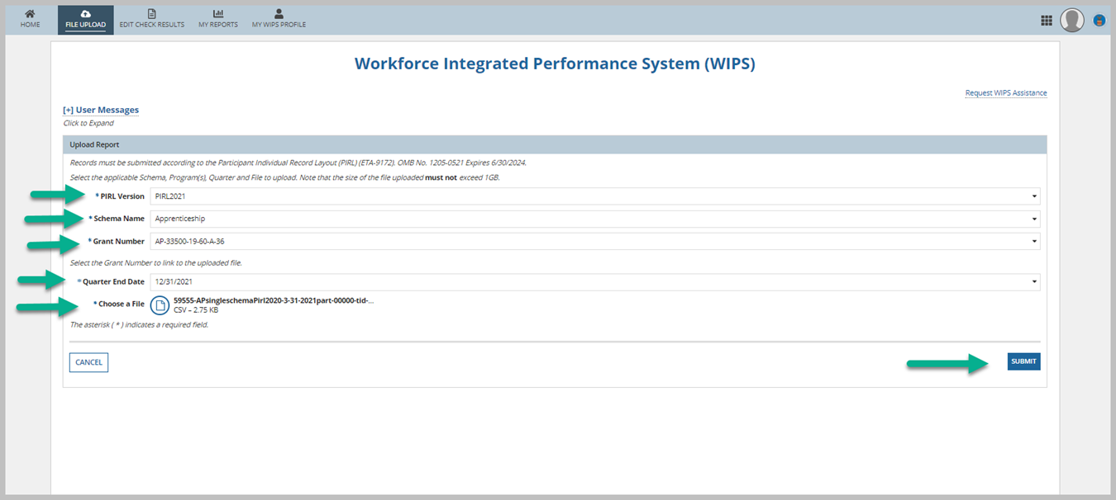
How to Upload your File – YARG Grantees
    Logon to WIPS
    Click on Upload tab
    Select the PIRL version
    Select Schema
    Select grant number from the Grant Number dropdown filter (list only assigned grant number to user)
    Select Quarter End Date for which user wish to submit
    Upload or drag and drop input file.
    Click SUMMIT button.

Slide 28
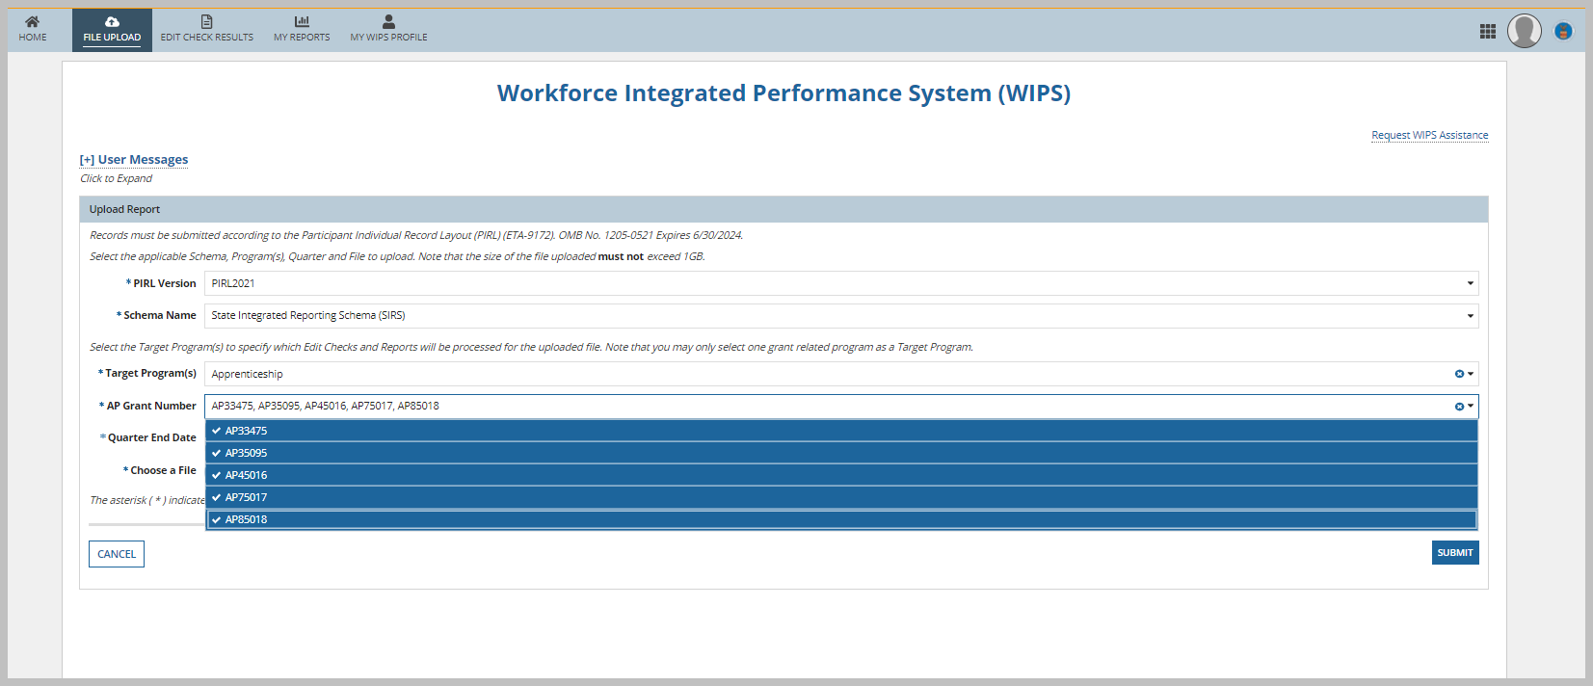
How to Upload your File – State Grantees
    Logon to WIPS Grantee site
    Click on Upload tab
    Select the PIRL version
    Select Schema ( which is usually State Integrated Reporting Schema SIRS )
    Make selection in the Target program(s) filter.
    The AP Grant Number dropdown filter would be populated for all the grant number for the User’s assigned state, all the grant number are selected by default. User can unselect a grant number as needed prior to submission. Note: The AP Grant Number filter list Apprenticeship Adult and Apprenticeship Youth grant number to user’s assigned state
    Select Quarter End Date for which user need to submit.
    Upload or drag and drop input file.
    Click SUMMIT button.

Slide 29
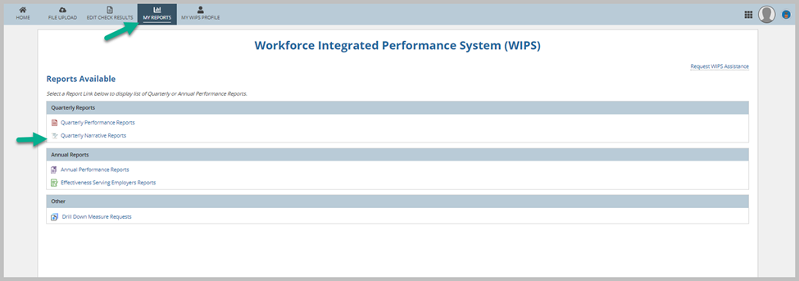
How to Upload your QNR in WIPS
    Logon to WIPS site
    Click on “My Report” tab
    Click on hyperlinked “Quarterly Narrative Reports”. Clicking on link would take user to interface where user can add QNR
    If the QNR is not listed under the “My Reports” section, please submit a ticket to the WIPS’ Help Desk requesting to have it added to your profile.

Slide 30
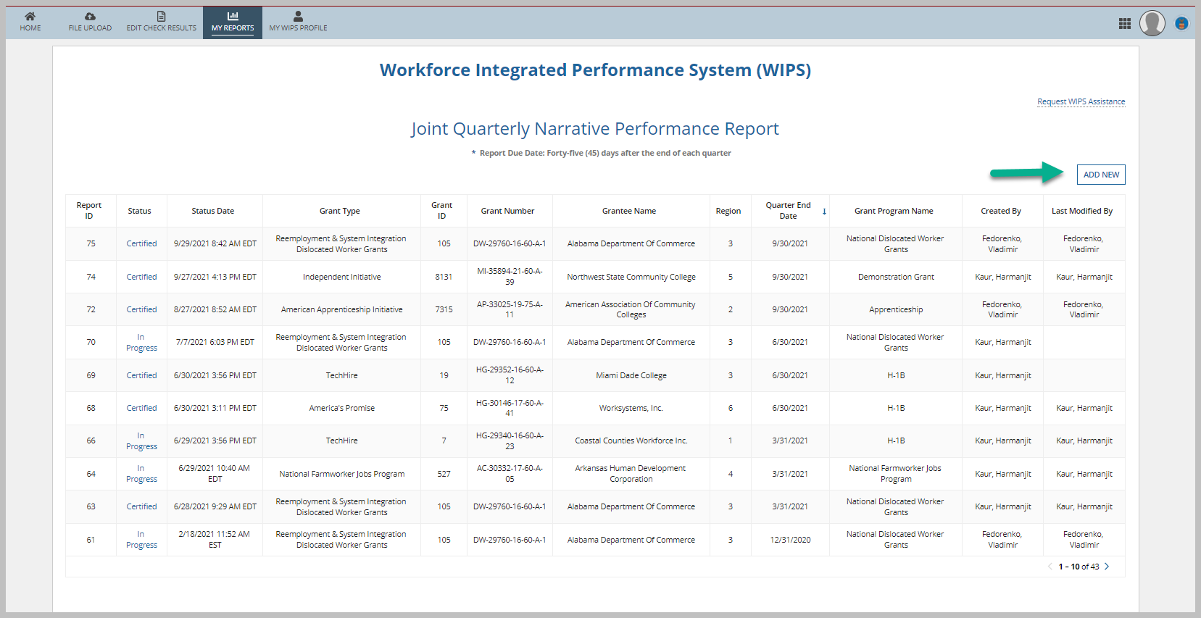
How to Upload your QNR in WIPS (2)
    Click on the “Add New Button”

Slide 31
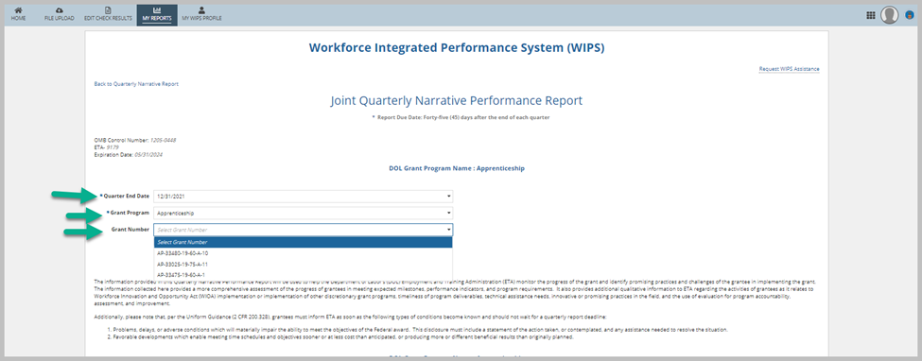
How to Upload your QNR in WIPS (3)
    In the drop-down menus select:
    Quarter End Date
    Grant Program
    Grant Number

Slide 32
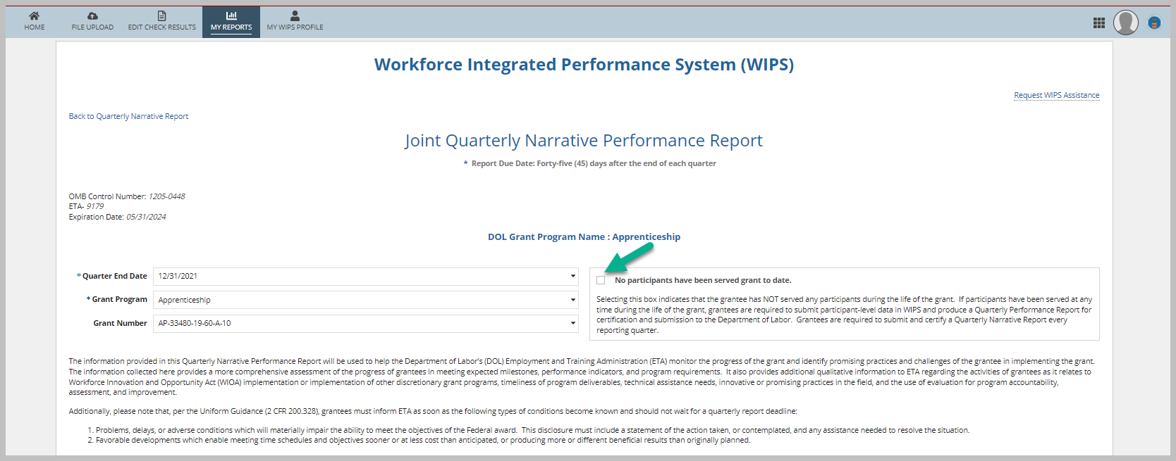
How to Upload your QNR in WIPS (4)
    Grantees who were not able to certify a QPR will see a box indicating that No participant have been served by the grant to date. Please check this box if you do not have any participants.
    Grantees who were able to certify a QPR report and/or have participants, please do not check this box.

Slide 33
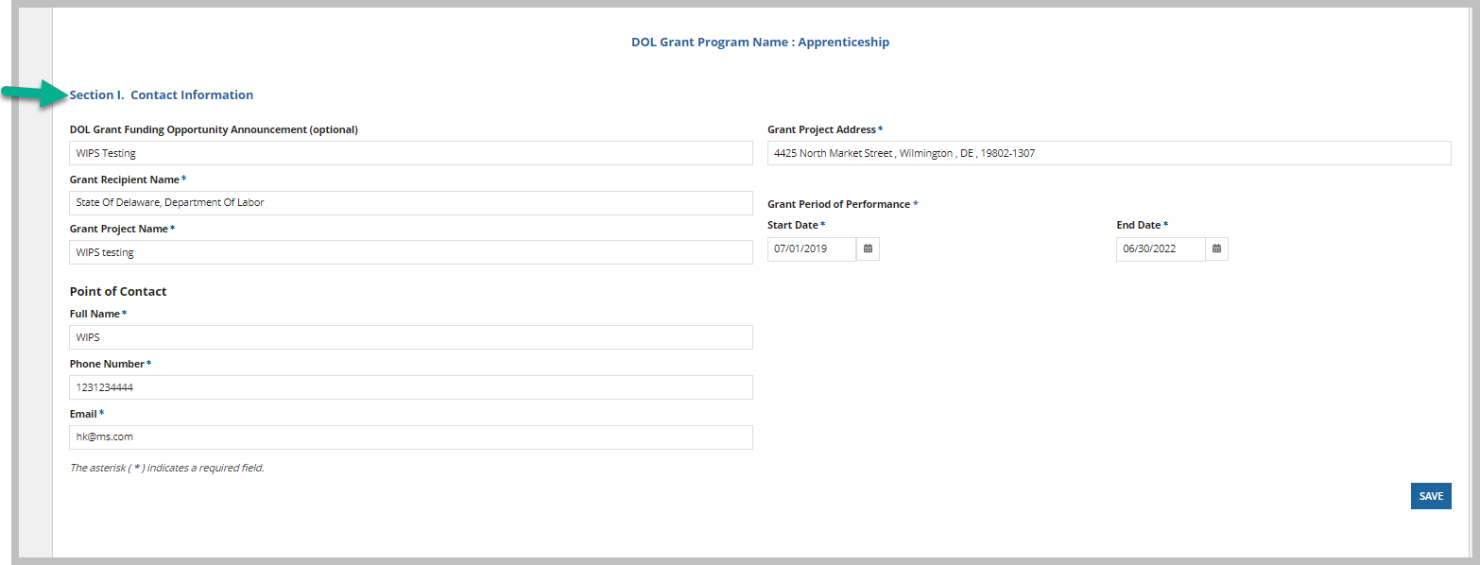
How to Upload your QNR in WIPS (5)
    Enter the information in Section I and click on the save button
    Grantees should enter information in all the sections of the QNR form (as applicable) and click the SAVE button before proceeding to the next page.

Slide 34
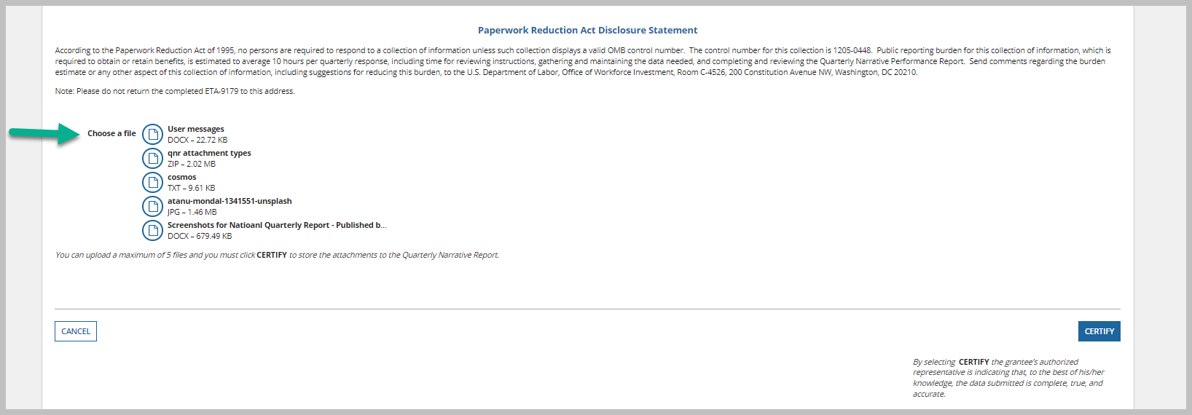
How to Upload your QNR in WIPS (6)
    Grantees can upload supporting documents by clicking on the Upload button or dragging and dropping a file
    Grantees can upload up to 5 files
    Files must be in Word, PDF, TXT, JPG, or ZIP formats.
    If grantees are satisfied with the QNR, they can click on “Certify”.

Slide 35
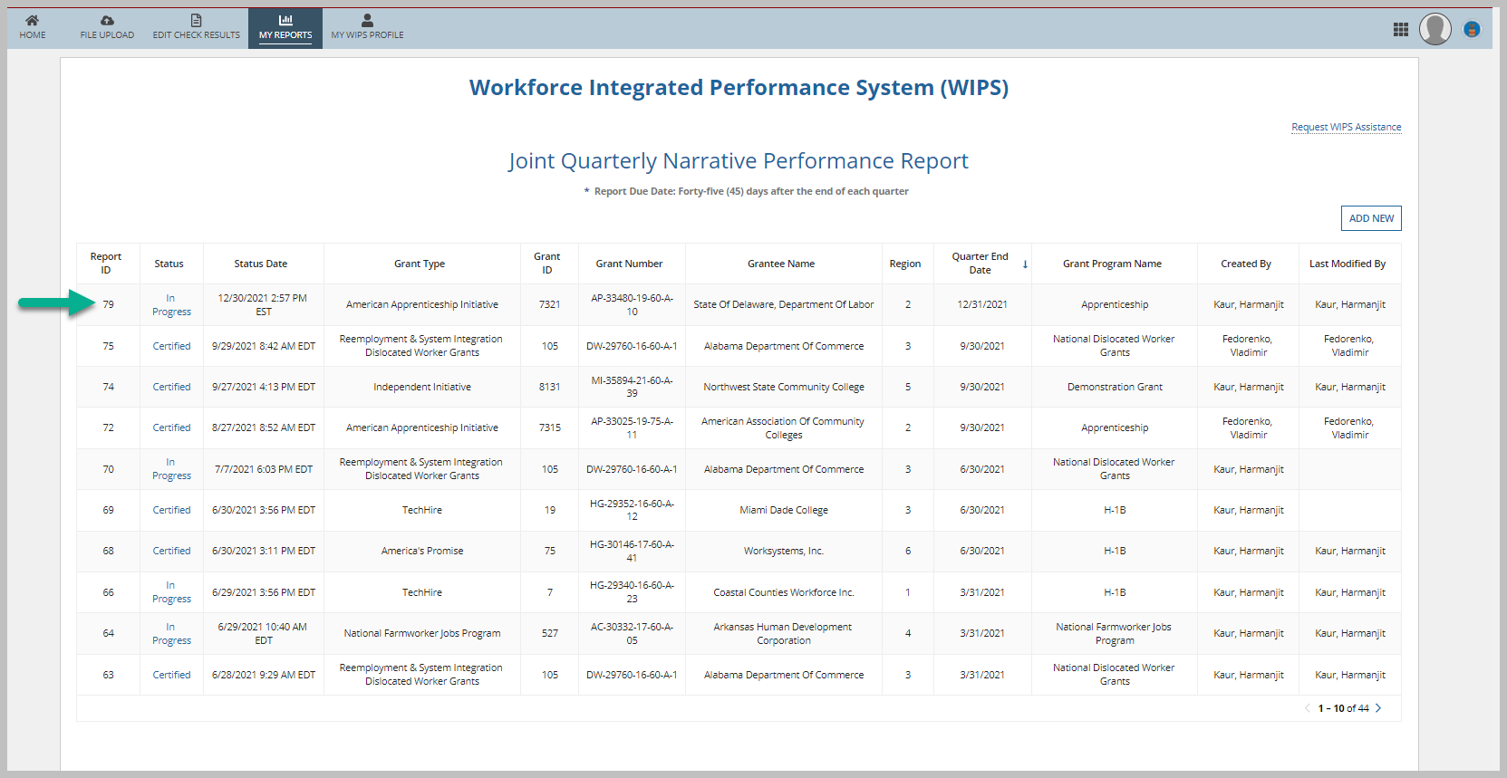
How to Upload your QNR in WIPS (7)
    Once the QNR has been saved but not certified, it will show as “In progress”.
    Grantees can check the status of a QNR by going to My Reports> Quarterly Narrative Reports.

Slide 36
Messages Received When Preparing Data Files for WIPS
Invalid Column Error #
Format error message that includes lines not associated with a participant ID
Valid Values or Logic Rule error
This error occurs for values that are known to be impossible, either because they are invalid options or are illogical based on the values in other fields (see logic rules)
A format error that occurs when the data file column number doesn’t match the current schema.
You may have mistakenly input values in rows that are not a part of your data file, i.e., letters instead of numbers, a decimal where none is expected, a ‘special character’

Slide 37

Data Validation
WIPS validates uploaded files for three types of edit checks.
VALID VALUES
To verify data for format, length, and a valid value (specific value required from options provided) – data relationship to itself. Errors show in Total Errors and Format Error.
DUPLICATE RULES
To ensure there are no multiple records on the same individual. Errors show in Total Duplicates.
LOGICAL RULES
To confirm data is accurately entered, including required fields – data relationship to other data. Errors show in Total Errors.
37
Notes:
Tiered order –
Formatting -
Value errors that the validation process stops
Formatting

Slide 38
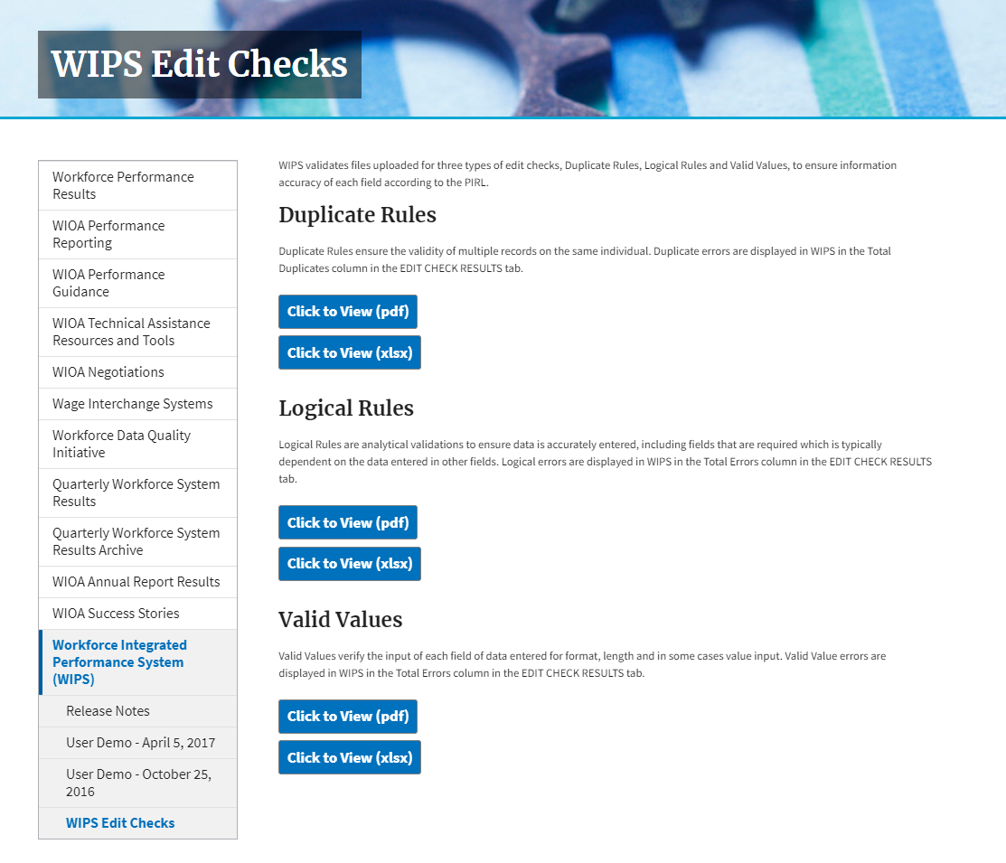
Edit Checks
Located on the WIPS page at the link
  As with the schema page - check this site at least monthly to see if updates affect your system to avoid reporting issues at the end of the quarter.
Click the ‘blue buttons to download either an excel file, or a .pdf
https://www.dol.gov/agencies/eta/performance/wips/editchecks
38
Notes:
If you are a WIPS user, you should also be receiving the WIPS newsletter. The newsletter provides an update on major changes to the system including edit checks.

Slide 39
Edit Check: Valid Values
Valid Values
  Are also logical in their way
  Apply to EVERY data element in the PIRL, regardless of program
  Has to do with the relationship of the data entry to the data element definitions and data
  Make sure that data is in the correct format as indicated in the data type/field length and code value cells of the data element
  Updated published Valid Values are always found on the WIPS site
Element Number | Element Name | Edit Check Description | Date Implemented
0 | OBS Number | This element must only contain numeric characters. This element must contain exactly 9 characters. | 1/13/2017
100 | Unique Individual Identifier (WIOA) | This element may contain both letters and numeric characters. This element must contain exactly 12 characters. | 3/16/2018
101 | State Code of Residence (WIOA) | This element may contain both letters and numeric characters. This element must contain exactly 2 characters. | 1/13/2017
102 | County Code of Residence | This element must only contain numeric characters. This element must contain exactly 3 characters. | 1/13/2017
103 | Zip Code of Residence | This element must only contain numeric characters. This element must contain exactly 5 characters. | 1/13/2017
104 | Economic/Labor Market Area and Physical Location Code | This element must only contain numeric characters. This element must contain no more than 9 characters. | 1/13/2017
105 | Special Project ID - 1 | This element may contain both letters and numeric characters. This element must contain exactly 7 characters. | 1/13/2017
39
Notes:
TBD

Slide 40
Edit Check: Valid Values
Most Common Valid Value Errors
  Dates
    Must be in the format
      YYYYMMDD
    This is the standard language which applies to MOST dates, however, does not apply to PIRL 2909 and 2903 which are expected completion dates for apprentices and pre-apprentices, respectively
  Alpha/Numeric mix-up = typos
  Extra space which counts as a code value*
    Hard to find because you can’t always see them depending on location
PIRL 200 Date of Birth (WIOA)
The date can be invalid for any of the 4 reasons:
This element must only contain numeric characters. This element must contain exactly 8 numeric characters. This element must be a date formatted as YYYYMMDD.
All date values must be <= the upload date*.
All date values must have a year >= 1900.
All date values in a record must be >= PIRL200 (Date of Birth).
40

Slide 41
Edit Check: Duplicate Rules
Ensures that an individual is only reported ONCE for a program
Below are all the Duplicate rules that currently apply to AP grants
Rule Number | Detection Logic | Error Message
1 | If multiple records have the same individual identifier (PIRL 100), then no record can have the same Covered Person Entry Date (PIRL 306). | No period of participation can begin/occur within 90 days of any other period of participation for the same unique identifier.
2 | Where the 'Date of Program Entry (WIOA)' is not null: If multiple rows have the same 'Unique Individual Identifier (WIOA)', then no record can have a 'Date of Program Entry (WIOA)' or 'Date of Program Exit (WIOA)' between the 'Date of Program Entry (WIOA)' and the 'Date of Program Exit (WIOA)' plus 90 days (inclusive) of any other record with the same Individual Identifier. | No period of participation can begin/occur within 90 days of any other period of participation for the same unique identifier.
3 | Where the Date of Program Entry (PIRL 900) is not null: If multiple records have the same Individual Identifier, then only the record with the most recent Date of Program Entry can have a blank Date of Exit (PIRL 901). | No period of participation can begin/occur within 90 days of any other period of participation for the same unique identifier.
4 | Where the Date of Program Entry (PIRL 900) is null: If multiple records have the same Individual Identifier (PIRL 100), then no record can have the same Date of First Basic Career Service (Self-Service) (PIRL 1000). | No period of participation can begin/occur within 90 days of any other period of participation for the same unique identifier.
10 | Multiple records with the same Unique Individual Identifier (WIOA) and non-null Date of Program Entry (PIRL 900) may not have blank Date of Program Exit (PIRL 901). | Multiple records with the same Unique Individual Identifier (WIOA) and non-null Date of Program Entry (WIOA) (PIRL 900) may not have blank Date of Program Exit (WIOA) (PIRL 901).
41

Slide 42
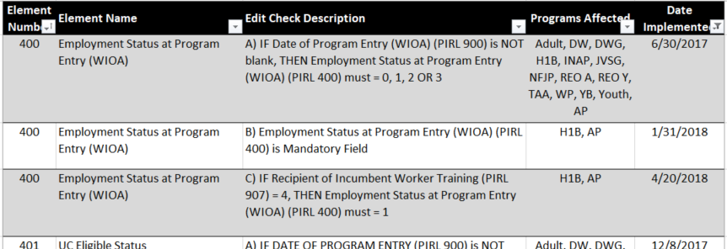
Edit Check: Logical Rules
Logic Rules
  DO NOT apply to EVERY data element in the PIRL
    You may see gaps on the rule list
  A data element in the PIRL may have MULTIPLE Logic Rules, depending on the programs utilizing any particular data element
  Has to do with the relationship between different data elements
  Updated published Logical Rules are always found on the WIPS site
  Look for an AP under Programs affected column to find rules that apply to your Apprenticeship grant
42

Slide 43
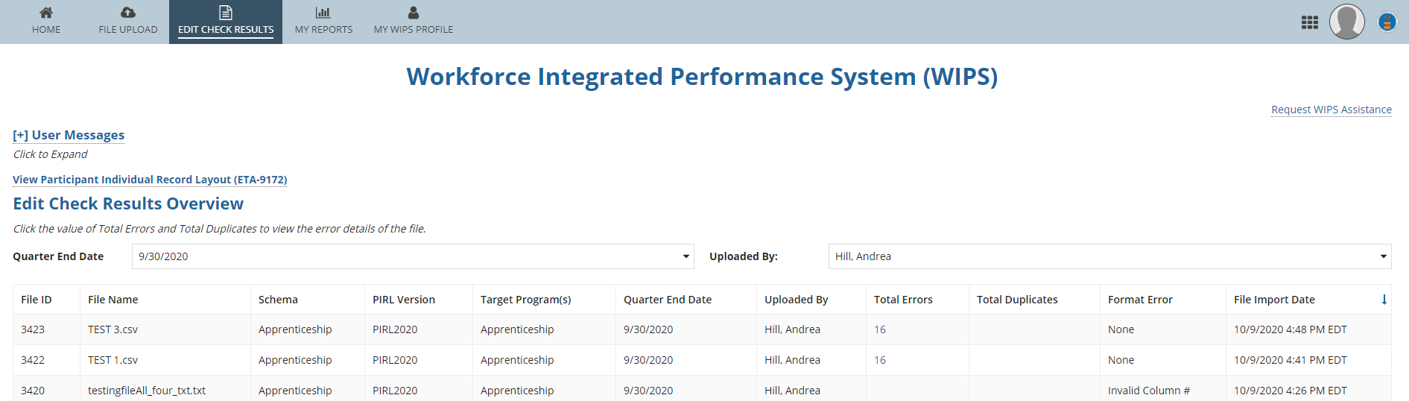
Edit Check Results
Select the EDIT CHECK RESULTS tab to display the Edit Check Results Overview screen.
A file with blank fields has not finished processing.
Check the file you uploaded for errors. A Quarterly Report cannot be generated for a file with errors.
43
Notes:
Notes:
From the menu bar on the homepage you click on edit check results to get to the edit check overview screen where you’ll see a list of the errors that WIPS encountered during processing the uploaded file.
If a file listing sill has blank fields across, it hasn’t finished processing – you’ll get an email when processing has finished which can sometimes take up to 30 minutes, or even beyond depending on file size, bandwidth usage and data quality.
If there are unresolved errors in a data file, a QPR cannot be generated

Slide 44
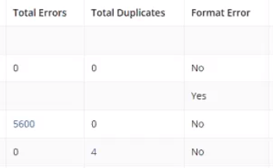

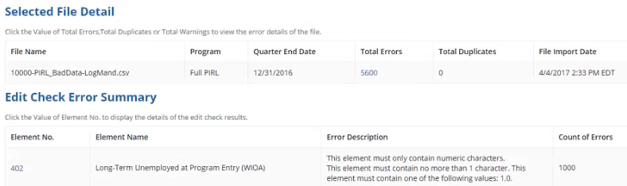

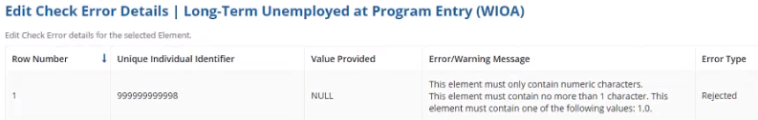

Edit Check Results
WIPS has built-in diagnostics to help you correct errors in your file.
Click the number of errors to view a list of errors and their descriptions.
Click the Element No. value to show the row number that contains the error.
Review the error location and description.
44

Slide 45
Known WIPS Reporting Issues
QPR Results are not aggregating correctly:
        Total Participants
        Reportable Individuals
        Incumbent Workers
        Youth (ages 19 – 24)
        Total Participants who received a degree/credential
Error messages for PIRL 101, 102, 103
        PIRL 101, 102, 103 - Use the appropriate code for state, county, and zip

Slide 46
Tips and Best Practices:
Advice from Reporting Staff

Slide 48

Question
Can the Office of Apprenticeship provide individual training on reporting, WIPS, PIRL, etc.?
Notes:
Answer: The Office of Apprenticeship is not able to provide individual training for performance and reporting staff; however, the many technical assistance resources (e.g., webinars, presentations, TA Aids, e-Learning modules, newsletters, etc.) are available on WorkforceGPS.org and DOL.ETA/Performance are available.

Slide 49
Question
PIRL 900 (Date of Program Entry) – What date should I use?
Notes:
Answer: Date the participant enrolled in a RAP (e.g., RAPIDS start date) (also corresponds with PIRL 2908: Date Started Apprenticeship)

Slide 50
Question
My understanding is that each quarter we are only supposed to report info for the new apprentices that were served that quarter. Can you please clarify when and how we are supposed to report the updated info on those served in previous quarters such as the credential attainment, measurable skills gains, pre-apprentice completion and placed into a RAP, etc.
Notes:
Answer: Grantees should upload data for ALL active pre-apprentices and registered apprentices each quarter, until the participant exists the program.

Slide 51
Question
Do the performance outcomes get included in the state’s WIOA performance data? If so, how should that work and does it also count towards the negotiated performance?
Notes:
Answer: Negotiated performance targets do not apply to Apprenticeship Grants (i.e., ASE, SAE20, SAEEI, and YARG). Negotiated performance targets apply to WIOA Title I (i.e., Adult, Dislocated Worker, and Youth Programs) and Title III Wagner-Peyser Employment Services.

Slide 52
Question
By what authority are we supposed to submit data to ETA/Office of Apprenticeship?
Notes:
Answer: Each grant’s funding vehicle (i.e., Training Employment Guidance Letter (TEGL) and Funding Opportunity Announcement FOA) contains information related to requirements for reporting data to the Agency for performance and evaluation purposes.

Slide 53
Question
Is there a list of data elements that apply to pre-apprentices and to registered apprentices?
Notes:
Answer: The Office of Apprenticeship has not currently categorized PIRL data element by pre-apprentice and registered apprentice categories, but plans to do so within the next few weeks. There appears to be a need for such categorization in order to facilitate data collection and reporting.

Slide 54
Question
In the description/instructions for some data elements, “program-specific” guidance is mentioned. Where do we find this guidance?
Notes:
Answer: Most ETA program report using the PIRL data layout. In the description/instruction section of many PIRL data element, a reference is made to “program-specific” guidance. This reference applies to any programmatic-specific policies issued by each program office (e.g., WIOA Youth, Adult, Dislocated Worker, Trade Adjustment Act, National Farmworker Jobs Program, Job Corp, etc.).

Slide 55
Question
For PIRL 2913 (Type of Supportive Services Received) – Do we report supportive services received during both the pre-apprenticeship or just the RAP?
Notes:
Answer: Since supportive services are grant-funded services, this data element is collected for registered apprentices, however; in the future, Office of Apprenticeship will consider each PIRL data element collected for Apprenticeship Grants as they apply to both pre-apprentices and registered apprentices.

Slide 56
Coding Question
If a grantee needs to select more than one code value for PIRL 2913, how should their file upload be coded? For example, if they need to select transportation, uniforms, and childcare for one participant, how would their upload be coded?
1,3,4
134
1+3+4
Data Element Number | Data Element Name | Data Type/Field Length | Data Element Definitions/Instructions | Code Value
2913 | Type of Supportive Service Received | IN 3 | Record up to 3 types of supportive services: Record 1 if the supportive service received by the participant, is Transportation. Record 2 if the supportive service is Tools and/or Equipment. Record 3 if the supportive service is Uniforms. Record 4 if the supportive service is Child Care. Record 5 if the supportive service is something other than that previously listed. Leave blank if this data element does not apply. | 1 = Transportation 2 = Tools/Equipment 3 = Uniforms 4 = Child Care 5 = Other
Notes:
Answer: B…Data formatting when more than one code value is needed should include no spaces or extra characters.

