Slide 1
Tools for Expanding Apprenticeship
February 23, 2018
Developed by Industry and Equity Intermediaries

Slide 2
Amy Young
Senior Program Manager
Maher & Maher

Slide 3
Learn about new tools and resources that will help your efforts to grow apprenticeship:
New outreach and recruitment materials
Information on developing an effective apprenticeship program
Guidance on using social media to grow apprenticeship programs
Tool to help screen potential apprentice candidates

Slide 4
What type of organization do you represent?
National Industry and Equity Partners
Apprenticeship Grantee – American Apprenticeship Initiative grant
Apprenticeship Grantee – State Apprenticeship Expansion grant
US Department of Labor/Office of Apprenticeship
State Apprenticeship Agency
Other

Slide 5
Cierra Mitchell
Team Lead, U.S. Department of Labor, Employment and Training Administration, Office of Apprenticeship
Barbara Murray
Executive Director & SME, TransPORTs/Louisiana Technical College System
Art Lujan
Special Assistant to the President, North America’s Building Trades Unions
Brad Bentley
President, FASTPORT
Jennifer Carlson
Executive Director, Washington Technology Industry Association
Maurita Coley
Interim President and CEO, Multicultural Media, Telecom and Internet Council, partnered with National Urban League

Slide 6
National Industry and Equity Partners
National Industry Partners
National Restaurant Association Educational Foundation
AFL-CIO Working for America Institute
H-CAP, Inc.
Jobs For The Future, Inc.
FASTPORT, Inc.
TransPORTs/Louisiana Technical College System
North America’s Building Trades Unions
Washington Technology Industry Association
National Equity Partners
Chicago Women in Trades
National Urban League

Slide 7
Communication
OA
Industry-Equity Partners
SAAs
Communication and collaboration
is critical for success!
AAI Grantees
SAE
Grantees

Slide 8
Step-by Step Guide to Designing and Launching a Successful Apprenticeship Program
TransPORTs
Presenter: Barbara R. Murray
Executive Director & SME

Slide 9
Why We Created an Interactive Apprenticeship Program Development Workbook
Explaining apprenticeship and steps to developing a program with TransPORTs is lengthy
Potential sponsors wanted material they could take back to explain process to internal stakeholders
We needed a work outline guiding partnership, next steps
We wanted to demonstrate how program design work feeds into existing DOL materials (i.e. Work Process Schedules, Form 671)

Slide 10
Workbook for Designing Successful Apprenticeship Programs
Provided online (www.transportsapprenticeship.com) and after initial introduction and assessment meeting
Walks potential sponsors through step-by-step process to program design and development
Includes key questions to guide potential sponsor through internal work process
Working on parallel workbook for community college and intermediary sponsors

Slide 11
Unpacking Documents, Providing Tools
Explains DOL forms, processes
Provides sample applications, marketing material, certificate of completion request form, FAQs

Slide 12
Diversity Toolkit Your Guide to Best Practices for Recruiting a More Diverse Membership
North America’s Building Trades Unions
Presenter: Art Lujan
Special Assistant to the President

Slide 13
INDEX
Elements for Recruiting and Retaining Diverse Apprentices
Oregon Tradeswomen Inc
Planning Guide for Retaining Women in Industry
Oregon Tradeswomen Inc
Apprenticeship: What Works for Women
Chicago Women in the Trades
Apprenticeship: What Works for Women—National Center for Women’s Equity
Chicago Women in the Trades
Model Integrating Supply and Demand
Policy Group on Tradeswomen’s Issues
Women’s Equity in Apprenticeship and Employment Contact List
Department of Labor
Strategy for Engaging Underrepresented Populations
National Governor’s Association
Helmets to Hardhats Overview
Helmets to Hardhats

Slide 14
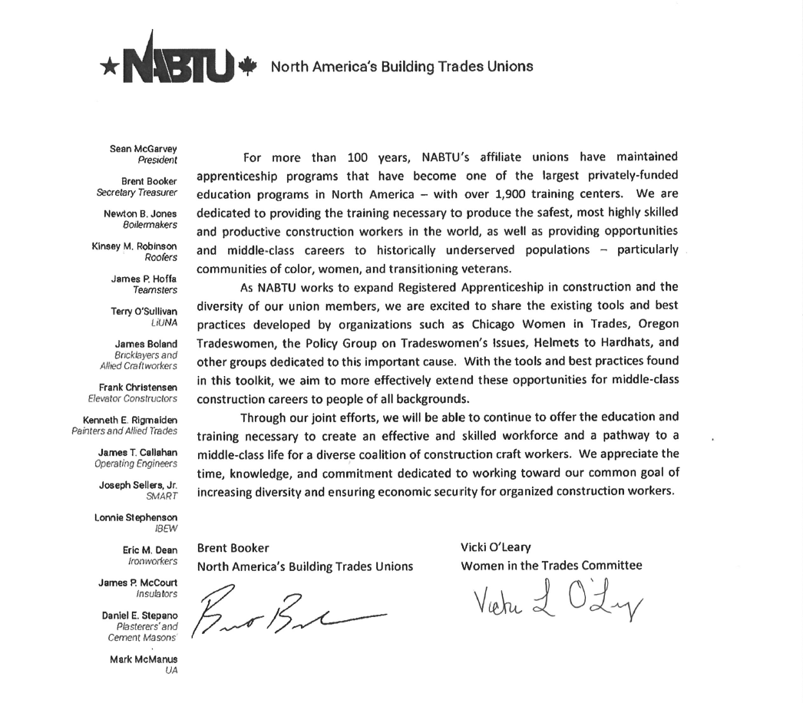

Slide 15
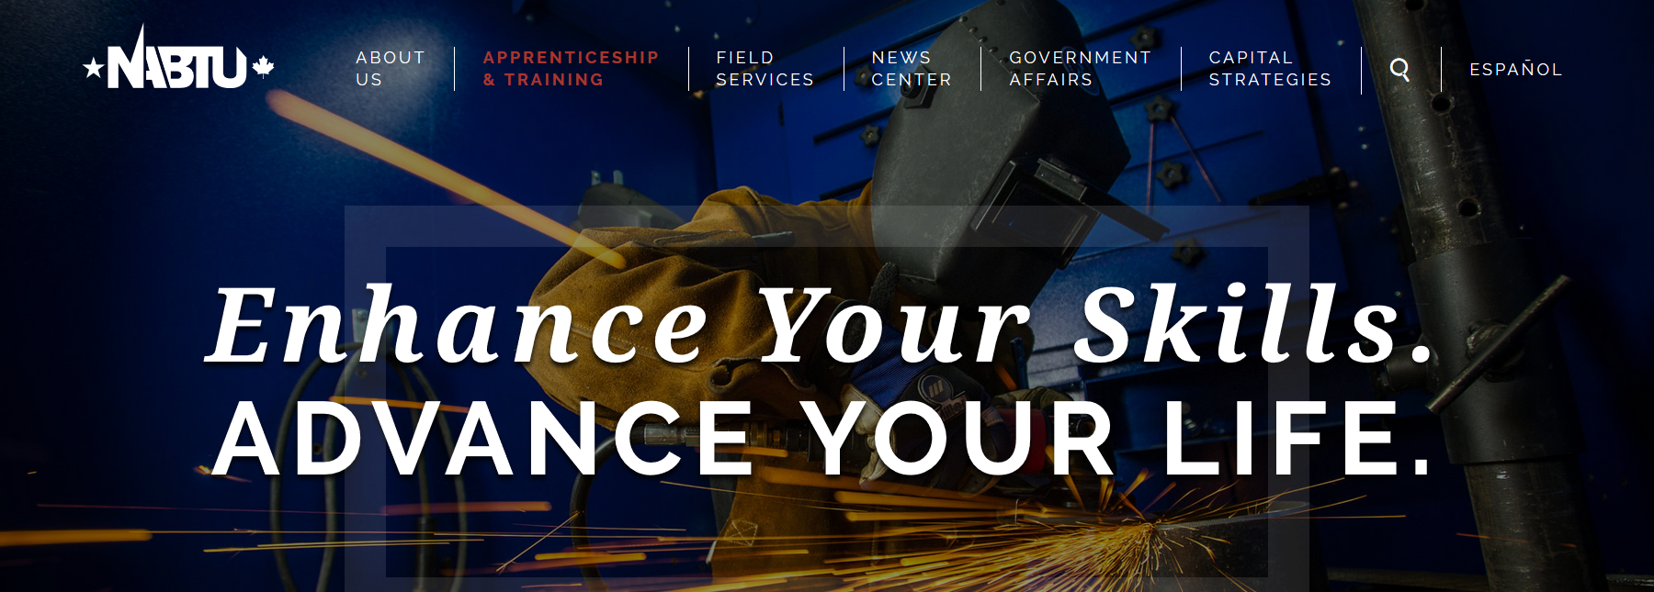
www.nabtu.org/apprenticeship-and-training/
www.nabtu.org

Slide 16
IMAGINE Video
FASTPORT
Presenter: Brad Bentley
President

Slide 17
IMAGINE Video

Slide 18
IMAGINE Video

Slide 19
Apprenti Tech Assessment
Washington Technology Industry Association
Presenter: Jennifer Carlson
Executive Director

Slide 20
About Apprenti Tech Assessment
Notes:
Because apprenticeship is a job, we only train those who have been selected by the employer. Thus, industry and funders like government want to ensure we are making strategic investment in those with highest likelihood of success and completion and ultimately retention. This tech assessment was informed by industry and a committee of people representing our target groups, women, minorities and veterans.
Base aptitude shows combination of skills and ability to learn, adapt, problem solve, work with diverse groups, etc.
The old adage, no one appreciates or values something for free, this may be free, but there is a significant time investment on the part of the participant.

Slide 21
About Apprenti Tech Assessment
Determines aptitude and competency for tech careers
Development funded by JP Morgan Chase & Accenture
3 Sections:
Math – 61questions
Logic & Critical Thinking – 41 questions
Soft Skills – 14 questions + Interviews
2-3 hour investment; prep materials available after registration
Must complete entire assessment within 10 days once a section is begun; can take by section
Can take 3 times, 3 months waiting period after second test attempt
Notes:
Because apprenticeship is a job, we only train those who have been selected by the employer. Thus, industry and funders like government want to ensure we are making strategic investment in those with highest likelihood of success and completion and ultimately retention. This tech assessment was informed by industry and a committee of people representing our target groups, women, minorities and veterans.
Base aptitude shows combination of skills and ability to learn, adapt, problem solve, work with diverse groups, etc.
The old adage, no one appreciates or values something for free, this may be free, but there is a significant time investment on the part of the participant.

Slide 22
Assessment Prep
Notes:
Math section, sample question, prep resources
Shows score, past scores,
Red, yellow, green rating in each test area
Math: through algebra, a couple of geometry questions

Slide 23
Assessment Results
Notes:
Overall minimum score for consideration is decided by the market and needs of employers locally, but is set for the market as a whole.
Candidate receives email after take test with
Total Score
Approx Rank
Red/yellow/green for each test area
Info about ranking and whether they should re-take. Notification if bumped from ranked pool.
When out of test attempts or perform poorly, refer to partners

Slide 24
Storytelling through Social Media, Podcasts, and Storify
National Urban League (NUL)
Presenter: Maurita Coley
Interim President and CEO
Multicultural Media, Telecom and Internet Council, a partner of National Urban League

Slide 25
NUL WIAAI Uses Social Media
To achieve the following:
Generate Exposure by promoting the mission, work, efforts, resources, and goals of WIAAI and diversifying Registered Apprenticeship Programs.
Advocate for Diversity Programs that promote and preserve equal opportunity, diversity, and inclusion in the Registered Apprenticeship domain.
Expand and Strengthen Relationships with
Underrepresented communities
Conference and policy event attendees, speakers, and intermediaries
Community and industry partners
Federal and state agencies
Mainstream media and other press
Social media influencers

Slide 26
Storytelling Objectives
Promote and Expand RA Programs – The “storytelling” tools the Consortium develops, uses, and deploys are at the core of its role of promoting, expanding, and diversifying RA Programs.
Spread the Word – Trainings, panels, and conferences only speak to target audience that is “present” at the moment. We keep the knowledge alive and disseminate it after the event is over through storytelling.
Social Media Toolkit – This Toolkit, created by MMTC for the NUL WIAAI Consortium to spread awareness, implements:
Website, conference, podcast, and webinar links
Social Media Accounts – Facebook, Instagram, Twitter, and LinkedIn
Social Media Ambassadors, targeted hashtags, and graphics prior to the events
E-blasts, podcasts, and posts on social media prior to each event
Content creation during each event through MMTC, attendees, and Ambassadors
Storify Blogs after the completion of each event

Slide 27
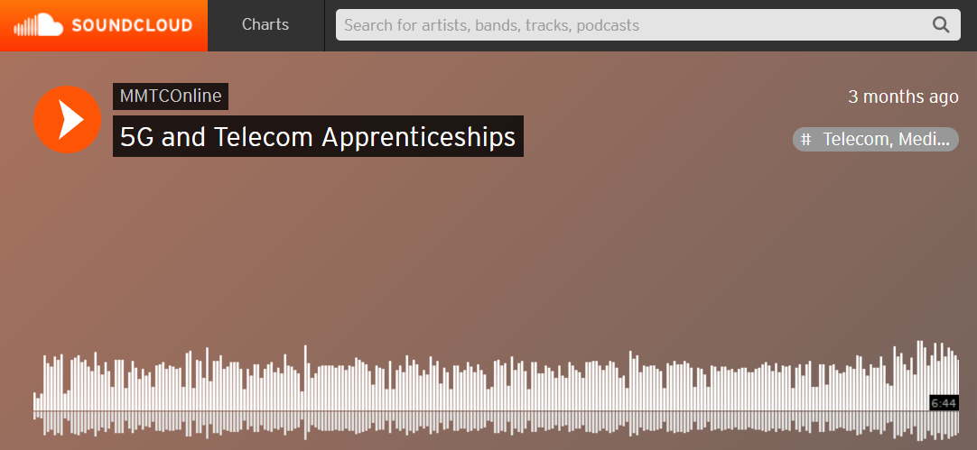
Podcasts: (Soundcloud and TalkShoe)
Soundcloud: An online audio distribution platform, to record and stream in-person podcast interviews
Cost: Free (up to 30 hours of podcasts)
Simple, for in-house podcast creation
On-the-go tool: Can be operated through any smartphone
Can upload your own podcast
Limitation: Physical presence with discussants is required
Example: WIAAI member discusses 5G and Telecom Apprenticeships
https://m.soundcloud.com/mmtconline/episodetwo
TalkShoe:
For discussions with people who are remote
Discussants can call in from phone or Skype
Can schedule in advance
Cost: Free
Multiple discussants can conference call and record at once
Example: http://www.talkshoe.com/tc/145734

Slide 28
Storify:
Storify: A social networking service that lets users create stories or timelines using social media
Turns what users post on social media into compelling stories
Allows users to search on Storify based on Twitter handles, hashtags or keywords
Simple click-and-drag approach to easily create stories
Users can implement descriptions, links, and videos, as well as connect to Facebook and Instagram
Alternative: Wakelet.com
Allows users to create collections of content from all over the Web, share them online, and embed them into blogs or websites.
Examples
MMTC’s Storify page: https://storify.com/mmtconline
Storify post on Apprenticeship panel: https://storify.com/mmtconline/the-key-to-bridging-the-wealth-and-skills-gaps-thr

Slide 29
Apprenticeship Community of Practice
www.apprenticeshipusa.workforcegps.org

Slide 31
Today’s Resources
Partner | Resource | Link
NABTU | Diversity Toolkit | https://nabtu.org/wp-content/uploads/2017/06/Diversity-Toolkit-draft-6-15-17.pdf
NABTU | Apprenticeship Webpage | https://nabtu.org/apprenticeship-and-training/
TransPORTs | Step-by-Step Guide to Designing and Launching a Successful Apprenticeship Program | https://apprenticeshipusa.workforcegps.org/resources/2017/08/02/12/10/ApprenticeshipUSA-Transportation-Logistics-Distribution
FASTPORT | IMAGINE video | https://www.youtube.com/watch?v=_gsMfYXq-Mw&t=5s)
WTIA | Apprenti portal and screening tool | https://portal.apprenticareers.org/
NUL | Podcast | https://m.soundcloud.com/mmtconline/episodetwo
NUL | Storify | https://storify.com/mmtconline

Slide 32
Amy Young
Senior Program Manager, Maher & Maher
ayoung@mahernet.com
202.361.8240
Cierra Mitchell
Team Lead, U.S. Department of Labor, Employment and Training Administration, Office of Apprenticeship
mitchell.cierra@dol.gov
202.693.3779
Barbara Murray
Executive Director & SME, TransPORTs
Barbara.murray@transportsapprenticeship.com
757.401.8259
Art Lujan
Special Assistant to the President, NABTU
alujan@buildingtrades.org
202.756.4692
Brad Bentley
President, FASTPORT
brad.bentley@fastport.com
256.454.5049
Jennifer Carlson
Executive Director, WTIA
jcarlson@washingtontechnology.org
678.361.0829
Maurita Coley
Interim President and CEO, MMTC
mcoley@mmtconline.org
202.332.0500
Ronald G. Marlow
Vice President, Workforce Development,
NUL
Rmarlow@nul.org
212.558.5481

